Slide 1

Expungements, Dispositions, & More
Tennessee bureau of investigation

Slide 2
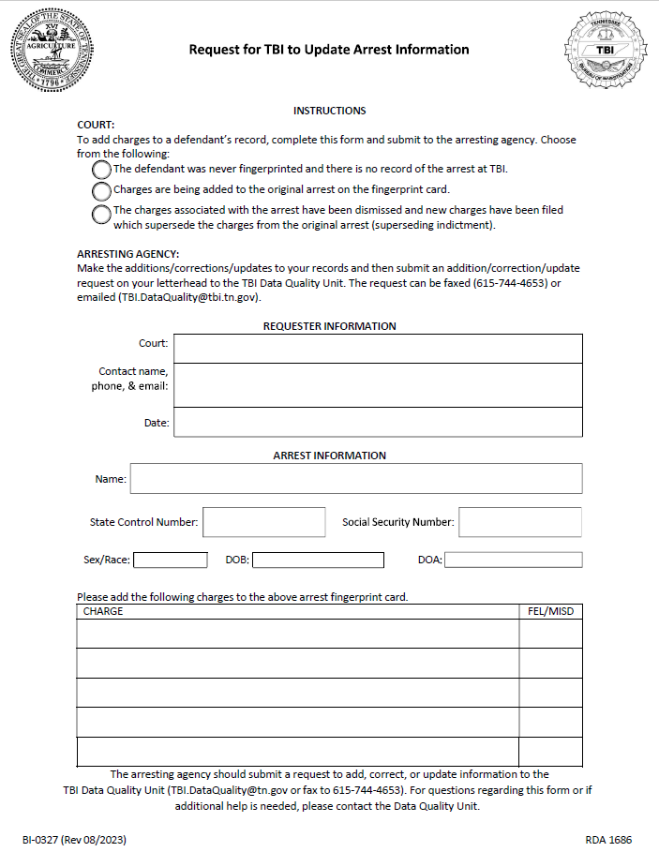
Form to Update Arrest Information
When should the form be used?
Why is this form important?
Why do you need to send the form to the arresting agency instead of TBI?
If the defendant isn’t fingerprinted for new or additional charges, use this form to notify the arresting agency that the original arrest needs to be updated. They should then notify TBI so that the charges show correctly on the defendant’s criminal history.
Notes:
When should this form be used?
If charges are added to an arrest event, the arresting agency and TBI need to add the charges to the defendant’s criminal history. If the defendant is fingerprinted for new charges or additional counts of existing charges this form will not be needed.
Why is it important?
When charges are not on a defendant’s criminal history record, dispositions for charges that are not on the record cannot be added because there won’t be an arrest to support it. This includes convictions.
Why do you need to send the form to the arresting agency and not TBI?
TBI is the state repository for criminal records, but an arresting agency owns the records that are sent to TBI. The record at TBI needs to reflect the record that is held by the arresting agency.

Slide 3

Superseding Indictments
What we get at TBI: arrest and dispositions.
Why does that matter?
How should you handle sending information on a superseding indictment to TBI?
Was the individual re-fingerprinted on the superseding indictment?
Notes:
Why does that matter?
A complete arrest event record consists of both arrest and disposition information. TBI cannot report an unattached disposition- the original arrest charge must be on the criminal history record. This means if charges or counts are added after the defendant has been booked and TBI doesn’t receive the charges a disposition cannot be reported- even if it’s a conviction. Each disposition must be supported by an arrest charge.
How should you handle sending information to TBI?
If you send a dismissal on the original indictment, then you will need to send us the new charges under the new indictment. If you are amending the original indictment, do not send us a dismissal on the original charge if there may be a different disposition at the conclusion of the case.
Was the individual re-fingerprinted?
If the defendant has new charges or additional counts of existing charges, the arresting agency should either fingerprint the defendant for the new charges or they should submit the form to update arrest information to TBI to amend the original arrest.
--------------------
One clerk has come up with a good way to handle these. She enters:
DISPOSITION - CHARGE DISMISSED/NOLLE
SENTENCE - SUPERSEDED BY (superseded case number)

Slide 4
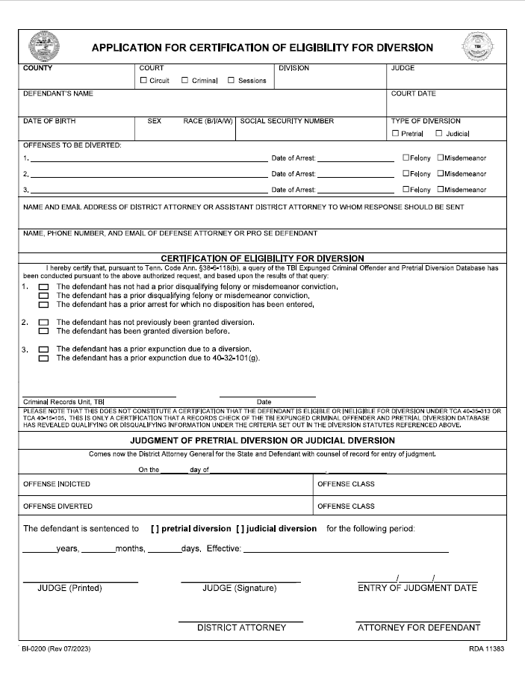
Granted Diversions
REMINDER: Certificate should be requested prior to placement on diversion.
Tenn. Code. Ann. 38-6-118 was amended effective March 14, 2023.
Defendants may now receive certificate.
CH from NCIC will not longer be included.
Please email granted diversion applications to TBI so that we can update our records. (TBI.Diversions@tbi.tn.gov)
Diversion certificates should not be used for expungement eligibility.
Notes:
The diversion application should be processed by TBI before the defendant is placed on diversion. Applications sometimes require research so it should be submitted as early as possible.
Due to CJIS Security policies, arrests that belong to other states or federal agencies can not be included in the diversion background check. This change on our end was in response to the change in statute which now requires TBI to send the certificate to defense attorneys/defendants.
When diversions are granted, please send the completed application to the Diversion Unit (TBI.Diversions@tbi.tn.gov).
--------------------
The diversion background check should not be used to check for eligibility for a conviction expungement.

Slide 5
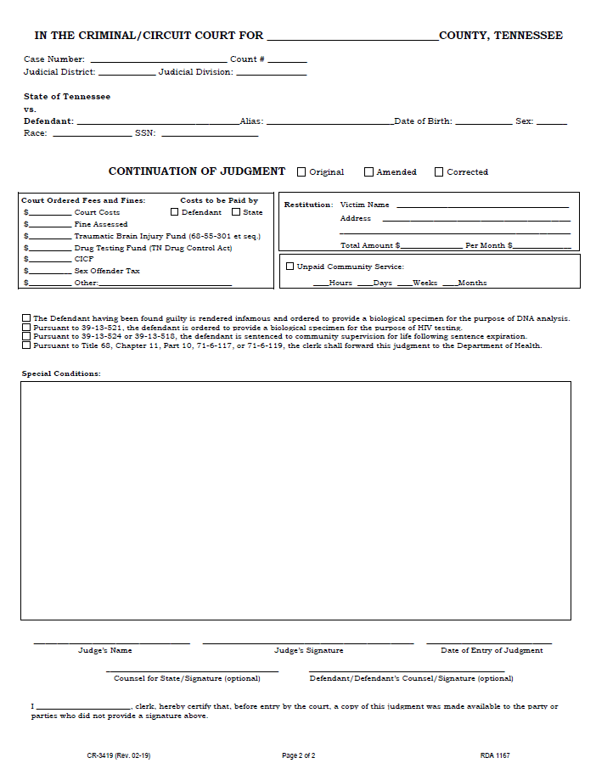
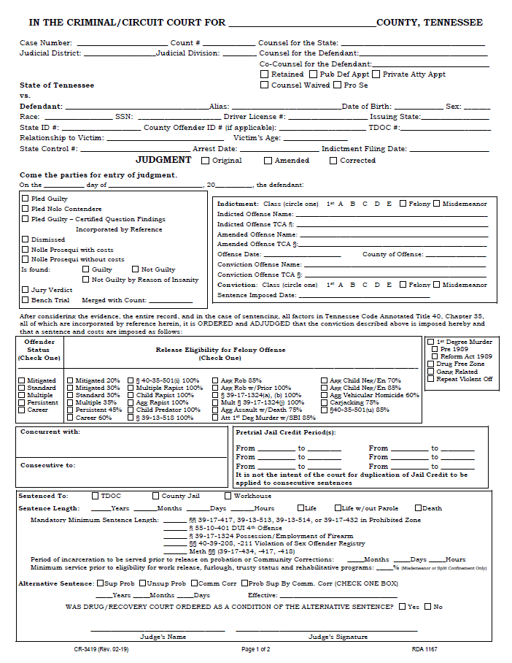
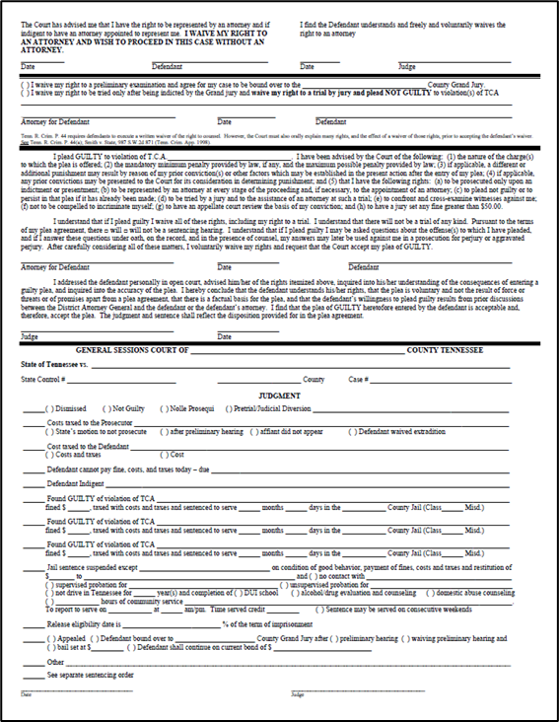
Dispositions
.
Tenn. Code Ann. 18-4-103 amended effective on the governor’s signature.
Requires electronic submission of dispositions.
Requires submission no later than 3 business days after final disposition of criminal proceedings to TBI.
No need to email or send paper dispositions to the Disposition Unit if dispositions are being sent electronically.
If you are not getting the State Control Number from your booking agency, please reach out to:
  Holly Folsom (Holly.Folsom@tbi.tn.gov),
  Heather Hurley (Heather.Hurley@tbi.tn.gov), or
  Kenneth Blue (Kenneth.Blue@tbi.tn.gov).
Notes:
All dispositions should be submitted electronically. If you want to verify or correct a disposition being reported by TBI it is OK to send a judgment or docket entry for verification or to correct/update the disposition.
If your court is unable to submit electronically through your court software, you can submit them through the Disposition module of FlexCheck.
Although you should stop sending dispositions to the Disposition Unit, you should still send them to other units at TBI that require they be submitted (i.e. CODIS, the Drug Registry, Animal Abuse Registry, etc.).
--------------------
Why is the State Control Number important?
The 12- digit State Control Number (SCN or STCN) connects the disposition from the court to the arrest event submitted by the arresting agency. Without the SCN, the disposition cannot be added to a criminal history.
Courts should not be referring defendants to TBI for:
Dispositions
Expungement process
Copies of expungement orders
Sentencing
When entering dispositions, please include the sentencing information. Please reach out to TBI.Dispos@tbi.tn.gov for examples.

Slide 6
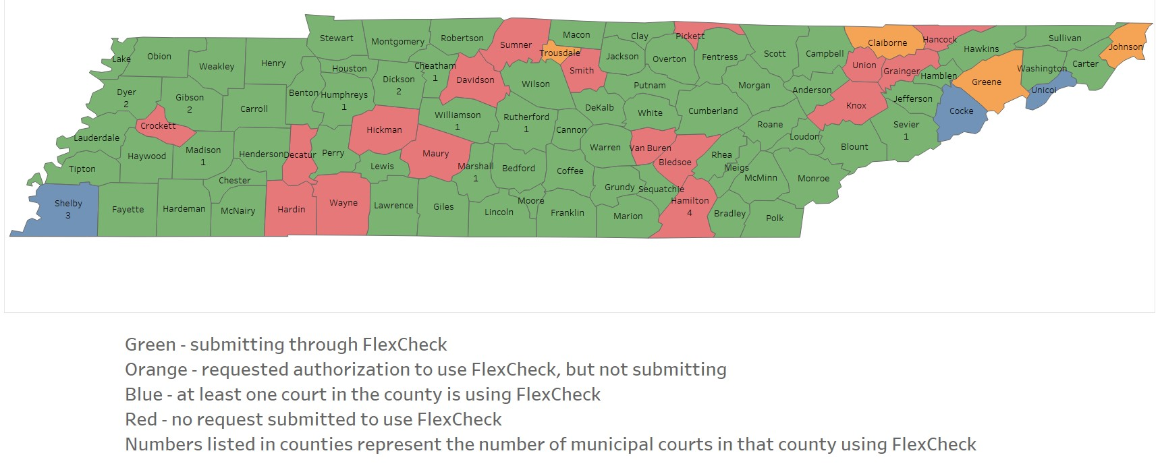
FlexCheck
FlexCheck is a free encrypted web-based application that allows your court to electronically submit expungements and dispositions securely to TBI.
FlexCheck is currently being used by a total of 100 Municipal, General Sessions, and Circuit Courts across Tennessee.
Notes:
Currently, expungements submitted through FlexCheck are typically completed within 3 business days.
Each court needs an ORI number in order to use FlexCheck. If you do not have an ORI number you must send a request on your letterhead to Katie Chestnut (Katie.Chestnut@tbi.tn.gov).
Reach out to us for any questions you have regarding FlexCheck. We are happy to provide training for FlexCheck either in person or remotely.
--------------------
If you are submitting through FlexCheck and you use the auto email check boxes... Please make sure you check the correct boxes. For instance if the arrest was made by your local SO or PD you should not check the THP RECORDS box. If the charge is SIMPLE POSSESSION you would not check the TBI SEX OFFENDER box.

Slide 7

Access to Online Court Records
If your court has online records, TBI would love to have access to them. It saves time for your clerks because they won’t have to answer our emails or phone calls when we are trying to update disposition information or clarify a defendant’s court records.
A frequent reason for our requests is for firearms transactions. In 2022 we processed 3,158 requests. January through August of 2023 we processed 3,267. If you have online records we can usually get all the information we need without reaching out to your clerks.
Notes:
When we request final dispositions we are trying to complete a criminal history for a number of reasons: firearms purchase, employment, carry permit, adoptions, immigration purposes, etc. These records are requested by federal agencies and states across the country.
When the background check is for a firearm and the FBI cannot make a determination within three business days of a background check, the Federal Firearms Licensee may transfer the firearm, unless prohibited by state law (per the Brady Handgun Violence Prevention Act of 1993). This is why the requests from NICS (National Instant Criminal Background Check System) are so urgent. We do understand delays are sometimes unavoidable (i.e. the arrest is from 1987 and your old docket books are at your archives site that someone visits twice a month), but we need the information as quickly as possible. When you receive requests from the Disposition Unit, please reply to the email you received or include any identifying information that was in the email’s subject line.

Slide 8
Amendments to Tenn. Code. Ann. 40-32-101
Public Chapter 43
Requires State Control Number on all Expungement Orders.
Public Chapter 315
Illegal registration or voting conviction now eligible for expungement.
15 years after completion of sentence.
Public Chapter 330
Abatement by death is eligible for expungement under (a)(1)(A).
Personal representative may file.
Public Chapter 392
Created an expungement certificate for certain offenses.
Created an expungement for arrest record if no history of arrest in the court’s records.
Effective April 21, 2023*.
Notes:
--------------------
Why is the State Control Number important?
The State Control Number (SCN or STCN) facilitates the ease of identifying the arrest event to be expunged.
Please note that the SID Number (State ID number) is NOT the same thing as the State Control Number (12-digit number starting with the ORI number).

Slide 9
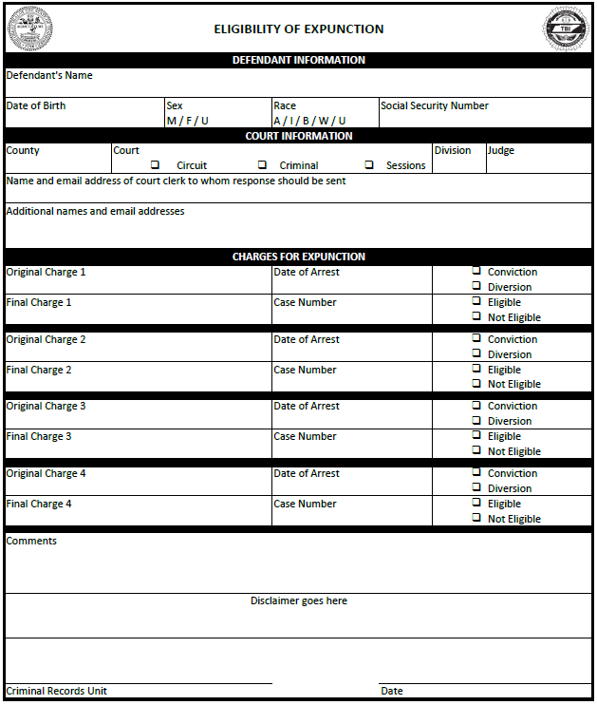
Expunction Certificate
Conviction, Human Trafficking, and Diversion Expungements signed January 1, 2024 and after must be submitted with an expunction certificate reflecting that a charge is eligible for expungement.
As the deadline approaches, please reach out to TBI.Expungement@tbi.tn.gov if you have questions.
**The form shown here is a working mock-up and will not be the final form.
Notes:
--------------------
Your DA’s office can send a request to TBI.Expungement@tbi.tn.gov to check for previous conviction expungements.

Slide 10
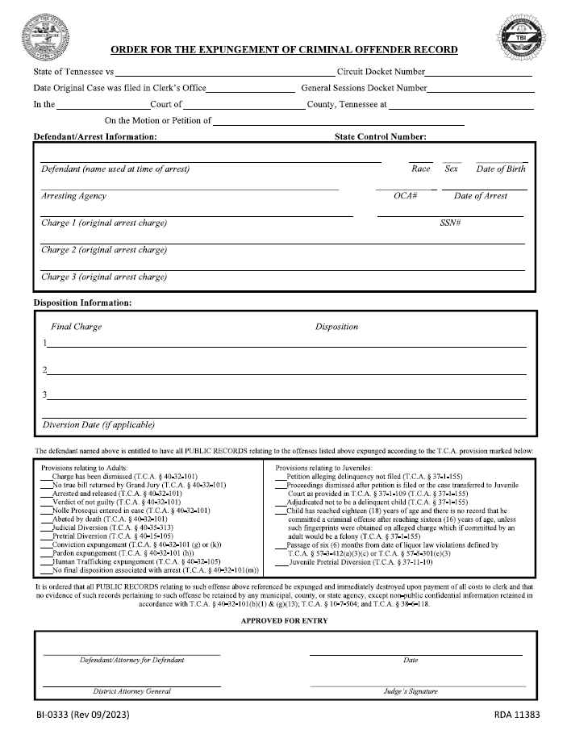
Updated Expungement Form
The expungement form has been updated to include expungements for abated by death, Conviction (g & k), Pardon (h), Human Trafficking, and charges with no final disposition (m).
Many provisions have been reworded (including Judicial Diversion and Pretrial Diversion) for greater clarity.
A PDF fillable form is available. If you use FlexCheck you can find all current forms by clicking on FORMS AND HELP DOCUMENTS on the navigation bar on the left side of the FlexCheck window.
Electronic signatures are acceptable.
Notes:
State Control Numbers are now required for expungements. If you are expunging an older arrest that doesn’t have one it’s OK for you to leave it blank. You may also reach out to TBI and we can supply the number if one exists.
A few noted additions:
Arrested & released
Abated by death
No final disposition associated with arrest
Juvenile Pretrial Diversion

Slide 11
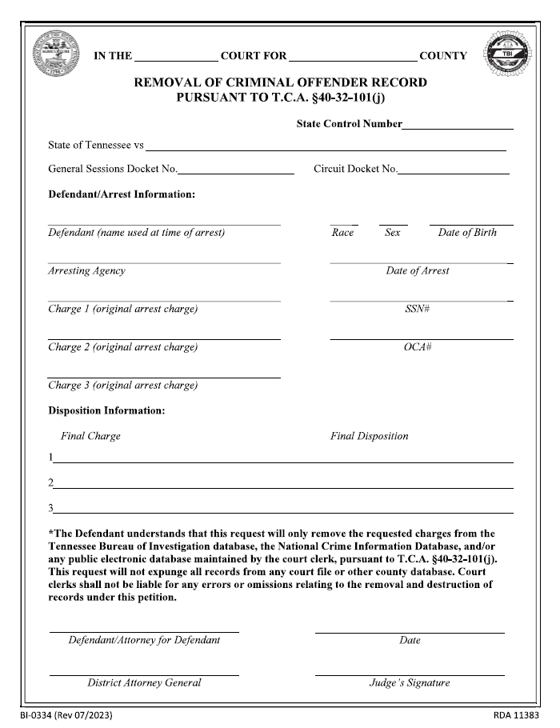
Updated Partial Removal Form
This form was created by the Sumner County Clerk’s Office, but TBI has now taken ownership of it. If you are removing one or more charges from the public court records and there will be at least one conviction remaining, this is the form you should use for removing them.
This is not an expungement of records.
A judge’s signature is required.
A PDF fillable form is available. If you use FlexCheck you can find all current forms by clicking on FORMS AND HELP DOCUMENTS on the navigation bar on the left side of the FlexCheck window.
Electronic signatures are acceptable.
Notes:
The partial removal form is not an expungement and is just used to remove some charges from a record. There should be a least on conviction left on the record.
If the order we have removes all the charges for an arrest event we will reach out to you to find out what charge (or charges) should remain on the record. If the conviction is for a charge we didn’t receive because the person wasn’t fingerprinted for that charge (for instance SPEEDING) we will remove what we have. If the conviction is for a charge that should be reported on the defendant’s criminal history we will ask the arresting agency send a request to the Data Quality Unit (TBI.DataQuality@tbi.tn.gov) to add the charge (or charges).

Slide 12

Relief from Firearms Disabilities
Person may petition three (3) years after the date of release.
Must be done by court which entered the judicial commitment or adjudication order.
List of factors for court to consider.
Court must forward order to TBI within thirty (30) days.
TBI will update NICS.

Slide 13
Contact Info
TBI email addresses have changed. Please use this updated contact information when reaching out to our team.
Name | Title | Phone | Email
Dispositions |  | 615-744-4617 | TBI.Dispos@tbi.tn.gov
Diversions |  | 615-744-4617 | TBI.Diversions@tbi.tn.gov
Expungements |  | 615-744-4617 | TBI.Expungement@tbi.tn.gov
Notes:
--------------------
Please update our contact information.

Slide 14
Helpful TBI Links
Tennessee Bureau of Investigation
https://www.tn.gov/tbi
TBI Dispositions/Diversions/Expungements
https://www.tn.gov/tbi/divisions/cjis-division/diversions-expungements.html
TBI Instant Check System
https://www.tn.gov/tbi/divisions/cjis-division/firearm-background-checks.html
Tennessee Applicant Processing Services (TAPS)/
Tennessee Open Records Information Services (TORIS)
https://www.tn.gov/tbi/divisions/cjis-division/background-checks.html

Slide 15
Helpful TBI Links (continued)
TBI Sex Offender Registry
https://sor.tbi.tn.gov/home
TBI Drug Offender Registry
https://www.tn.gov/tbi/divisions/drug-investigation-division/tennessee-drug-offender-registry.html
TBI Animal Abuse Registry
https://www.tn.gov/tbi/tennessee-animal-abuse-registry.html

Slide 16
Other Helpful Links
FBI’s CJIS Security Policy Resource Center
https://le.fbi.gov/cjis-division/cjis-security-policy-resource-center
Administrative Office of the Courts
https://tncourts.gov/
Tennessee District Attorneys General Conference
https://www.tndagc.org/
Tennessee Department of Correction
https://www.tn.gov/correction.html
Tennessee Felony Offender Information
https://foil.app.tn.gov/foil/search.jsp

