Slide 1
unclaimed property: beginning to end
john gabriel, director
division of unclaimed property

Slide 2

Overview
Consumer Protection
Intangible Assets
No Time Limit to Claim
No Fees to Claim
www.treasury.tn.gov/unclaim
Property Received: FY2017 - $78.5 Million
Claims Paid: FY2017 - $47.9 Million for 43,482 claims

Slide 3
What is Unclaimed Property
Definition–Intangible personal property that has gone unclaimed by the rightful owner after a specified period.

Slide 4


Reporting Requirements
Property Type
Dormancy Period
Due Diligence
ReportItTN.gov
Priority Rule: TX vs NJ

Slide 5
Legal History and Implications

Slide 6
Escheat
The old British common law practice where land with no owner was turned over to the lord or king of the manor.

Slide 7

21st Century
States are custodial in nature and not a true escheat.

Slide 8
NATIONALLY
States have adopted the different revisions of the Uniform Disposition of Unclaimed Property Act
Initial – 1954
Revised in 1966, 1981,1995 & 2016

Slide 9
Which state do I need to report to?
Priority rule was established and upheld by these three supreme court cases.
Incidental Property: 10 or fewer properties valued at $1,000 or less
Texas v New Jersey, US Supreme Court, 379 US 674 (1965).
Pennsylvania v New York, US Supreme Court, 407 US 206 (1972).
Delaware v New York, US Supreme Court, 507 US 490 (1993).

Slide 10

Determine your liability
Review your outstanding checks
Checks that have been written off?
Internal – Payroll
External – Customer Refunds, Vendor Checks
3rd Party Agents

Slide 11

Due Dilligence
No sooner than 180 days
Must wait at least 60 days
Must contains specific info
  What is it
  If they don’t respond it will be turned over to the State
  Provide instructions to prevent property from being reported
  TCA 66-29-128 & 129

Slide 12
Create your report
Must be an approved NAUPA file
Software: Free or $$$
Create your own file
Contains list of property and who it belongs too

Slide 13

ReportItTN.gov
Upload your file here
Pay through this web portal
Online instructions / tutorials
Just Say No to “Mail”

Slide 14
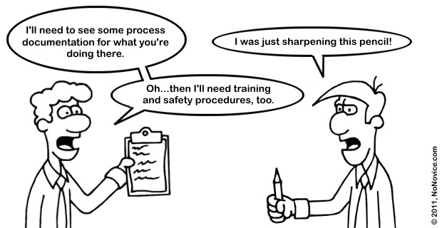
Compliance
Audits
CDA
Penalties

Slide 15

Claims: What happens after you report
State Efforts to Locate Missing Owners
- SSN match with the Division of Workforce and Labor
- Internet
- Letters to last known address
- Match with other databases
- Advertising

Slide 16


Questions ?

