Slide 1
Criminal and General Sessions Criminal
May 19, 2011 – Embassy Suites
Crystal Greene, Mike Forbess,
Lisa Niles, & Joy McCroskey

Slide 2
Are litigation taxes charged on violation of financial responsibility(traffic)?
DA says TCA says it is a fine only offense? (I thought the fine only portions is to punishment and not to costs)

Slide 3
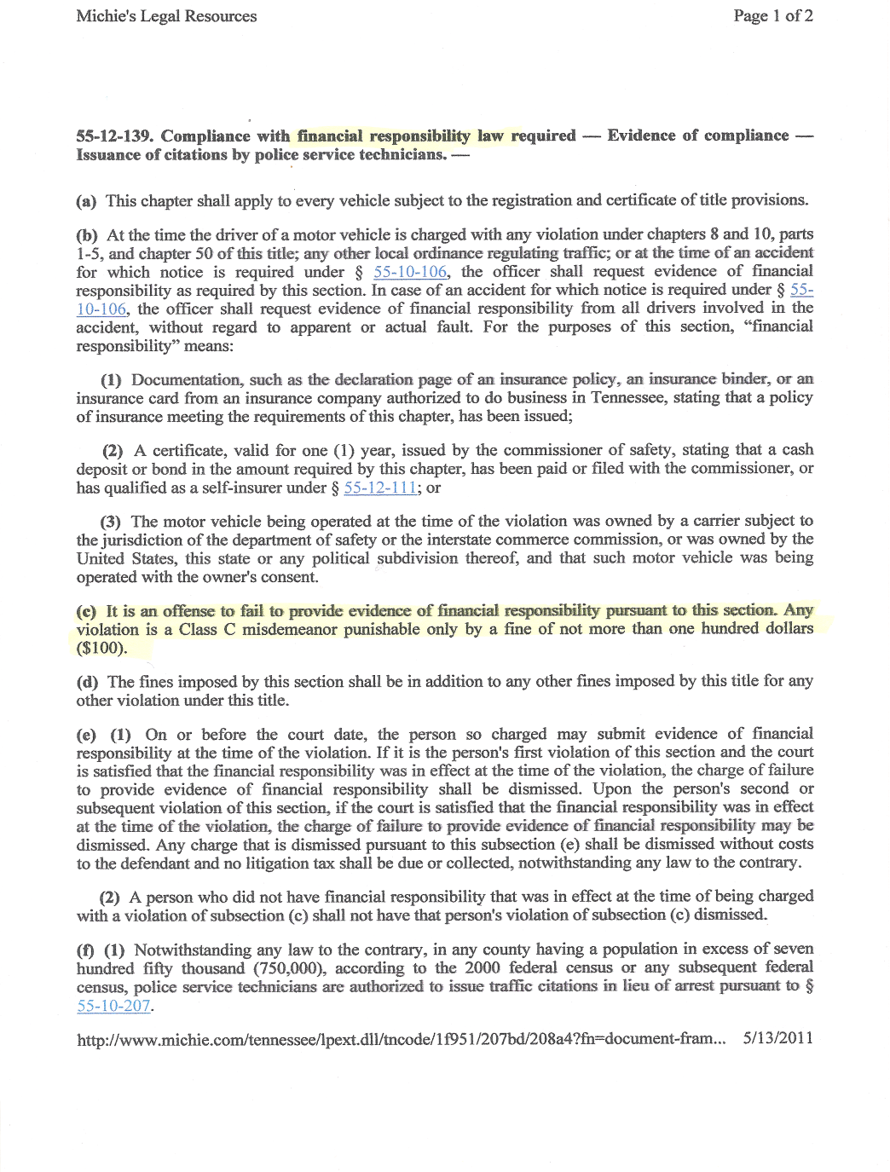

Slide 4
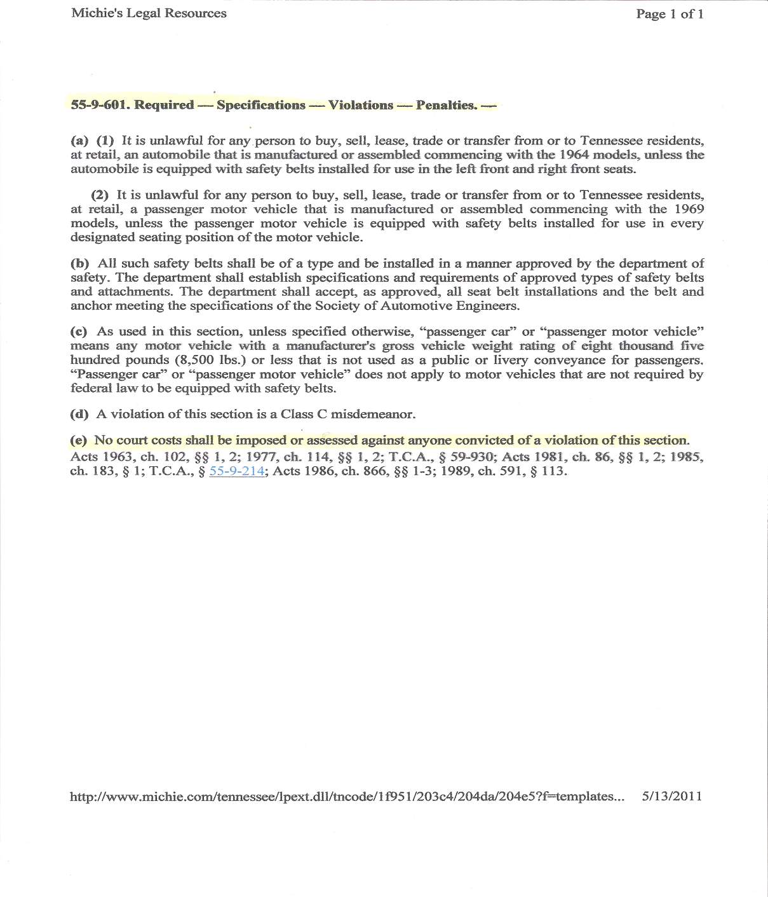

Slide 5
Payment of cost/fine. When defendant serves their sentence do they still owe?

Slide 6
Traffic tickets
Juvenile Traffic tickets
Dept. of Safety reports

Slide 7
Department of Safety Information:
    Insurance information
    Out of State DL
    Which are considered CDL

Slide 8
When a defendant is charged with driving on suspended license and fails to appear, do clerks send in to the state a failure to appear and then issue a FTA warrant per judge creating a new case? The defendant is now unable to clear his driving on suspended charge with state because of his FTA with the court. Both remain outstanding. Is there a suggestion to help defendants get their record clear to obtain their license showing proof to the judge to allow a disposition of the charge?

Slide 9
More information on the new restricted license for DUI and also on interlock (IID) information

Slide 10
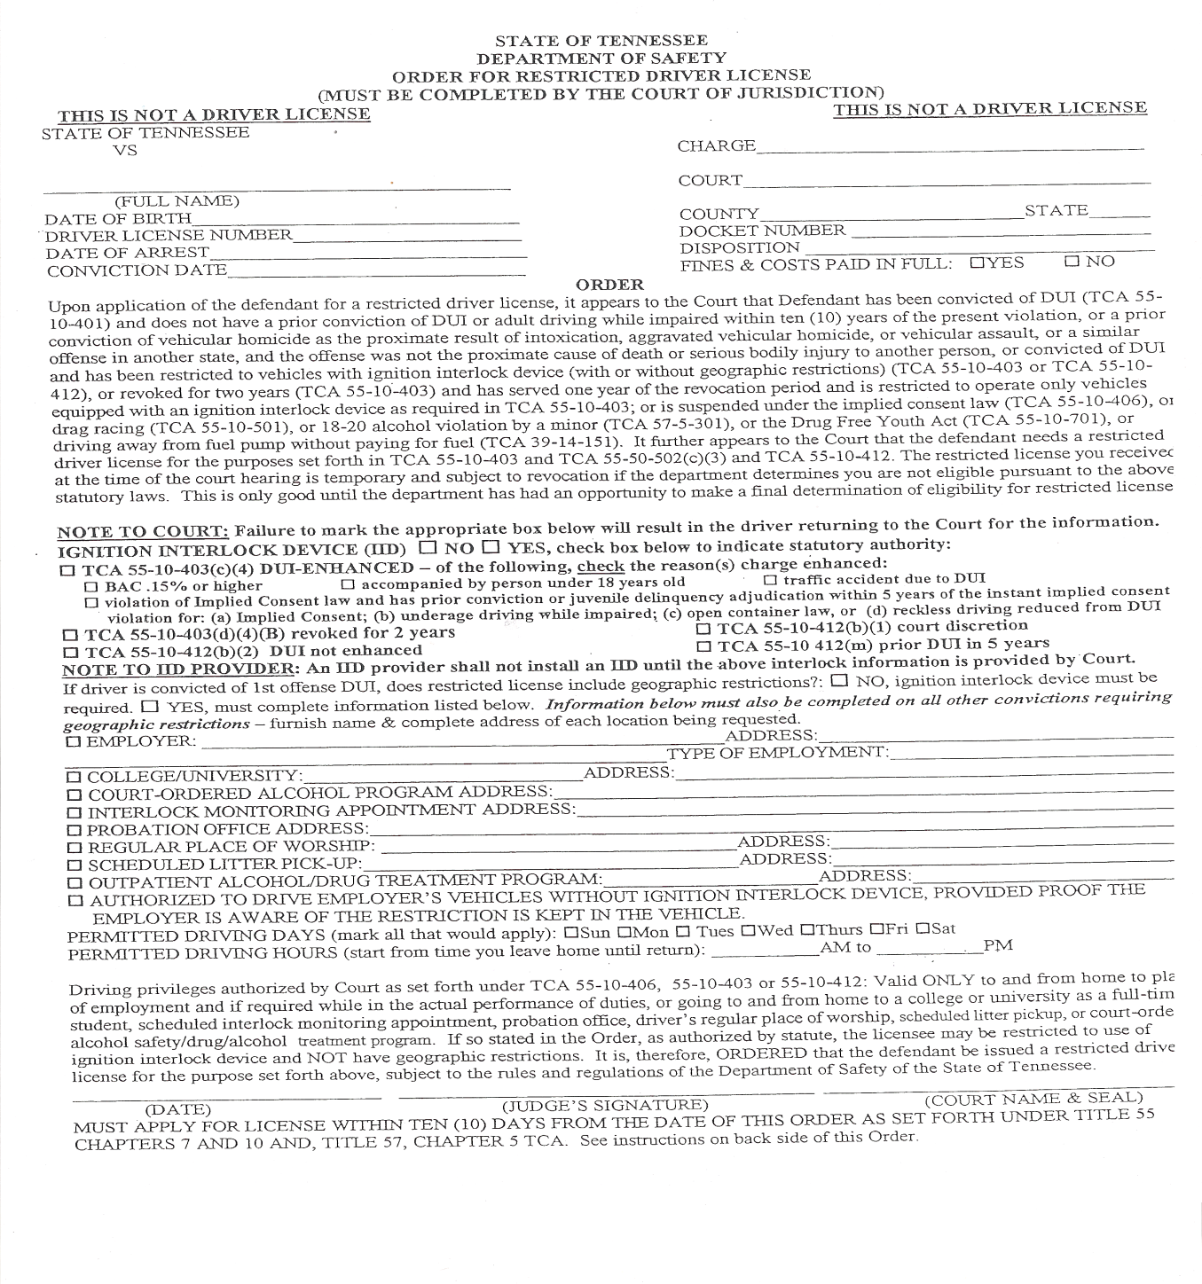

Slide 11
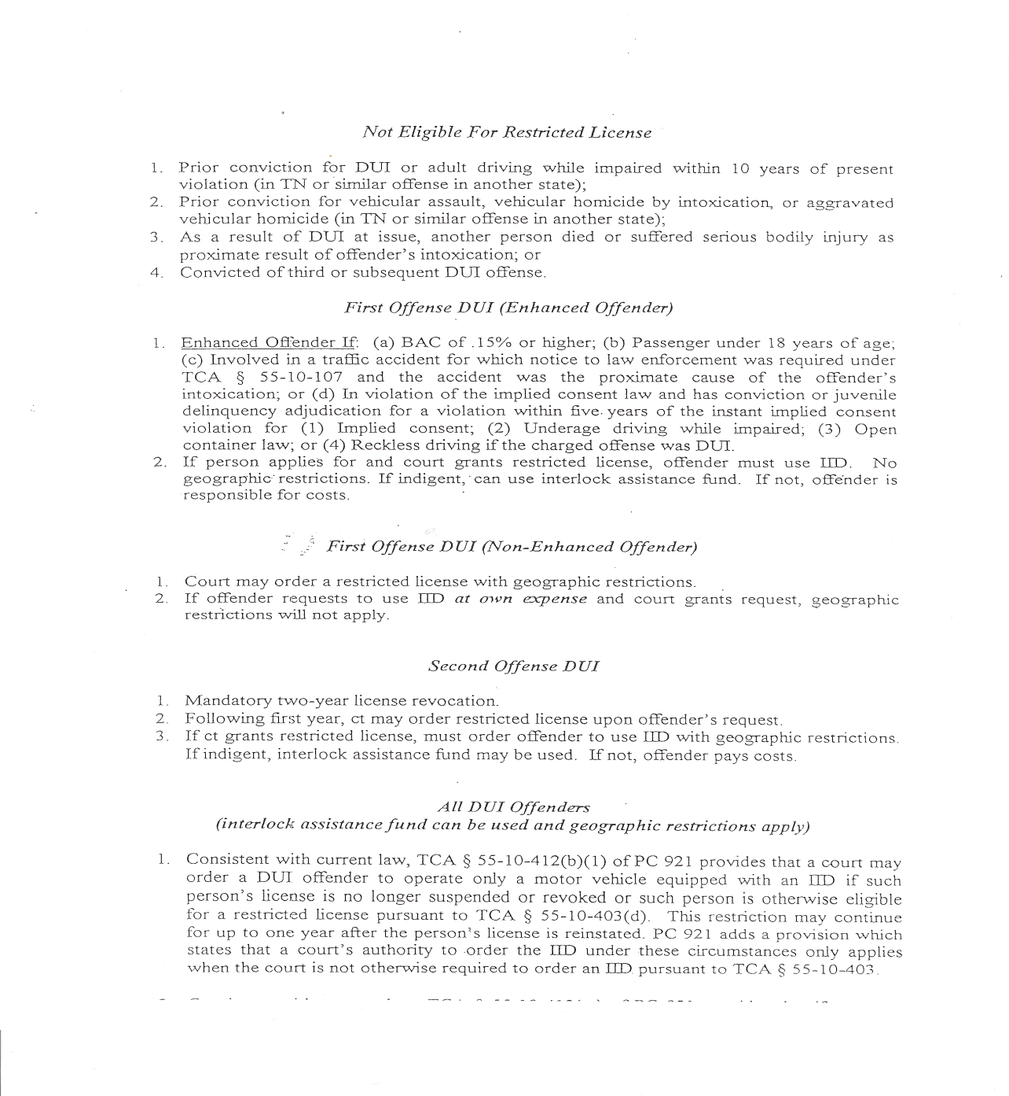

Slide 12
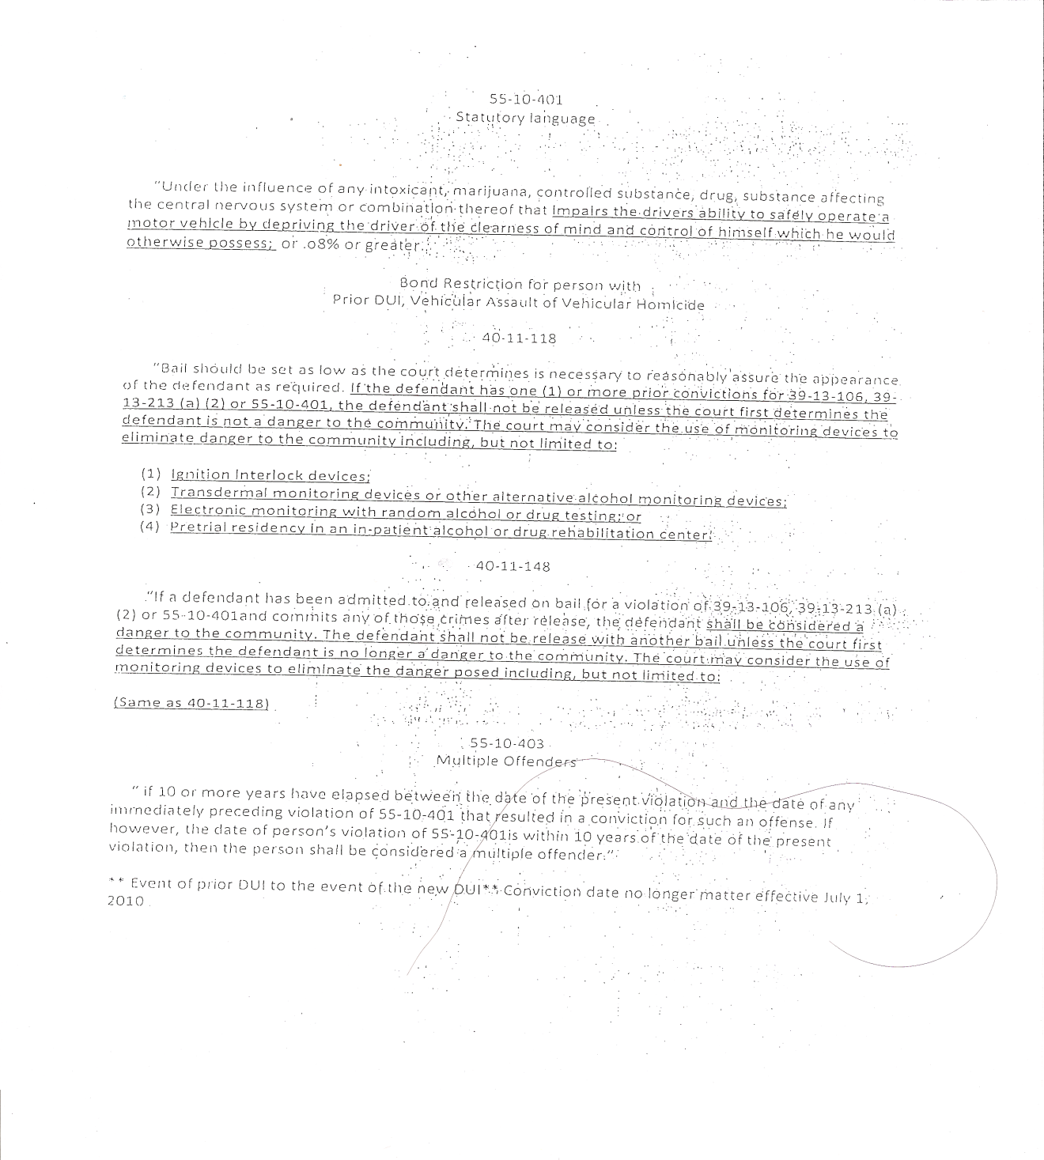

Slide 13
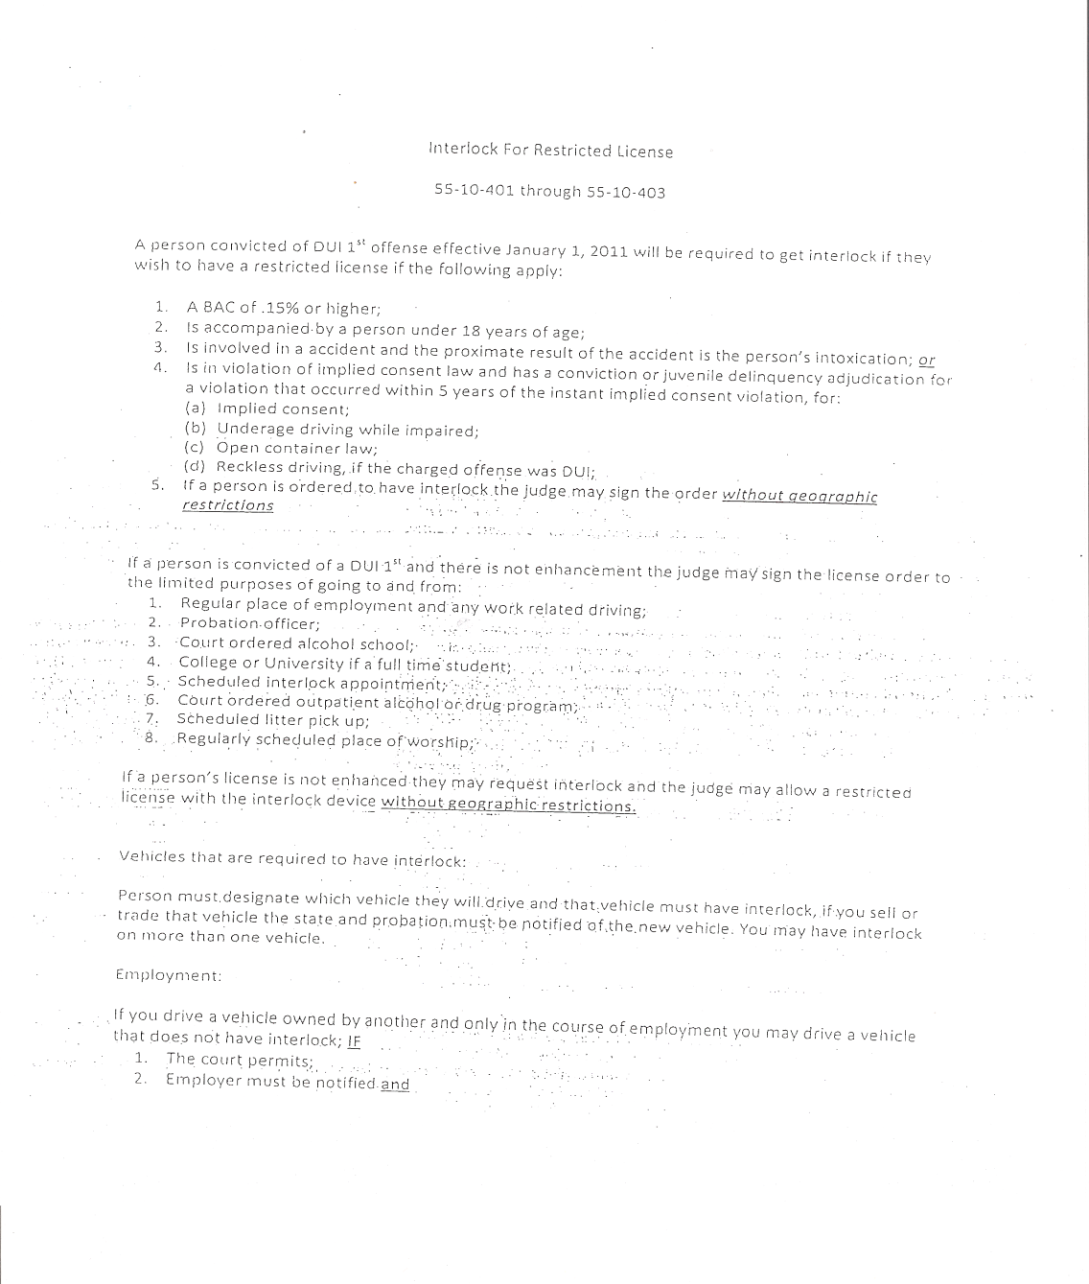

Slide 14
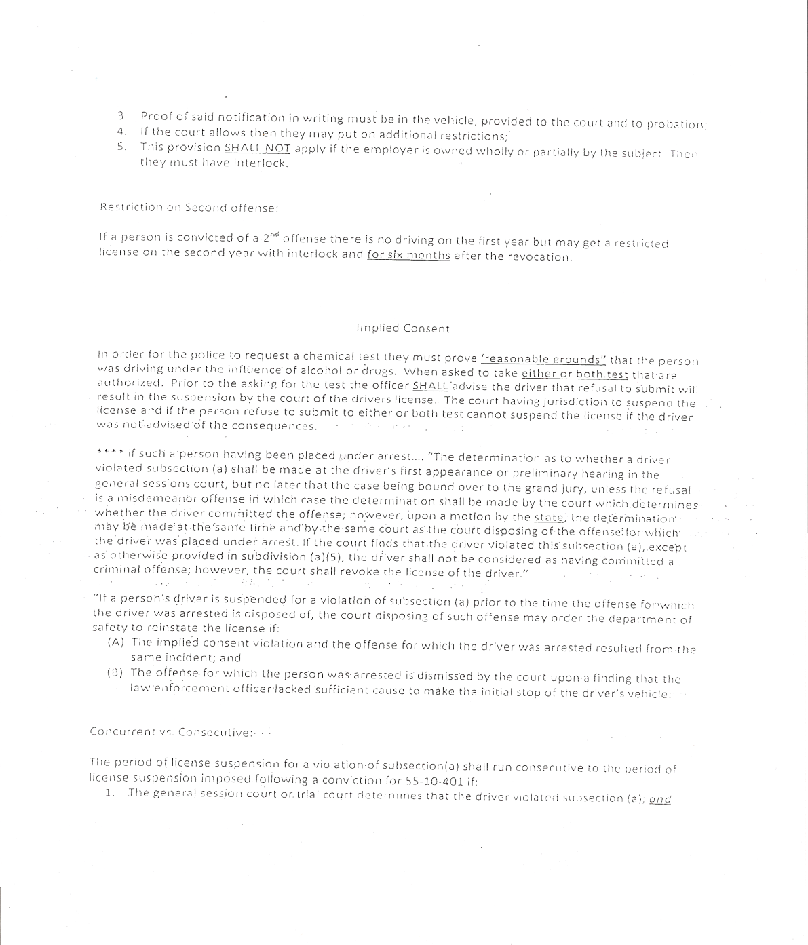

Slide 15
Can an individual whose driver license is suspended for failure to pay a fine or cost obtain a restricted license?

Slide 16
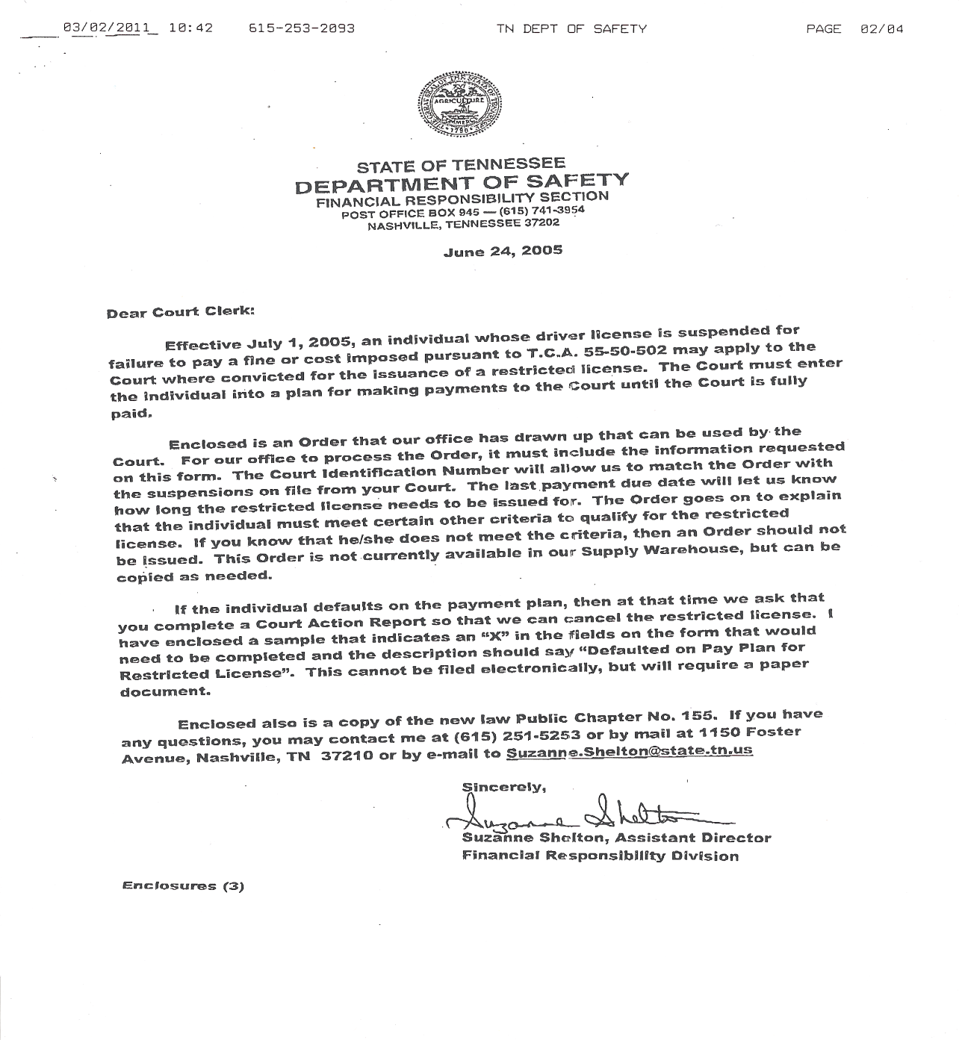

Slide 17
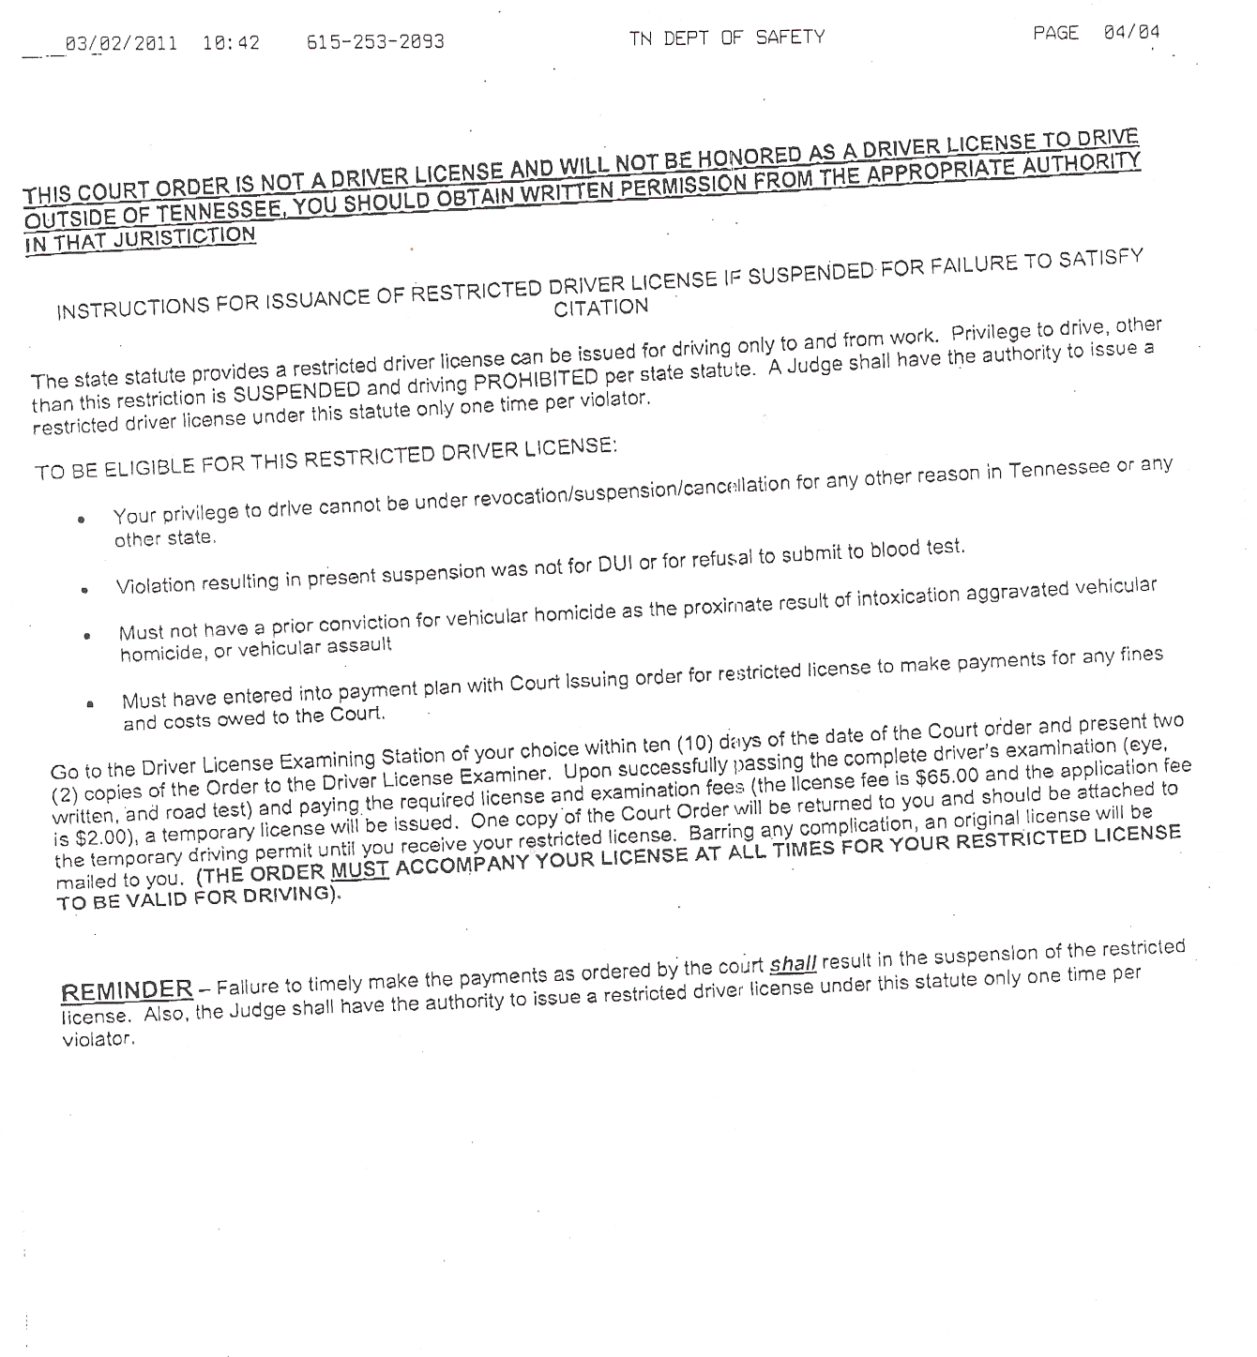

Slide 18
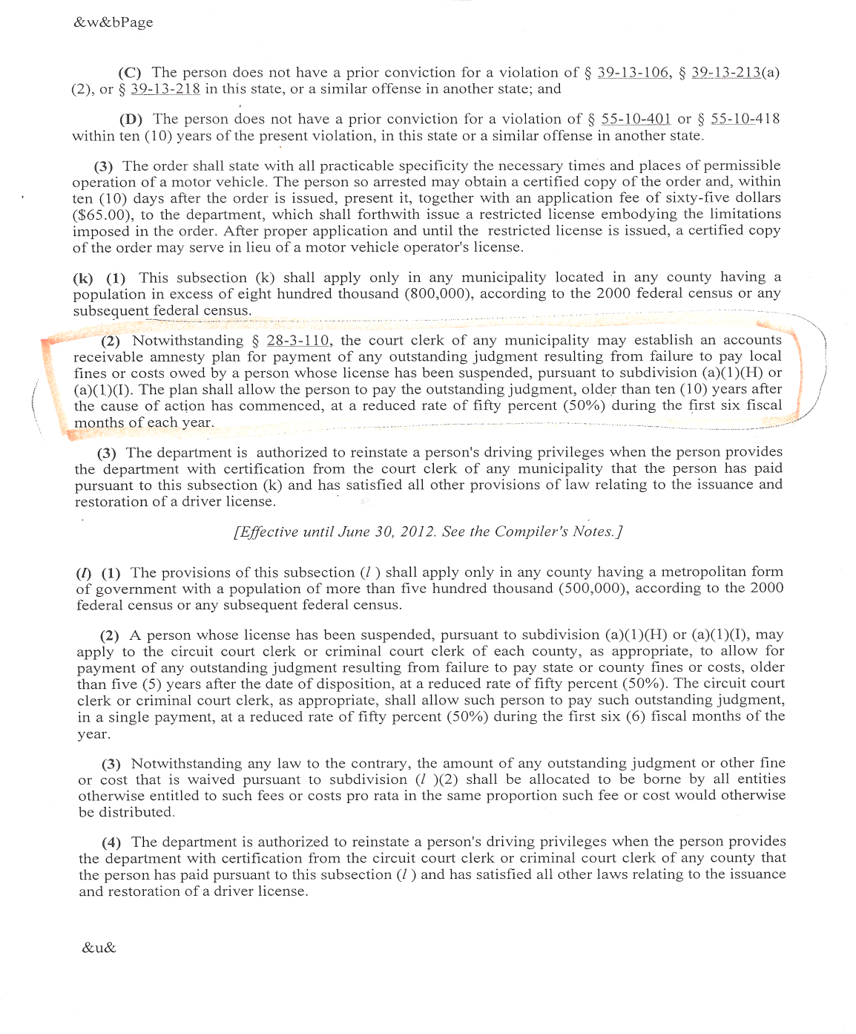

Slide 19
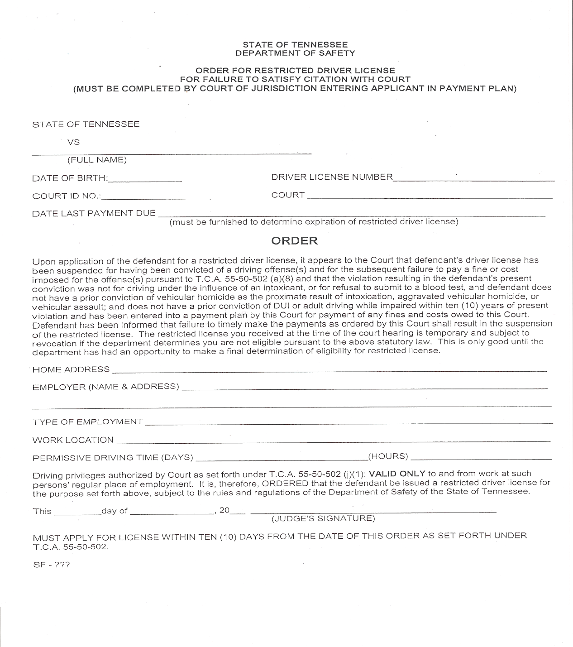

Slide 20
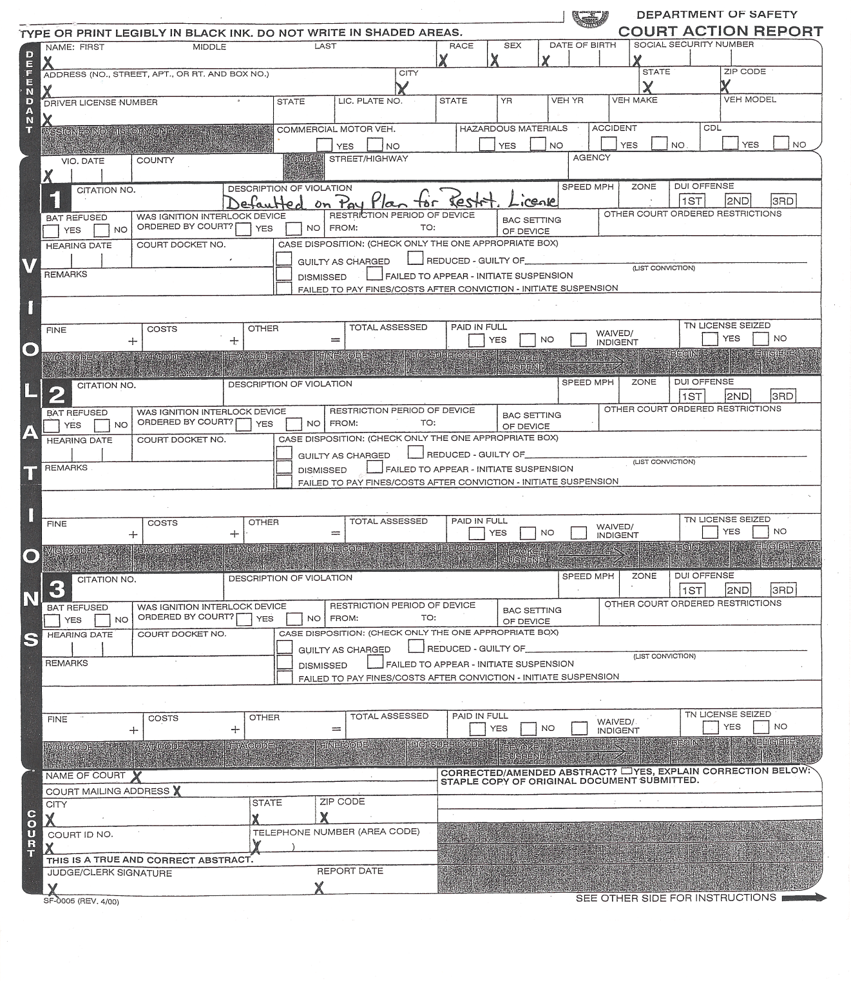

Slide 21
Re-tax/Cost to State
How is it handled in other counties?

Slide 22
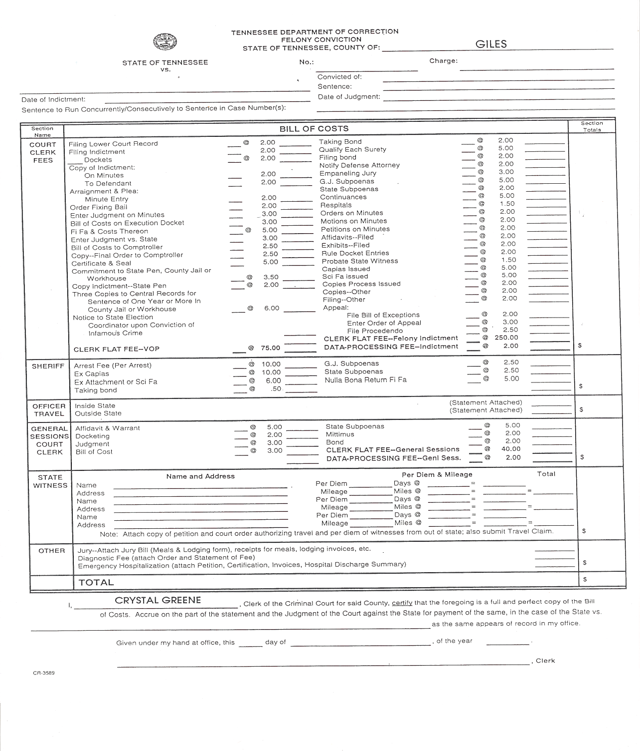

Slide 23
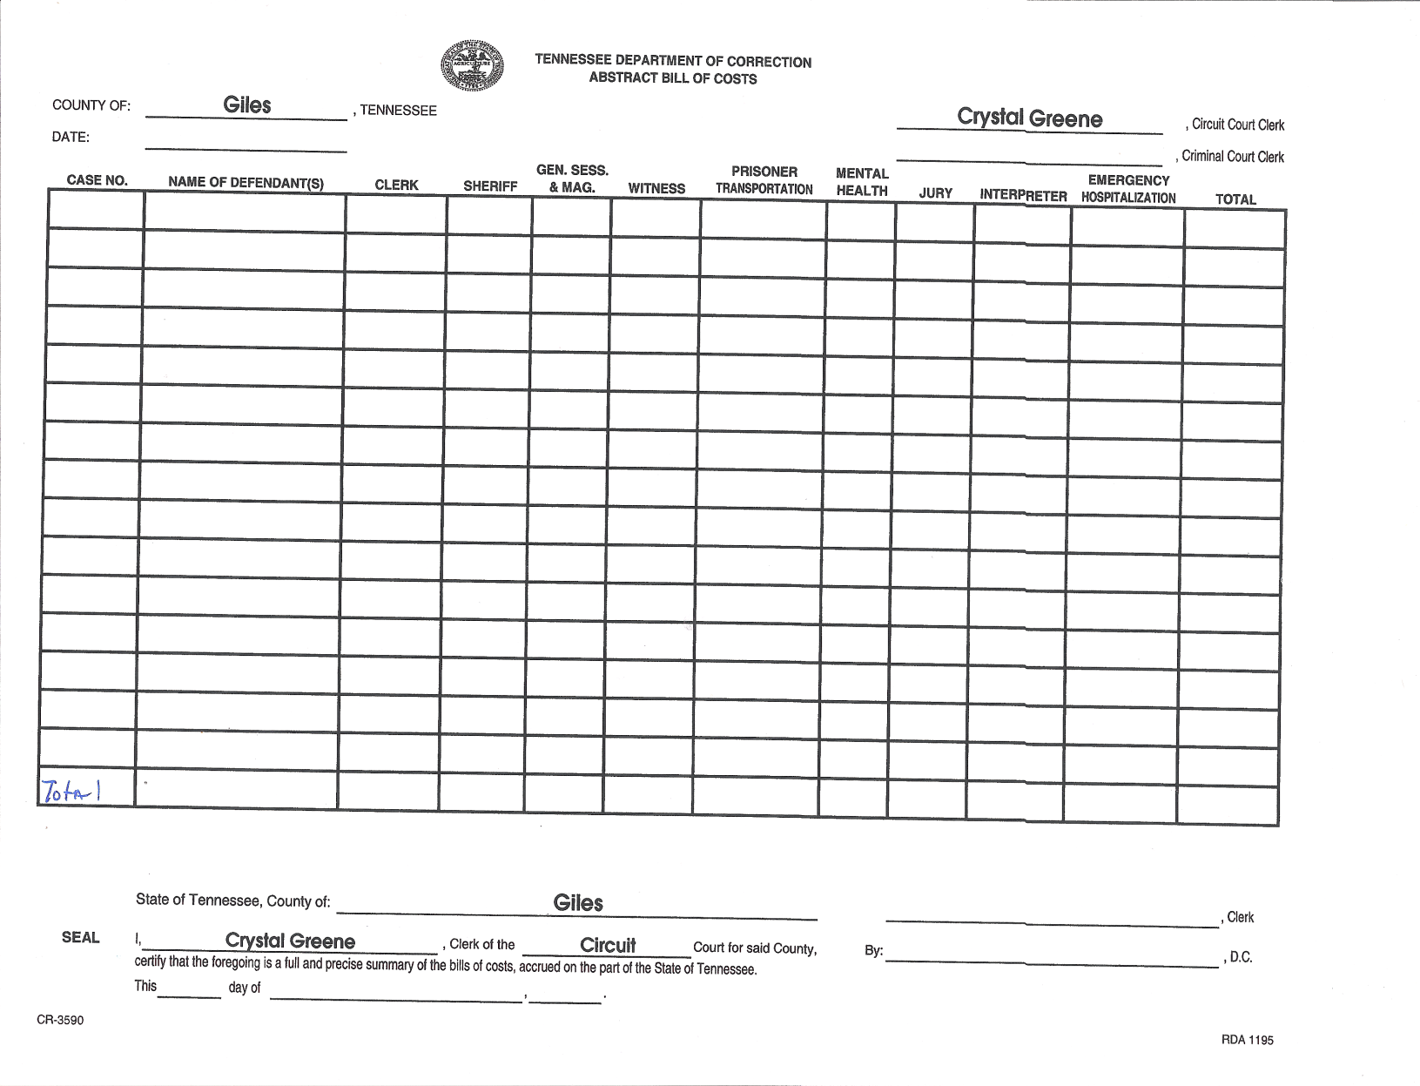

Slide 24
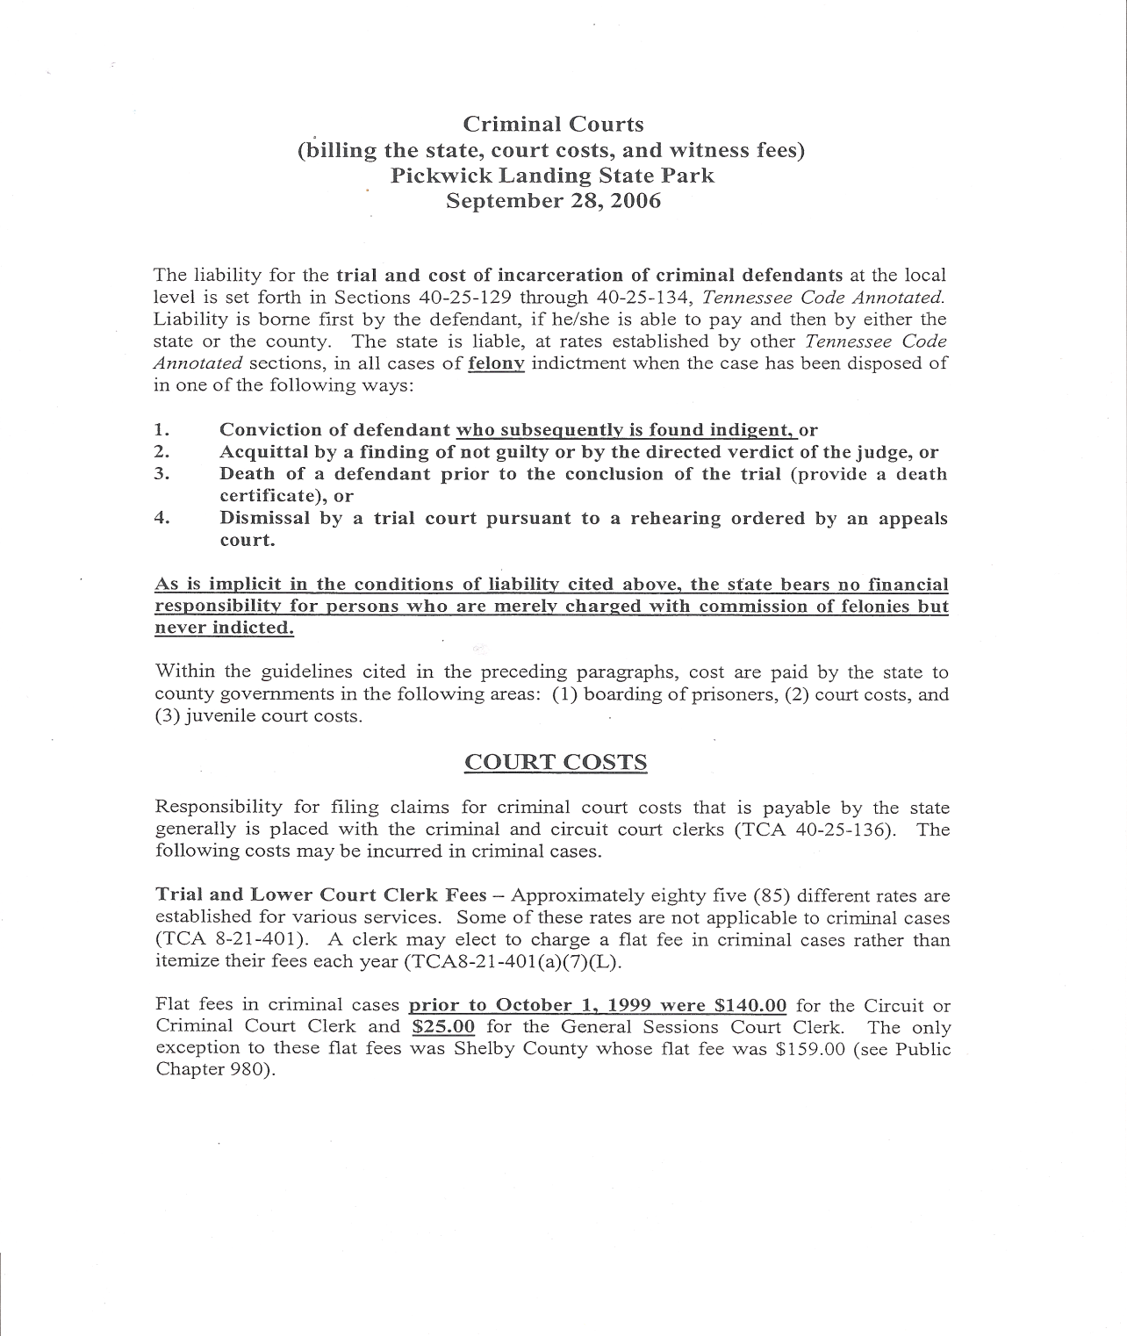

Slide 25
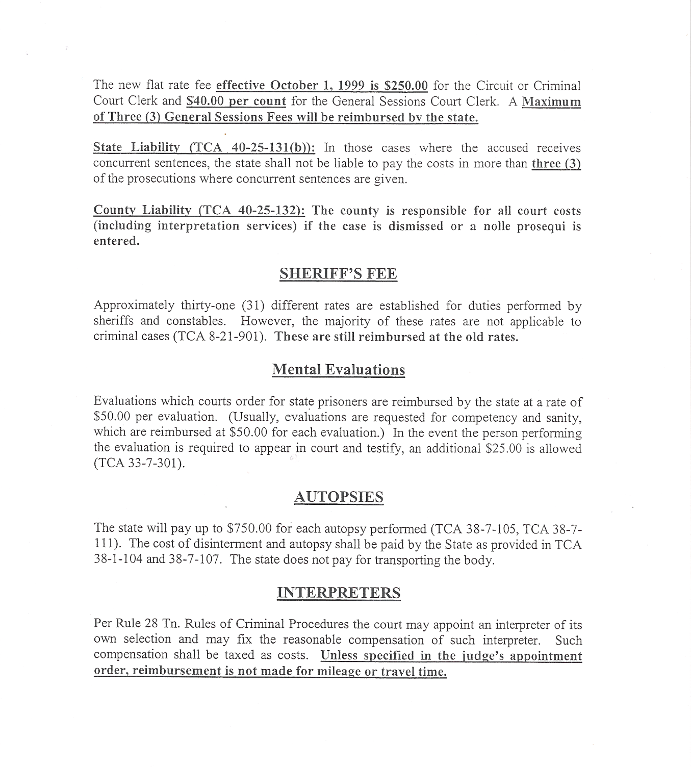

Slide 26
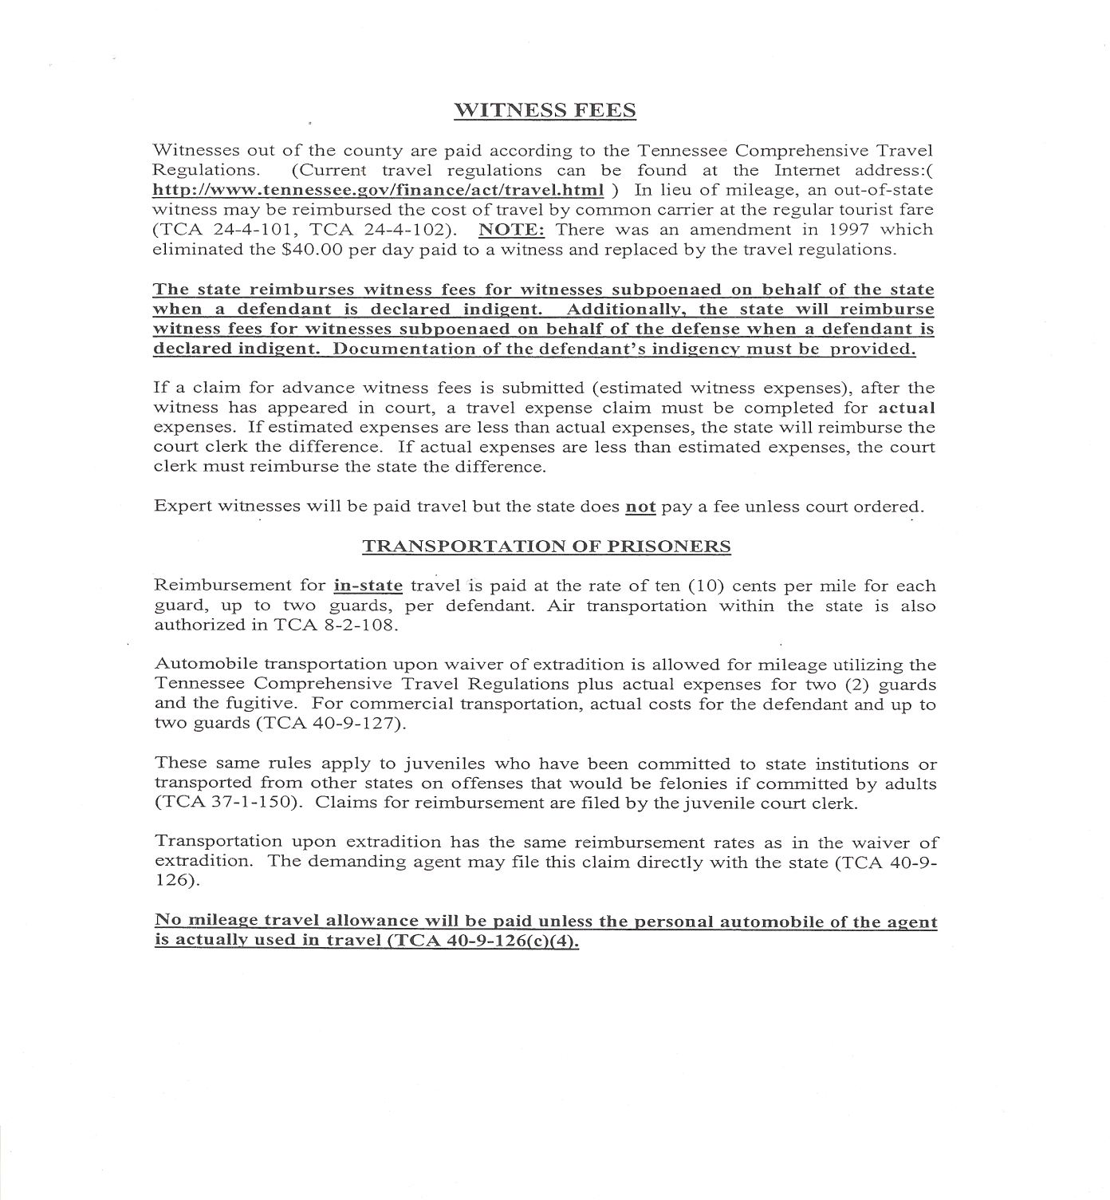

Slide 27
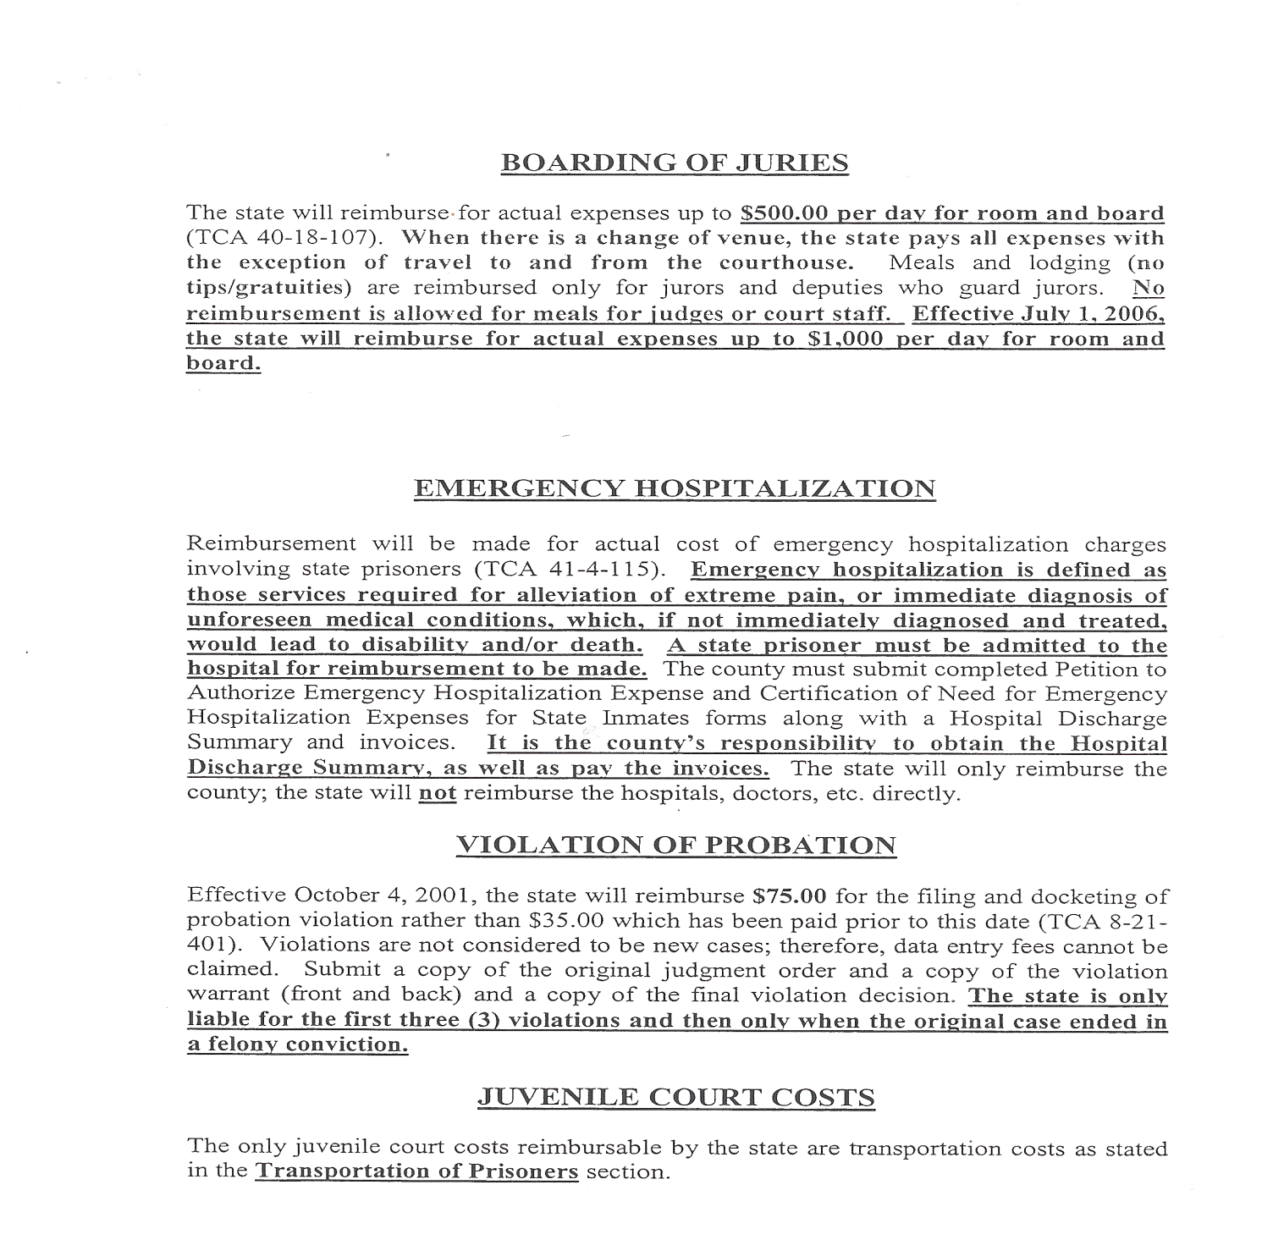

Slide 28
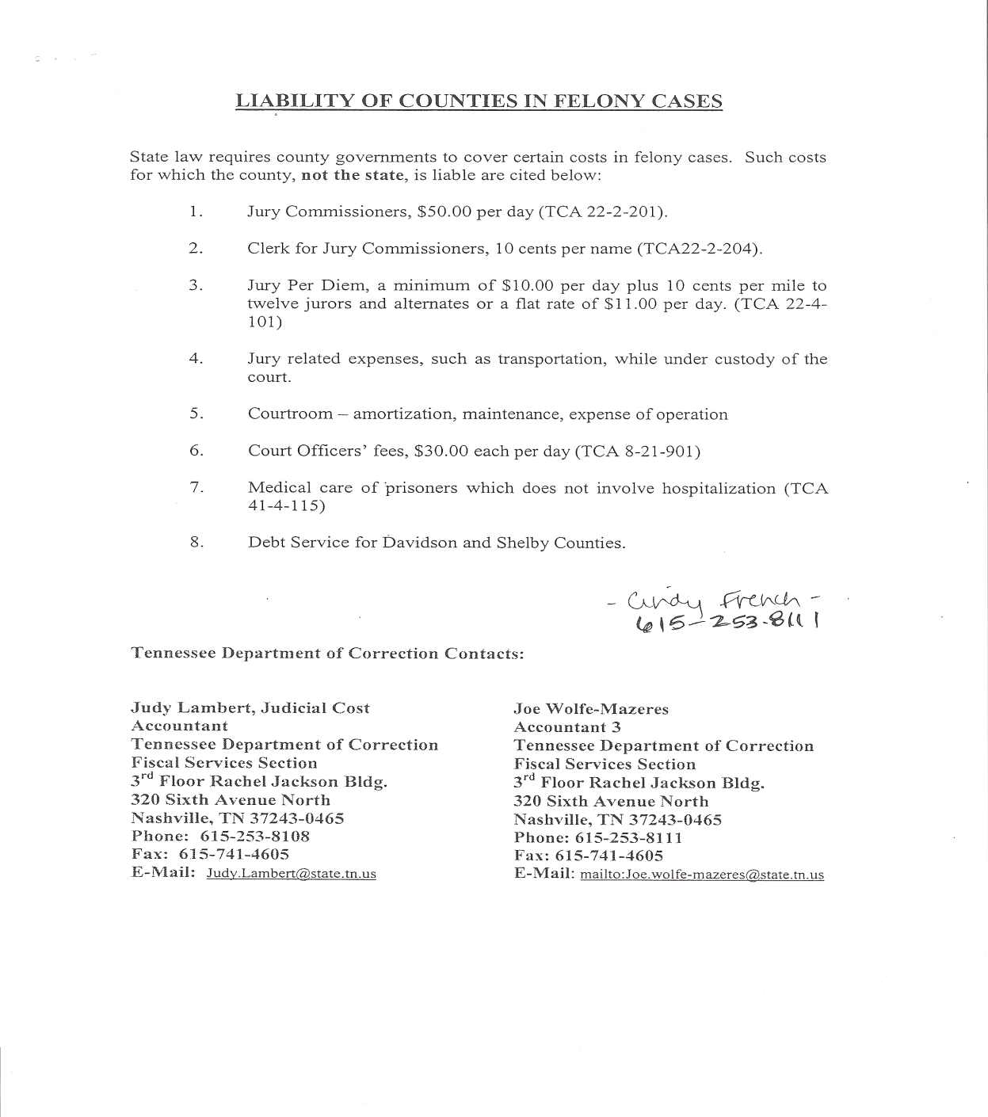

Slide 29
With regard to the TBI interface, error report - is it a requirement that cases remain on the report that have never been booked and a FTA for booking has been issued and not served?

Slide 30
TBI Meth Registry

Slide 31
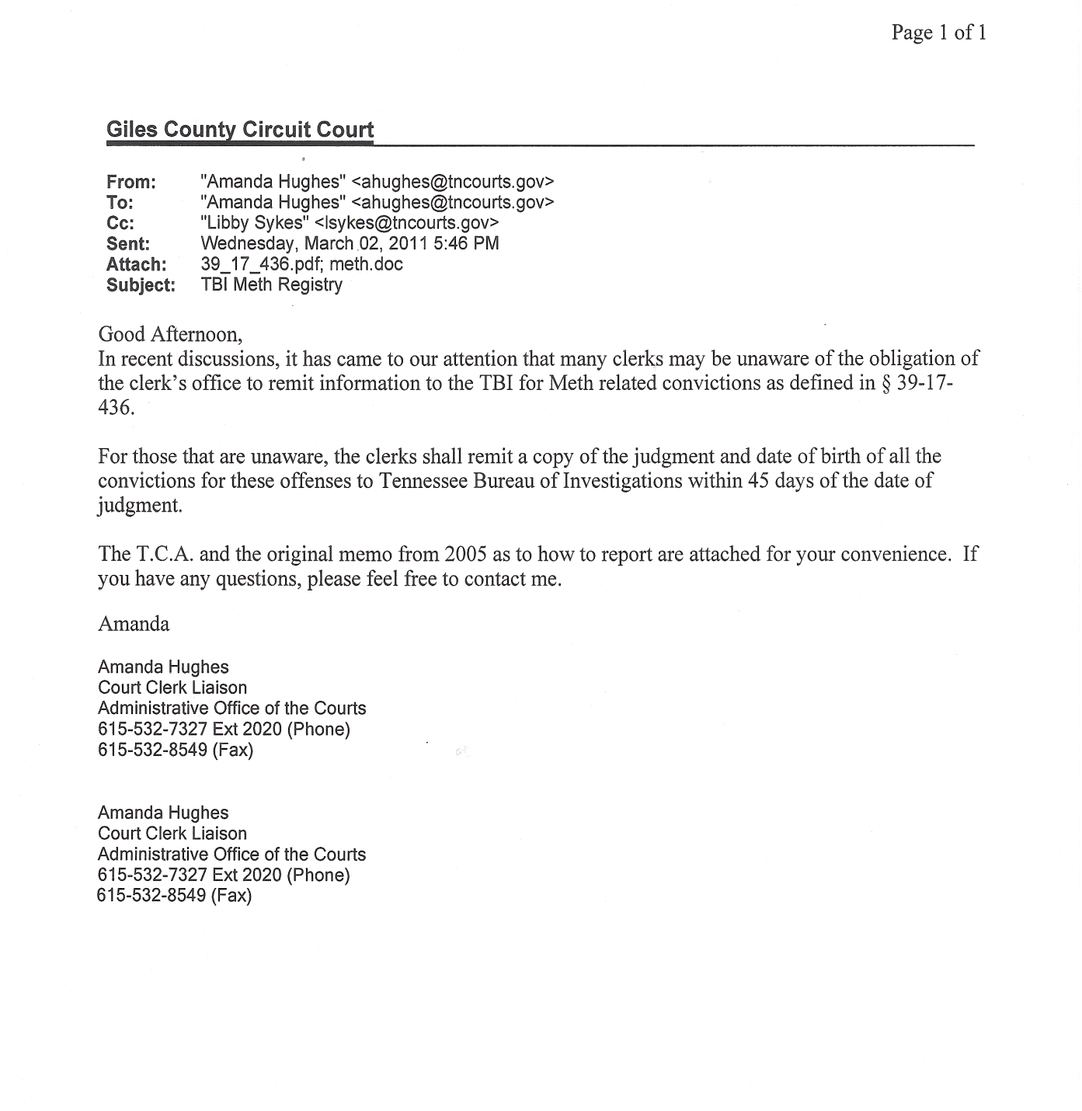

Slide 32
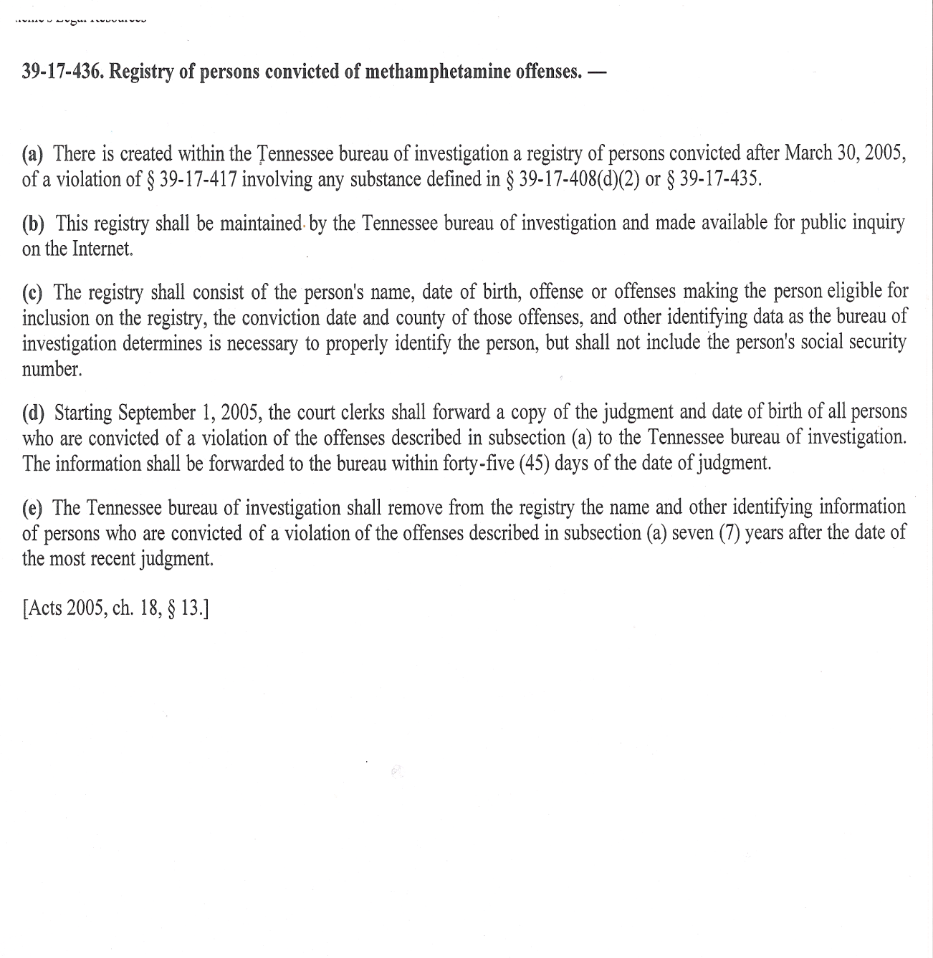

Slide 33
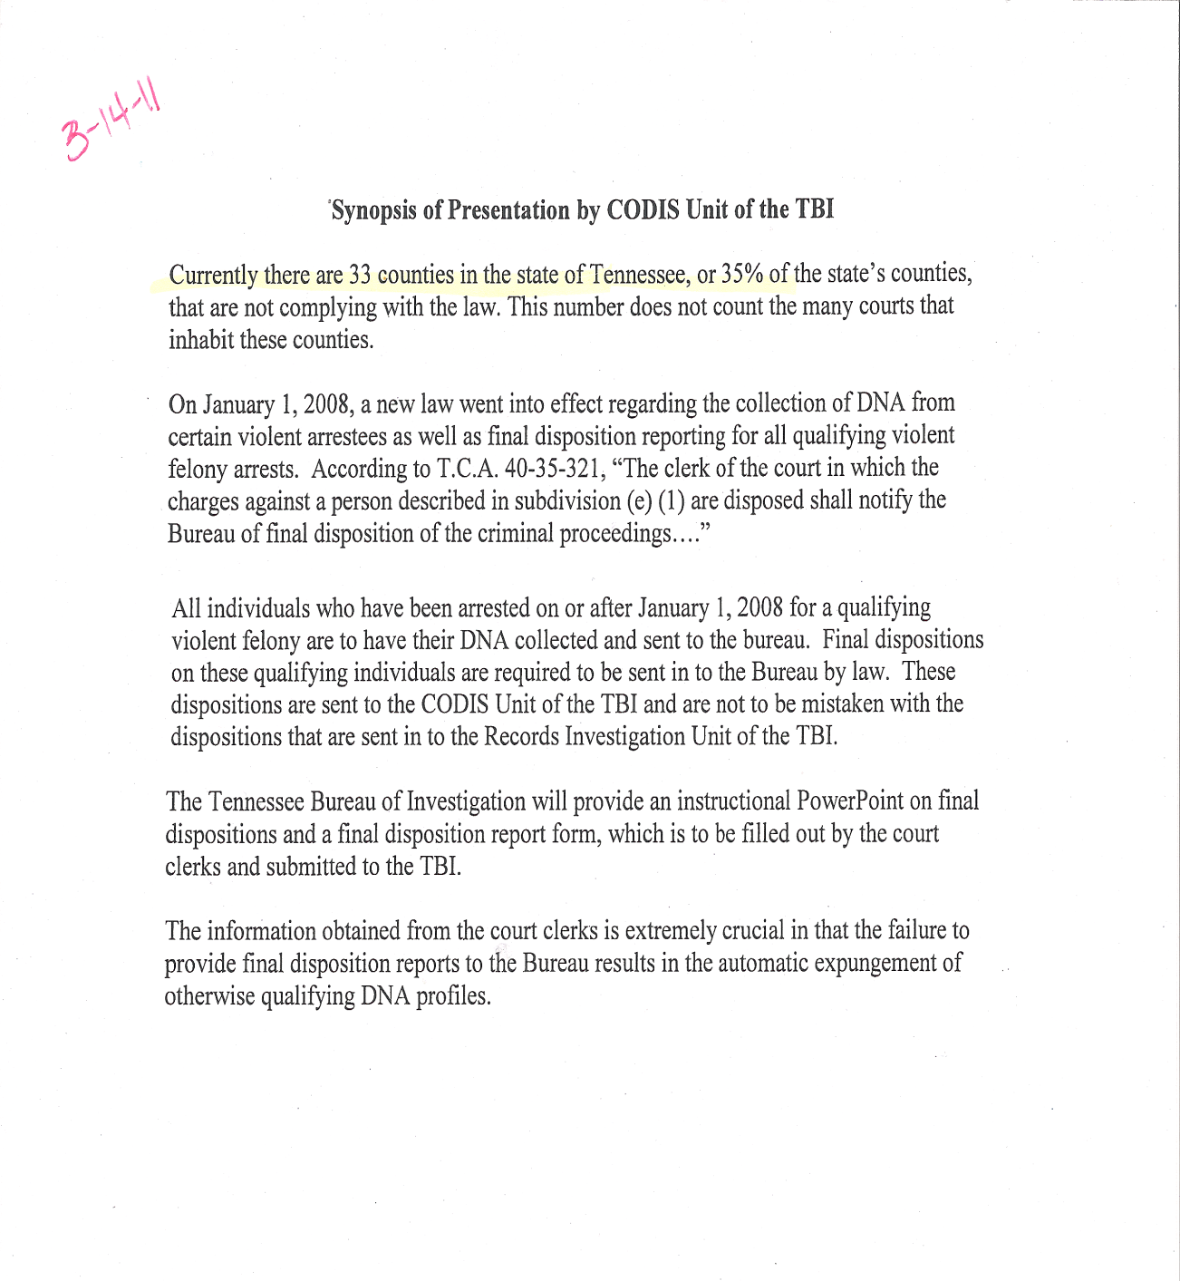

Slide 34
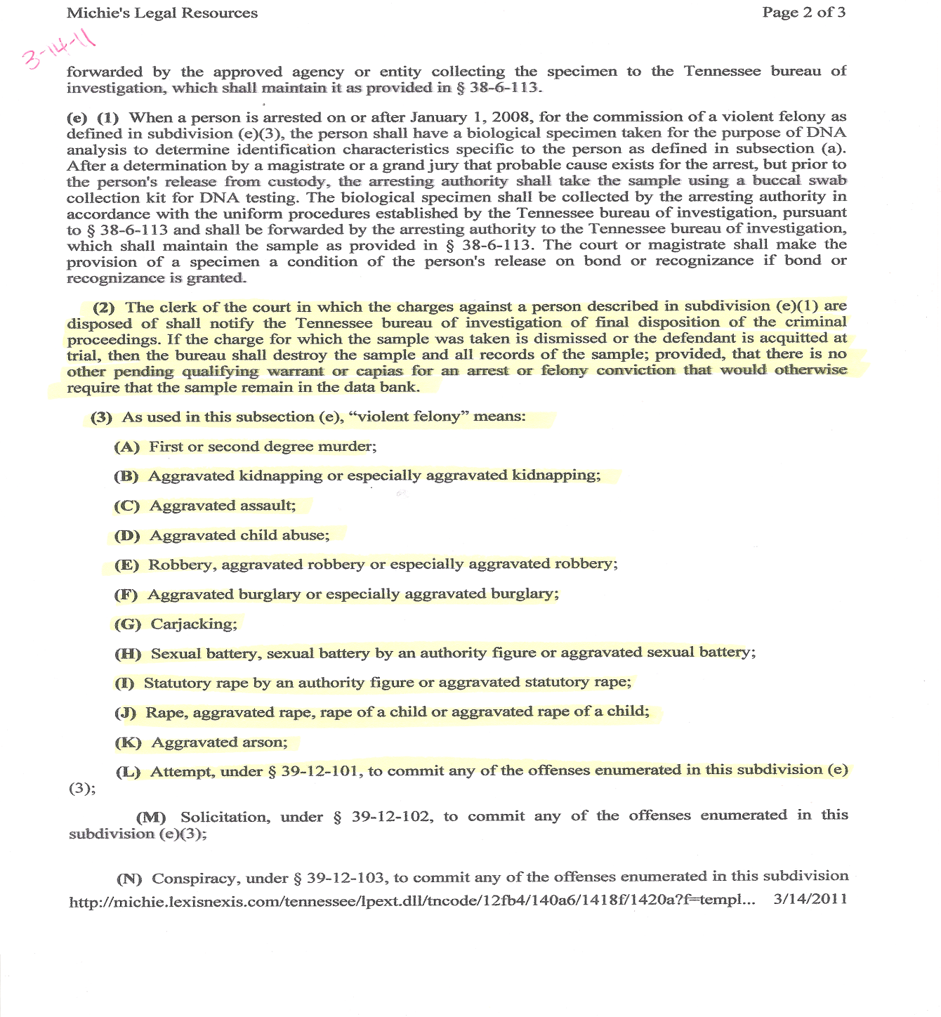

Slide 35
Texting While Driving
Are fine and cost assessed?

Slide 36
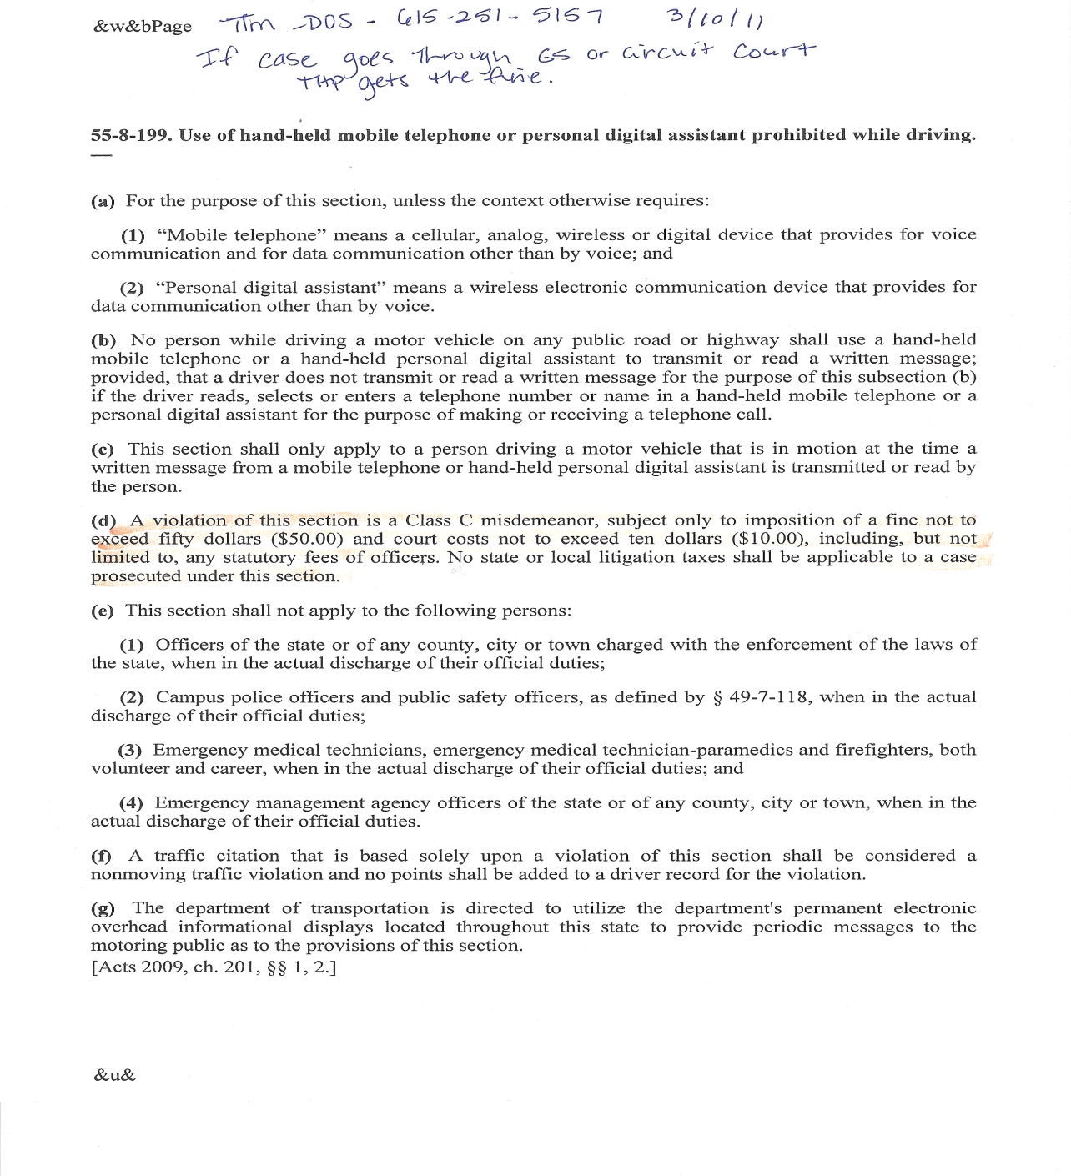

Slide 37
DUI ignition interlock fee
Does the clerk receive a commission?

Slide 38
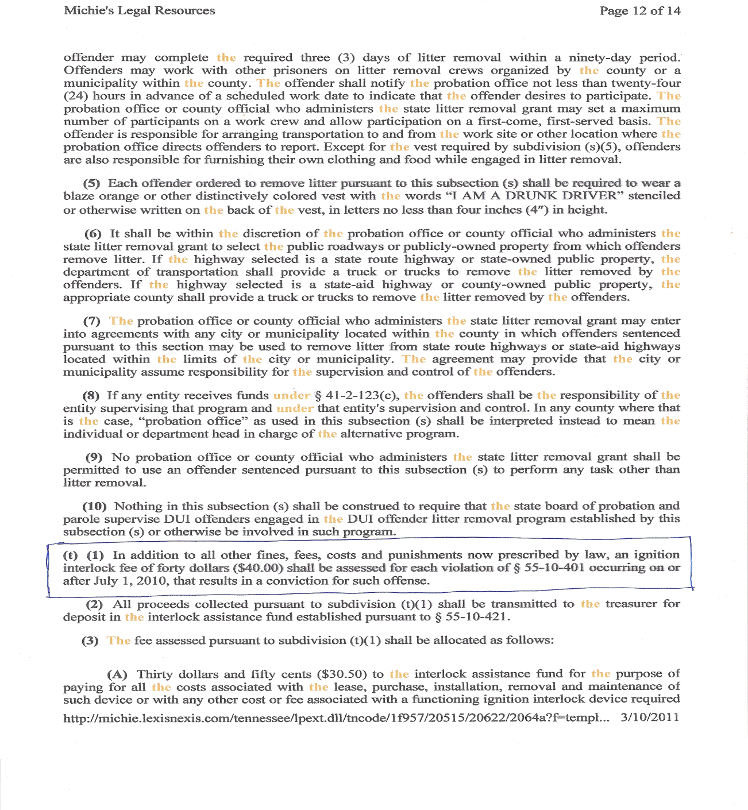

Slide 39
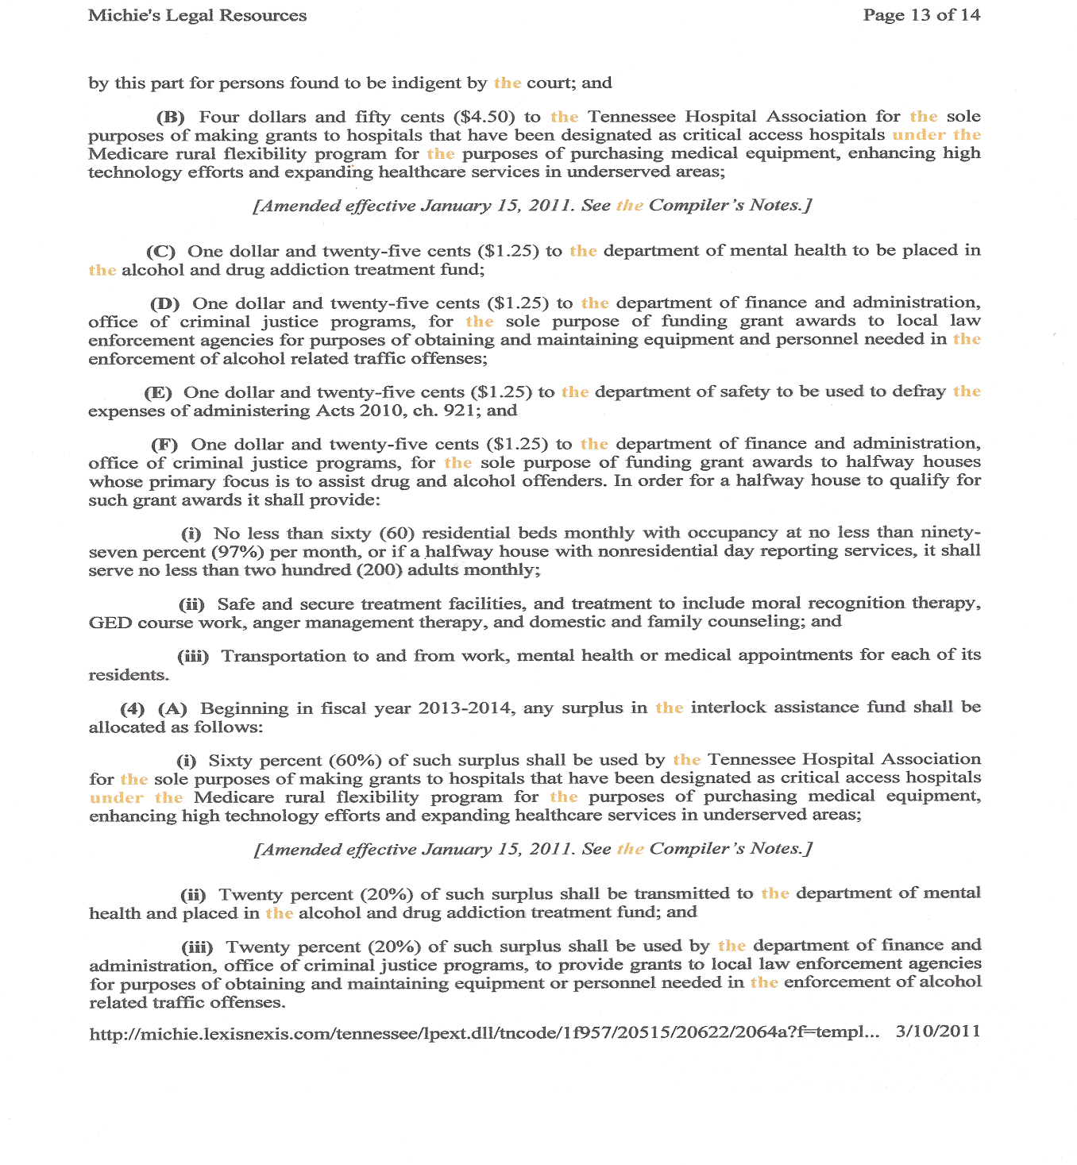

Slide 40
Continuance fee on cases needs to show when you reschedule & not wait until disposed?

Slide 41
Manual filing of TJIS
When should this be done?

Slide 42
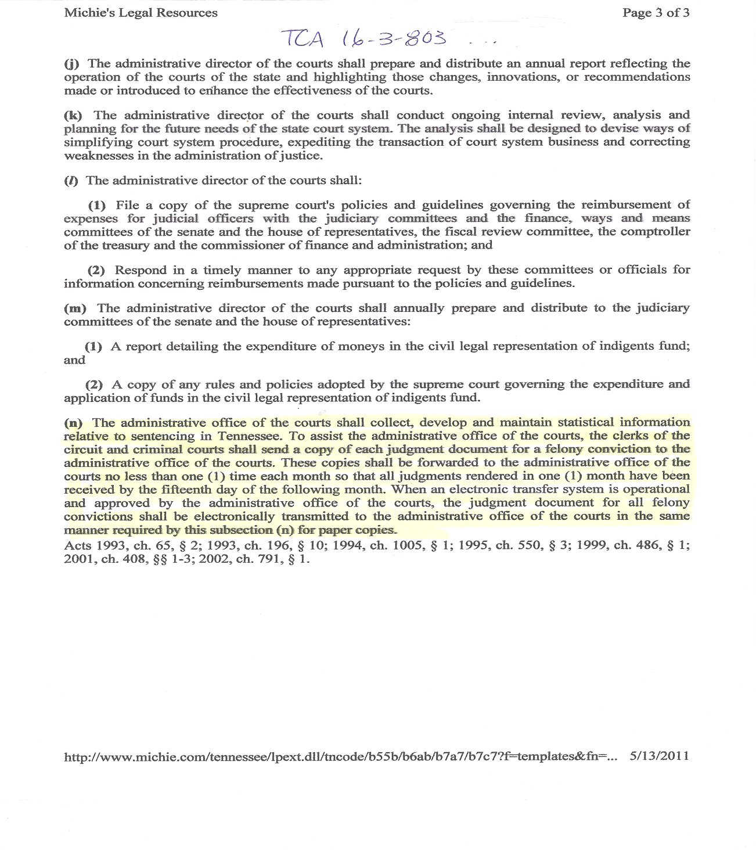

Slide 43
Appeals from municipal courts and/or administrative agencies
Appeals from General Sessions Criminal to Circuit and from General Sessions Civil to Circuit Civil – bonds, paperwork, procedure???

Slide 44
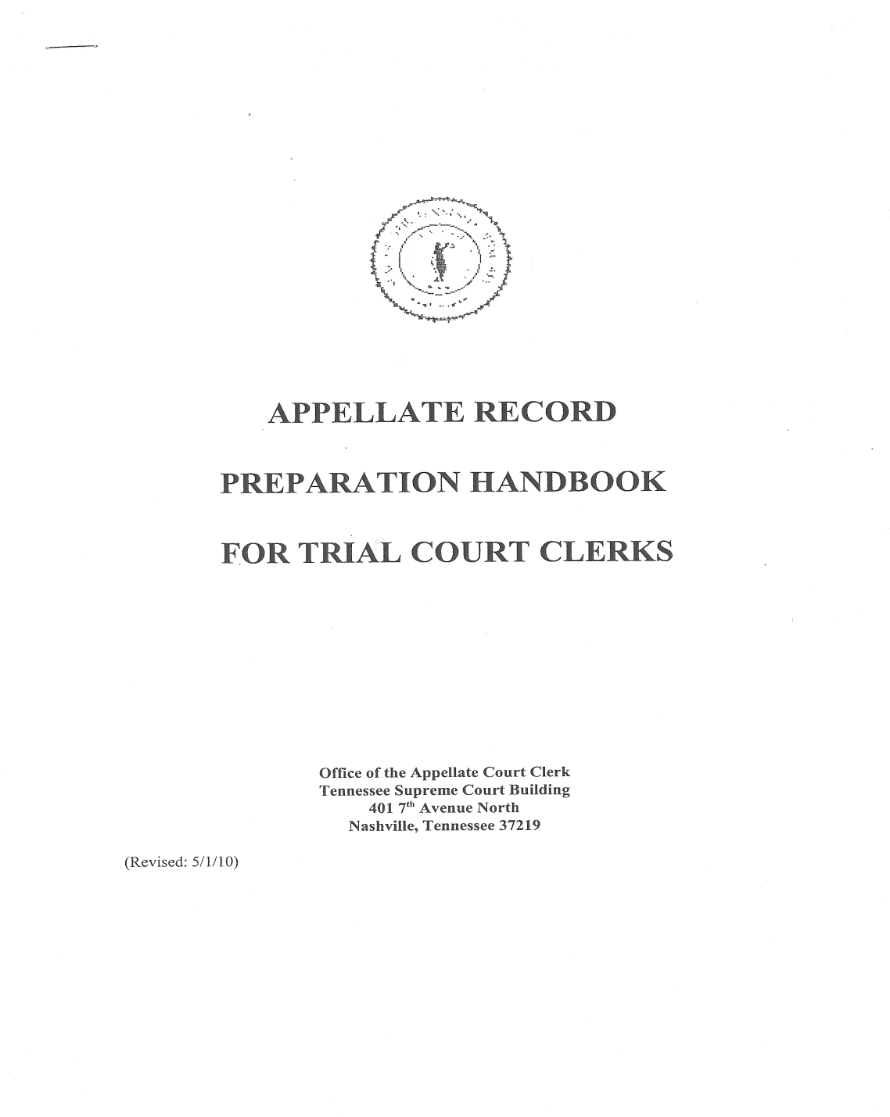

Slide 45
Property Bonds
  Correct procedure

Slide 46
Other fines and cost.

Slide 47
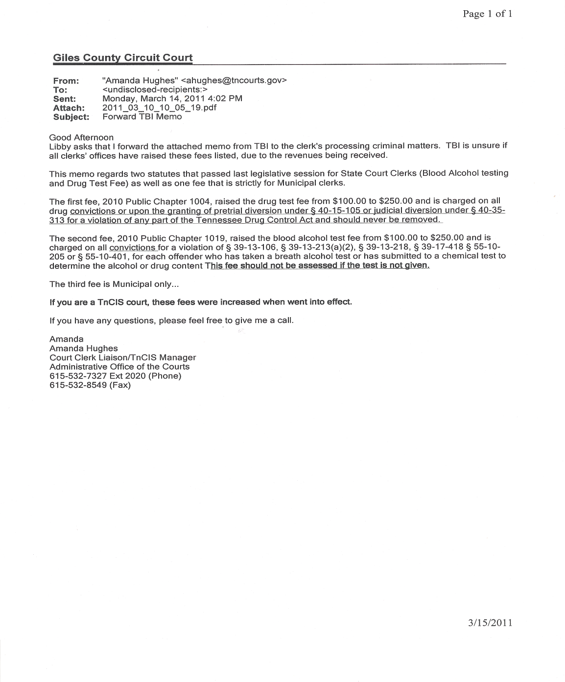

Slide 48
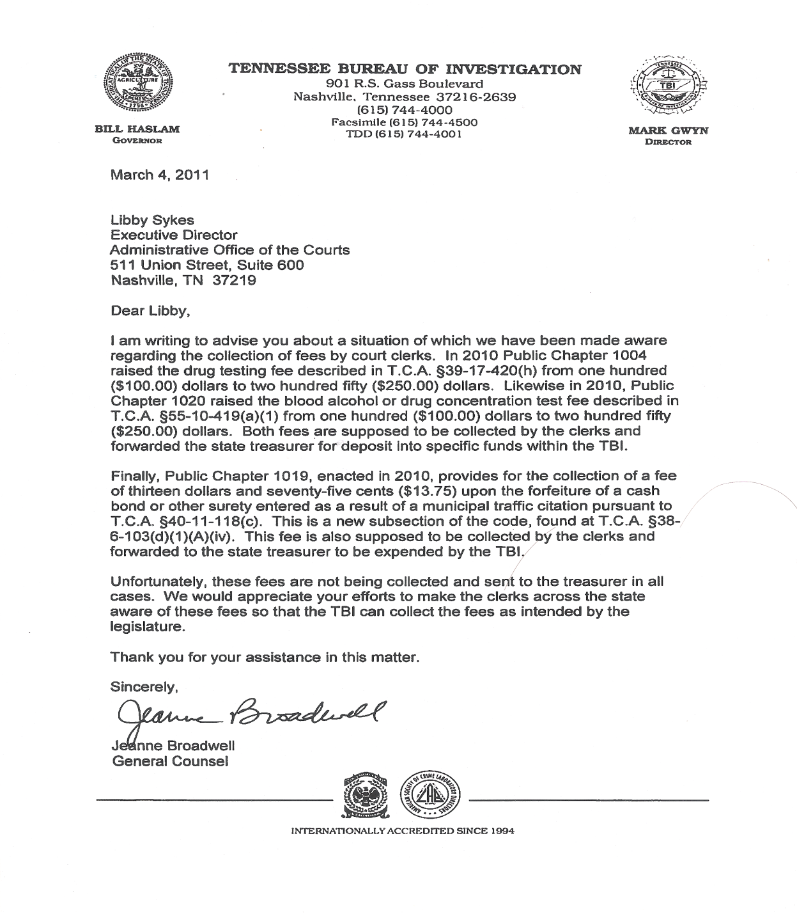

Slide 49
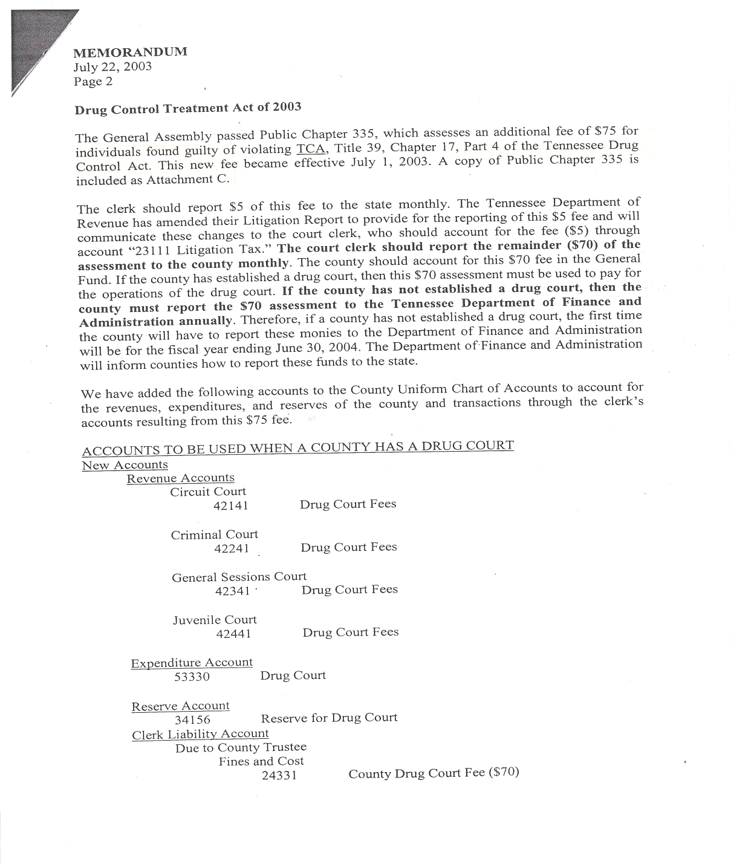

Slide 50
If you postpone a juror for the next term to serve and they don’t show up for jury selection what can you do?

Slide 51
If a military defendant is deployed what action is taken on all outstanding cases?
Code application.

Slide 52
When making copies for the public what must be redacted and how much do you charge for a copy?
Is there a difference in the charge for a copy and a certified copy?

Slide 53
In issuing garnishments, many defendants have more than one debt and the plaintiff’s wish to get their money back. Now we que up the garnishment requests and issue them in order they are requested, sometimes having to wait a year or more.
Is there a better way?

Slide 54
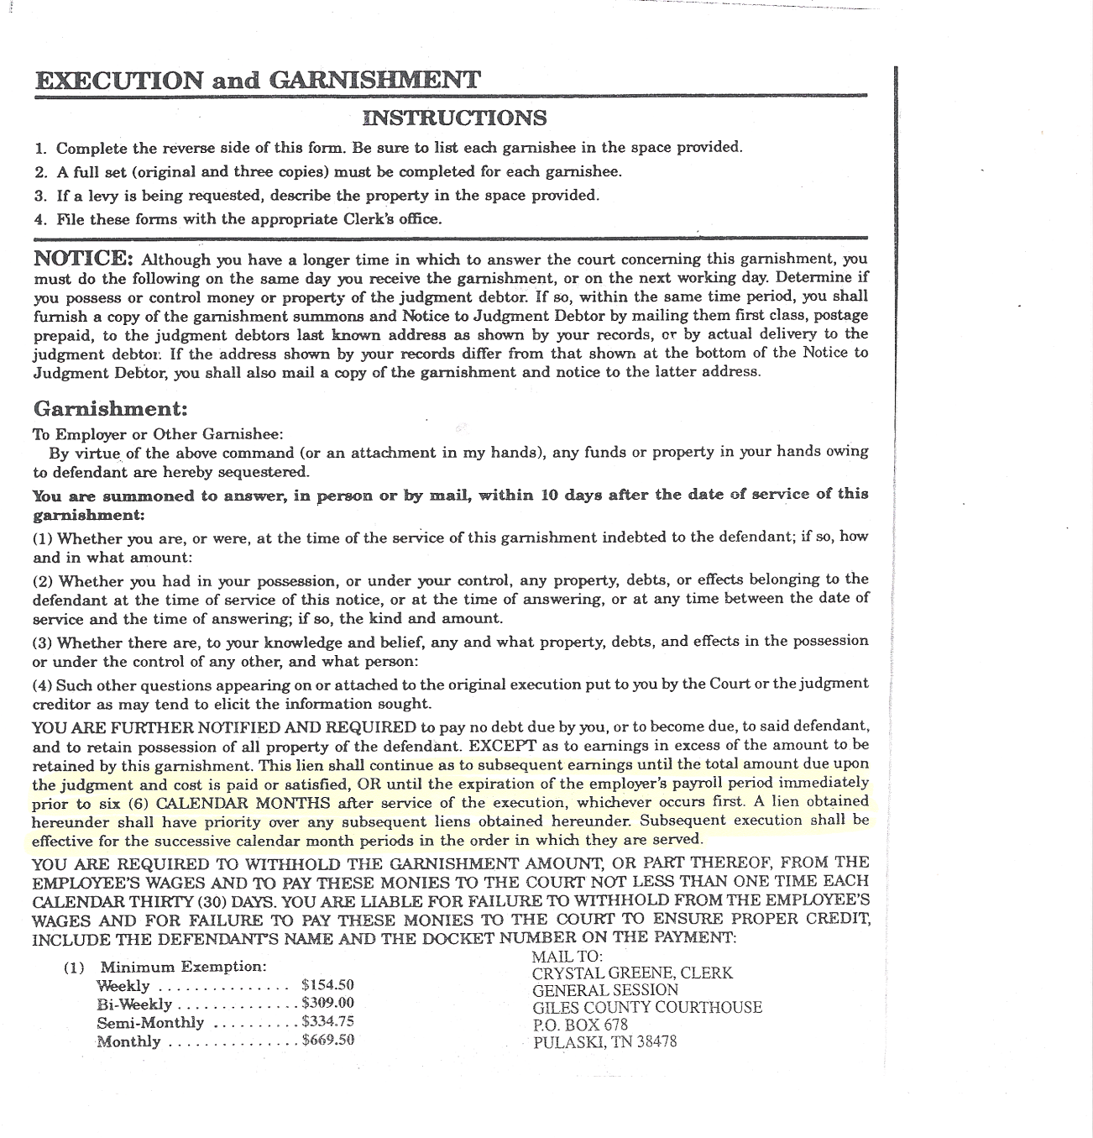

Slide 55
What procedure does one need to “repossess” property immediately, like a car that the defendant has stopped paying for, or is a court date always necessary? And is a bond for the value of the property always necessary?

Slide 56
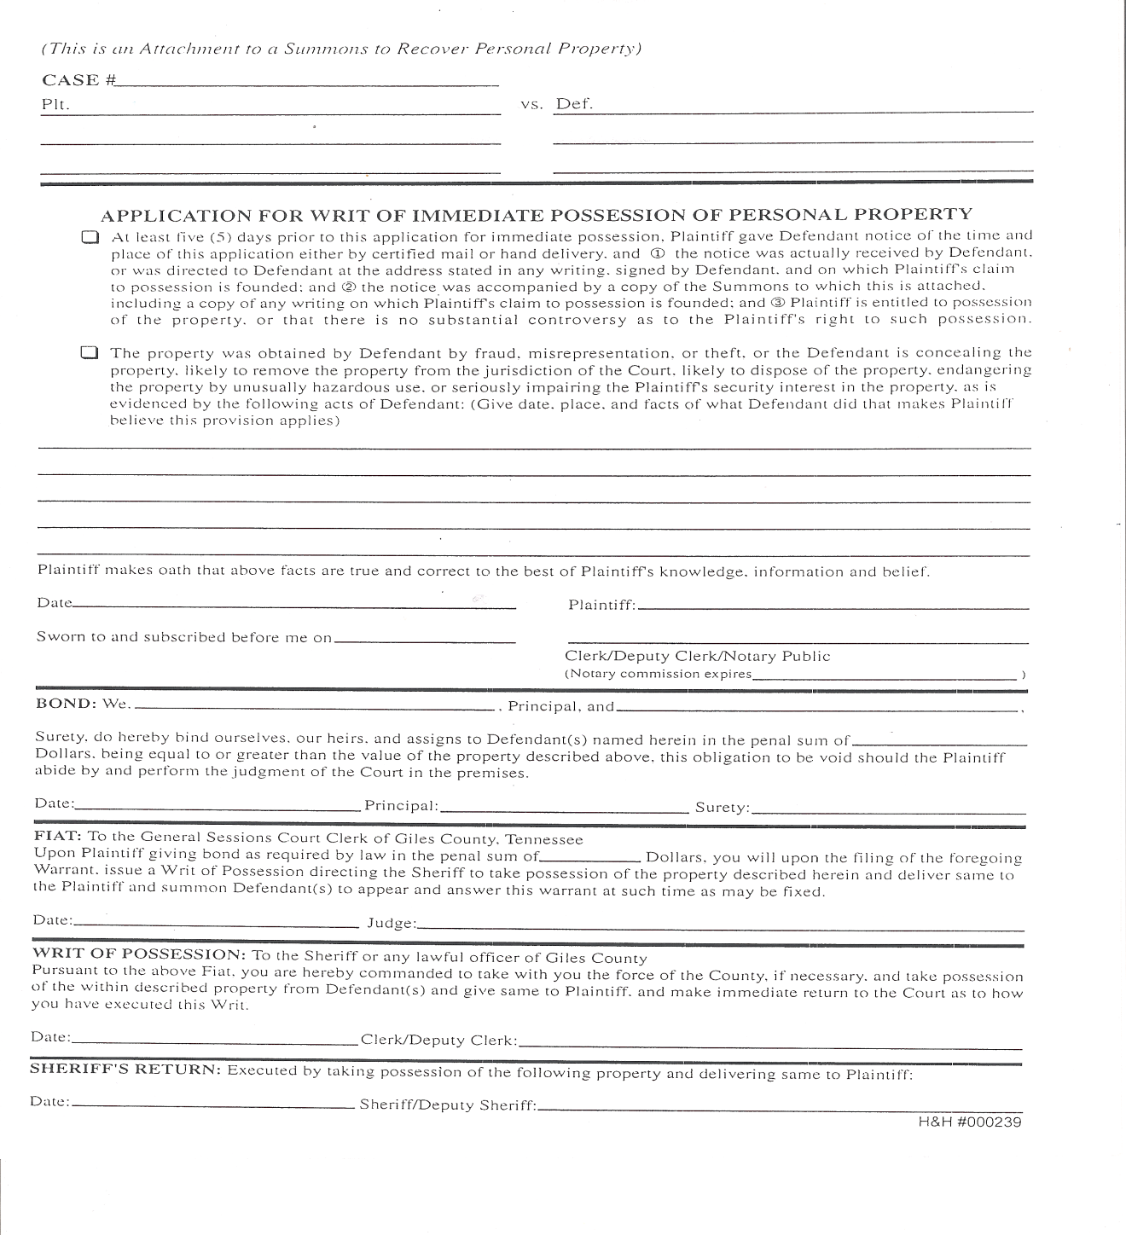

Slide 57
Anything concerning bankruptcy order. How to file the claim? What is our responsibility in civil and criminal Court?

Slide 58
Civil - is it the law to retain
first of ??? for twenty days, must we retain all of ??? twenty days? Or how long? Is there a difference in cash and check payments, credit card payments?

Slide 59
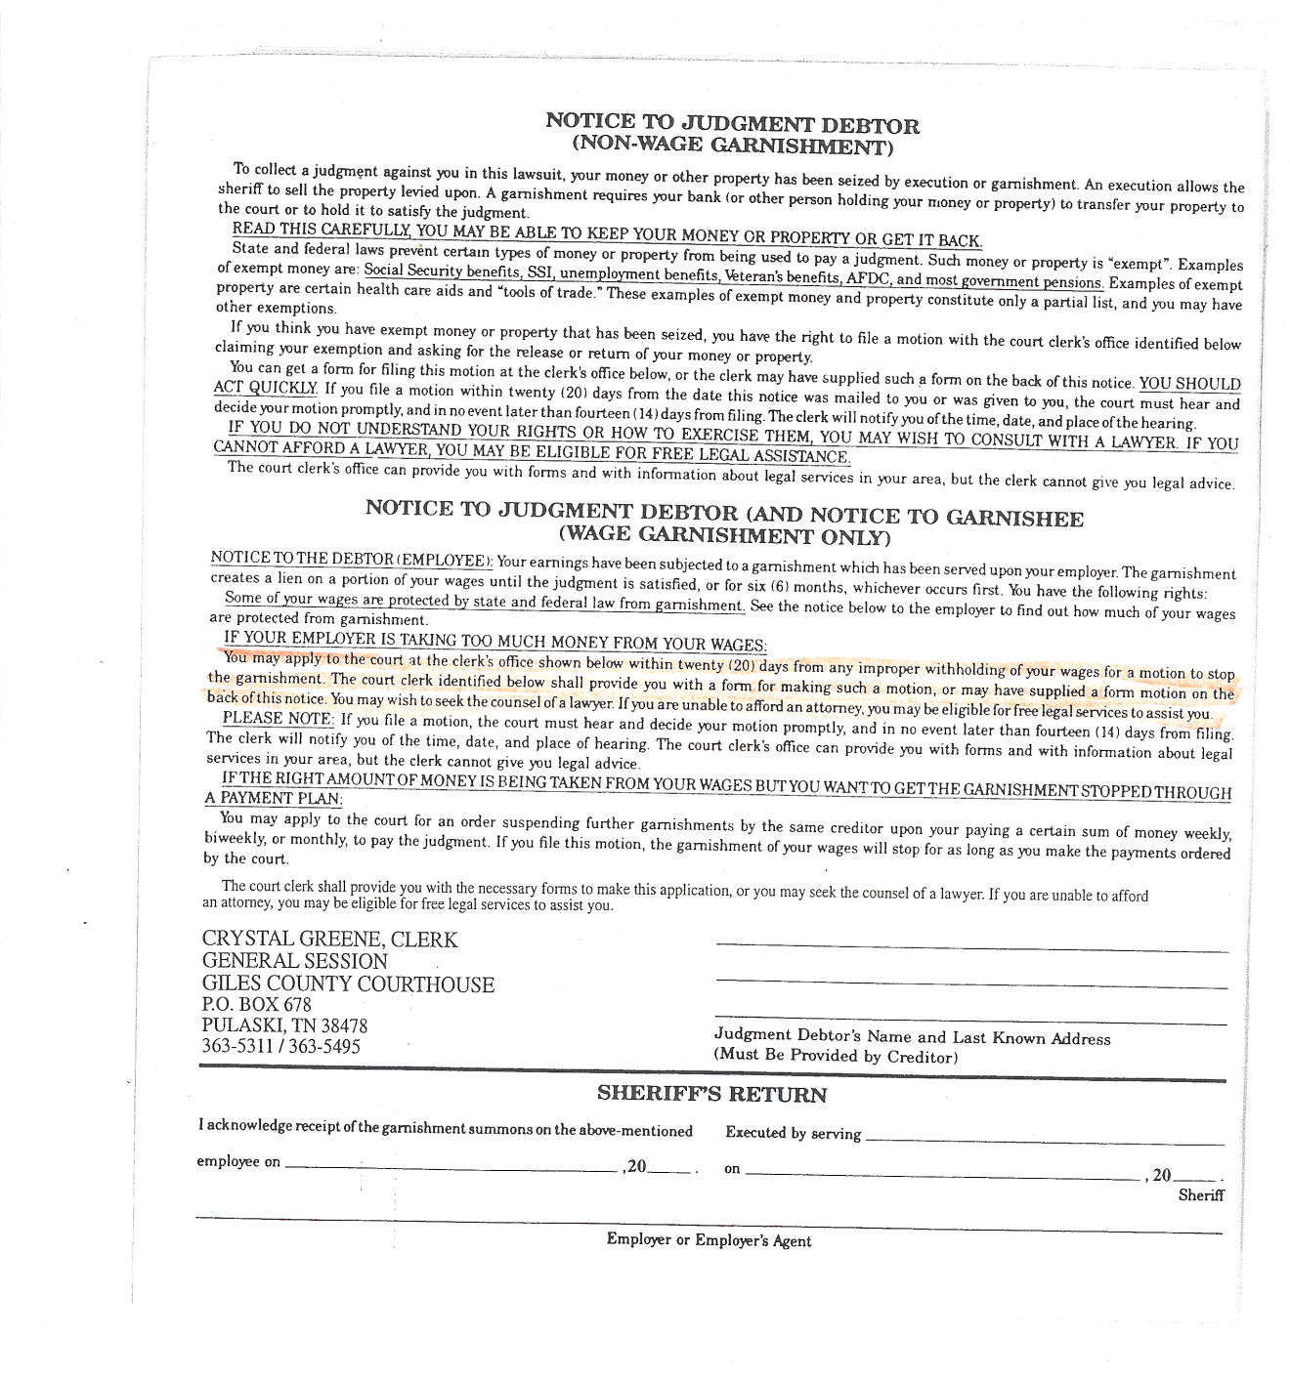

Slide 60
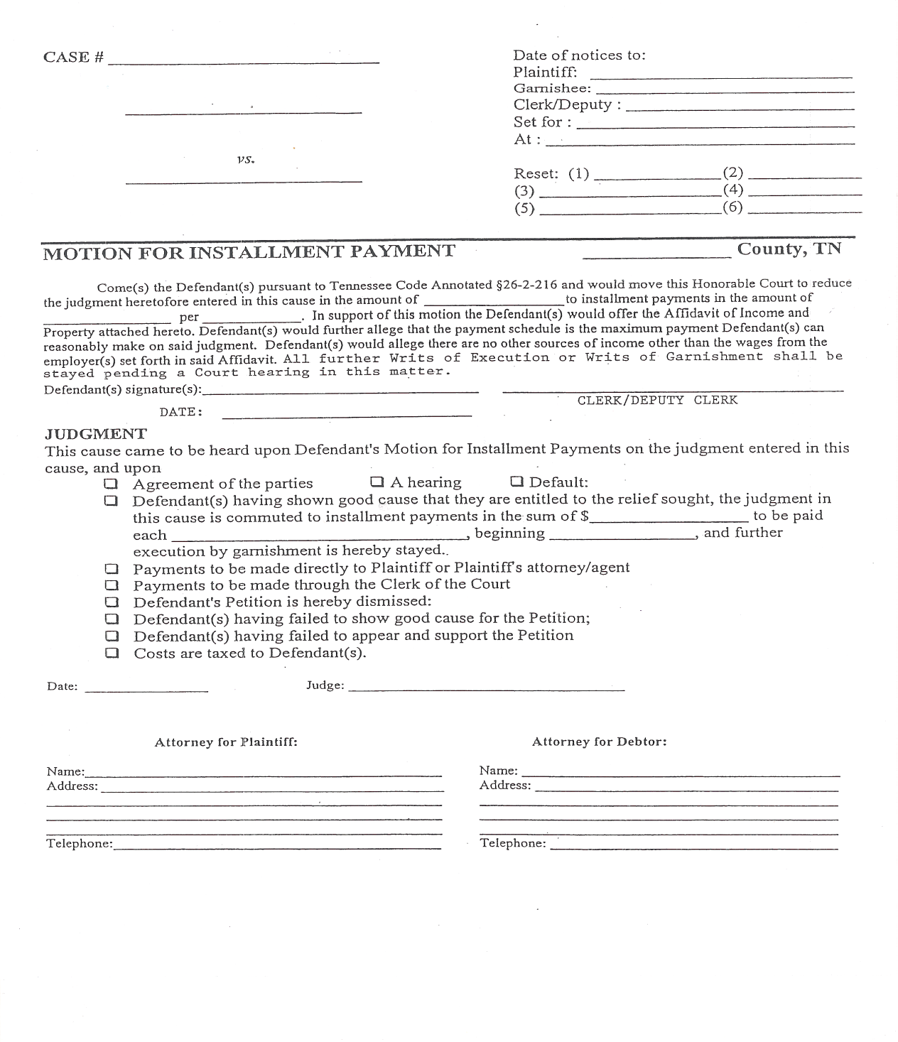

Slide 61
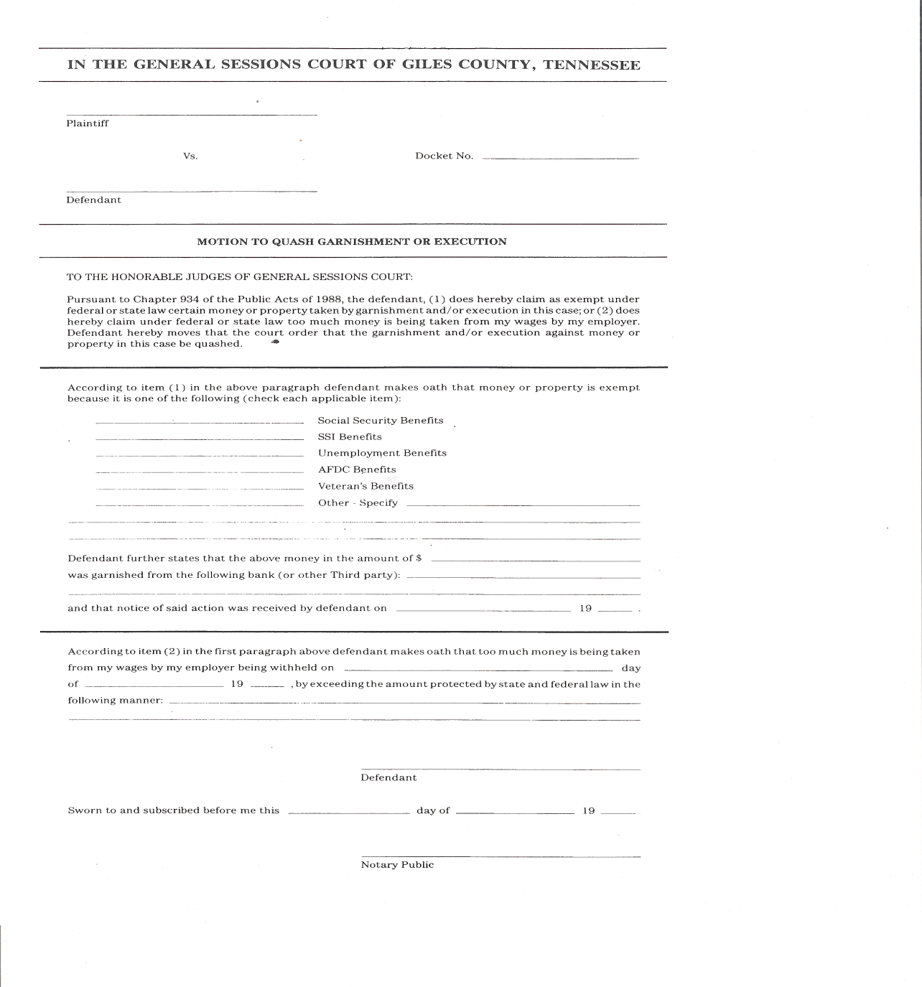

Slide 62
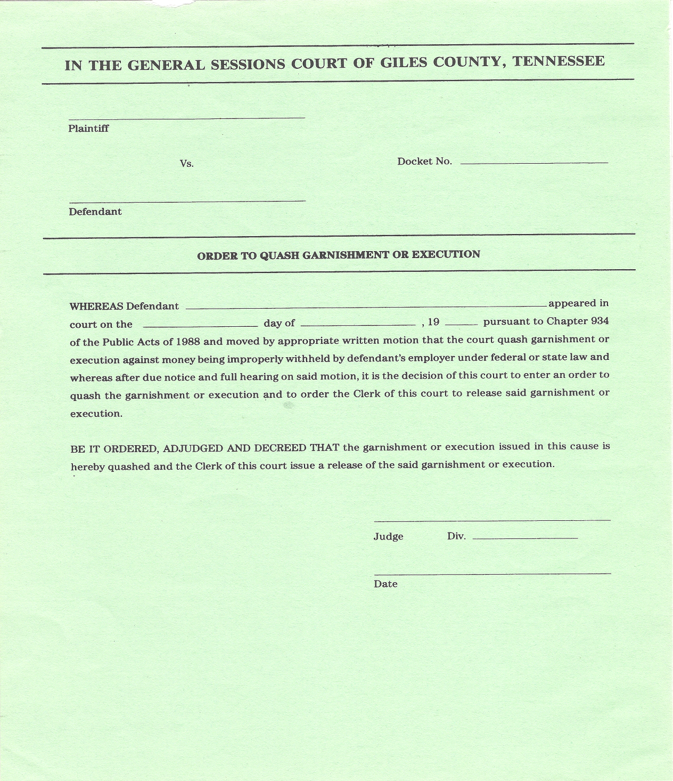

Slide 63
Criminal and General Sessions Criminal
May 19, 2011 – Embassy Suites
Crystal Greene, Mike Forbess,
Lisa Niles, Joy McCroskey

