Slide 1
Immigration Basics
Chay Sengkhounmany, Esq.
February 2015

Slide 2

Who is a U.S. Citizen?
Ryan Gosling
Ryan Gosling is a Canadian citizen born in London, Ontario.
Notes:
Ryan Gosling was born in London, Ontario.

Slide 3

Who is a U.S. Citizen?
Marc Anthony
Singer Marc Anthony performed “God Bless America” at the 2013 MLB All-Star game. Some fans were upset that a “Mexican” was chosen to sing the patriotic song. Marc Anthony was born and raised in New York.
Notes:
Singer Marc Anthony performed “God Bless America” at the 2013 MLB All-Star game. Some fans were upset that a “Mexican” was chosen to sing the patriotic song. Marc Anthony was born and raised in New York.

Slide 4

Who is a U.S. Citizen?
Natalie Portman
She was born Natalie Herslag in Jerusalem, Israel. Her mother is a U.S. citizen and her father is an Israeli citizen. She has dual citizenship from the United States and Israel.
Notes:
She was born Natalie Herslag in Jerusalem, Israel. Her mother is a U.S. citizen and her father is an Israeli citizen. She has dual citizenship from the United States and Israel.

Slide 5
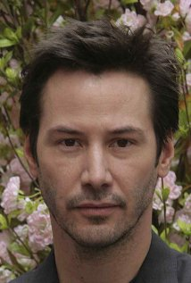
Who is a U.S. Citizen?
Keanu Reeves
Keanu Reeves was born in Beirut, Lebanon in 1964, the son of English-born mother and American-born father. Reeves is a U.S. citizen through his American father and also holds Canadian citizenship by naturalization; he grew up as a Canadian and identifies as such. He is also entitled to British citizenship through his English mother.
Notes:
Keanu Reeves was born in Beirut, Lebanon in 1964, the son of English-born Patricia Taylor, a showgirl, and American-born Samuel Nowlin Reeves, a geologist. Reeves is a U.S. citizen through his American father and also holds Canadian citizenship by naturalization; he grew up as a Canadian and identifies as such.^{[34]} He is also entitled to British citizenship through his English mother.

Slide 6
U.S. Citizens and Non-citizens
USCs can’t be excluded or deported/removed from the United States
All persons who are not U.S. citizens are non-citizens
Non-citizens can be refused admission to or deported from the U.S. Categories include:
  Lawful permanent residents
  Temporary visa holders (diplomats, tourists, students, athletes, performers, temporary workers, etc.)
  Persons in the U.S. by administrative grace, including asylees and refugees
  Persons in the U.S. without authorization

Slide 7
U.S. Citizenship – How Acquired
By birth in the U. S.
By naturalization
Automatically acquired by statute
  At birth - by birth abroad to U.S. parent or parents
  Derivative, during childhood – upon naturalization of parent(s)

Slide 8
A simple way to take measure of a country is to look at how many want in. And how many want out.
– Tony Blair

Slide 9
U.S. Population
314,159,265
  2:29 p.m. on Tuesday, August 14, 2012
  Pi (π) times 100 million
  U.S. Census Bureau's Population Clock
Notes:
1 birth every 8 seconds
One death every 13 seconds
One international migrant every 40 seconds
Net gain of one person every 15 seconds

Slide 10
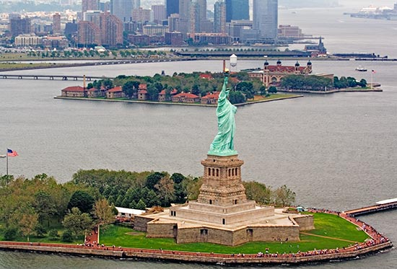
Nation of immigrants
Statue of Liberty and Ellis Island
Notes:
1840’s -1920’s - Largest scale immigration, driven by Irish potato famine, German depression and industrial revolution
During a span of 6 decades, Ellis Island welcomed 71% of all immigrants
Nearly 25% of all Americans can trace their ancestry through Ellis Island

Slide 11
Migration Numbers
1905
  1,026,499 Legal Permanent Residents
2003
  703,542 Legal Permanent Residents
  180,500,000 Nonimmigrant admissions
2011
  1,062,040 Legal Permanent Residents
  158,500,000 Nonimmigrant admissions

Slide 12
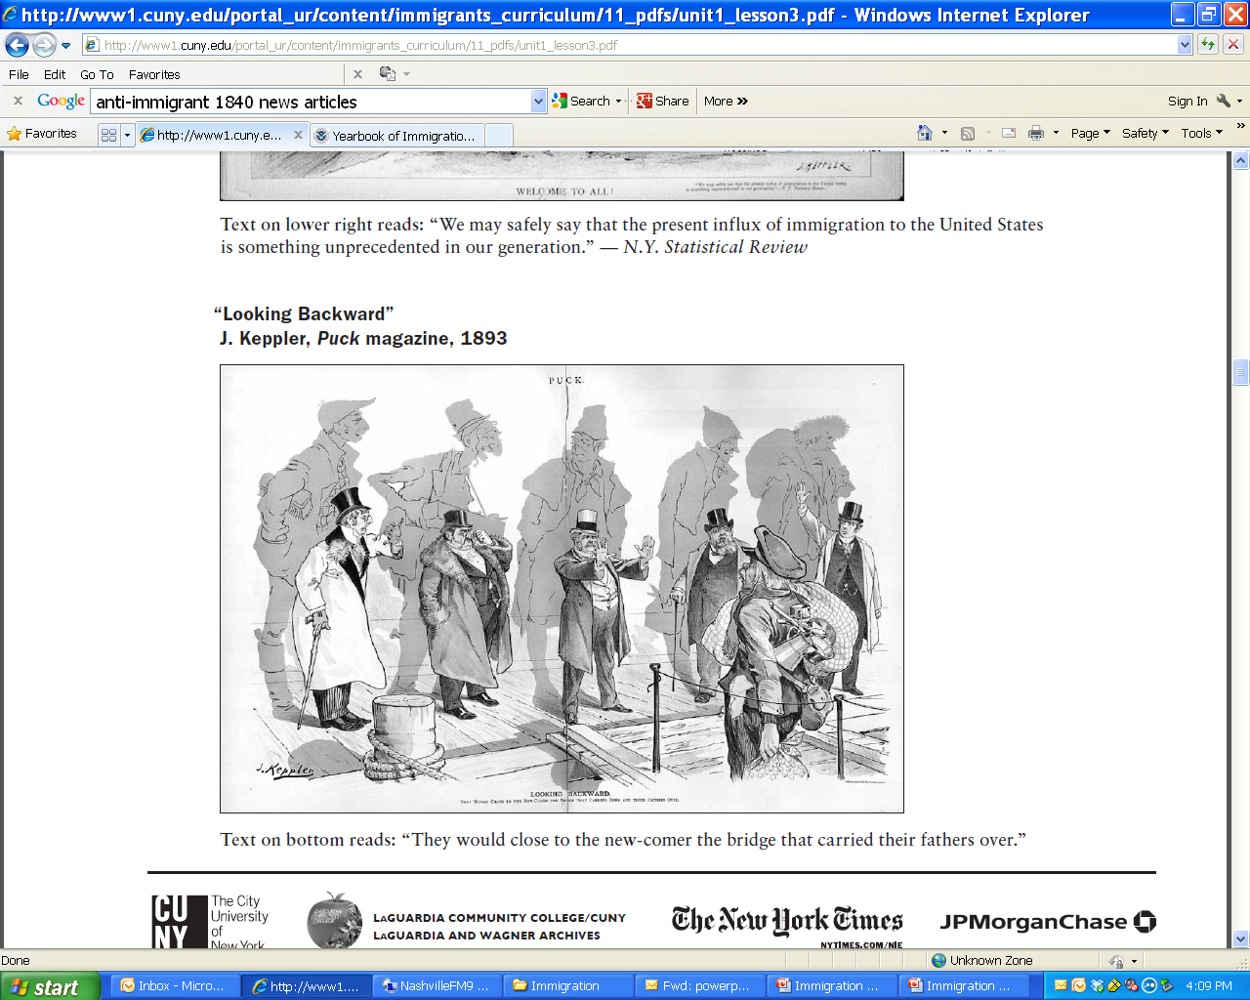
Nation of Immigrants
Notes:
But each new immigrant group tends to “pull up the bridge” behind them after they have settled
1830’s and 1840’s, Irish immigration
It was not uncommon for writers, orators, and politicians of the day to look upon the Irish as having the following universal traits: incapable of overcoming poverty, incurably lazy and immoral, uneducable, completely ignorant, and superstitious (largely because of their devotion to the Catholic faith). There were fears that the Irish, who were immigrating in large numbers and who seemed, to the British-Americans, to have an alarmingly high birth-rate, would take over the country and degrade its political, commercial, educational, and religious institutions. Journalists commonly used the epithets “violent,” “drunken,” “ape-like,” “wife-beaters,” and “anarchists” to describe the Irish.
2001
Anti-immigration advocates feel newcomers lower wages, increase unemployment, pollution, traffic and crime, and strain hospitals, parks and energy resources.

Slide 13
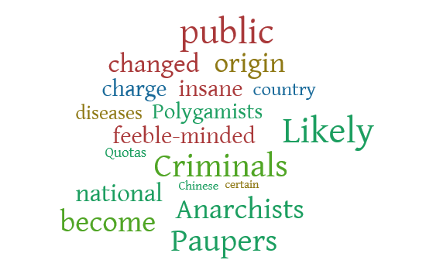
Excluding undeSIrables
Notes:
Polygamists
Anarchists
The feeble-minded
The insane
Those with certain diseases
Paupers
Criminals
Likely to become a public charge
Chinese (1882)
Quotas on certain national origin (changed to country quotas)

Slide 14
Grounds of Inadmissibility
Health condition that poses a threat to others, e.g. TB
Criminal reasons
National security reasons
Foreign policy reasons
Public charge
Present without admission or parole
Fraud or misrepresentation
False claim to U.S. citizenship
Smugglers

Slide 15
Grounds of Inadmissibility
Failure to possess valid visa or entry document
Failure to possess passport that is valid for a minimum of six months
Previously removed from the United States, inadmissible for ten years
Unlawfully present for more than 180 days and then departed from the United States, inadmissible for three years
Unlawfully present for more than a year or ordered removed, inadmissible for ten years
Practicing polygamists
International child abductors

Slide 16
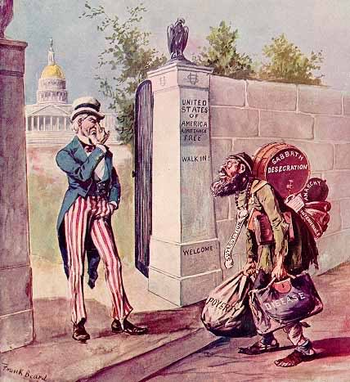
Notes:
Polygamists
Anarchists
The feeble-minded
The insane
Those with certain diseases
Paupers
Criminals
Likely to become a public charge
Chinese (1882)
Quotas on certain national origin (changed to country quotas)

Slide 17

Sources of Laws
“establish an uniform Rule of Naturalization”
Legislative
Immigration & Nationality Act
Judicial
Cases
Executive
Regulations
BIA Decisions
Agency Policies & Guidance
Executive Orders
Notes:
U.S. Constitution Art. 1, § 8, clause 4: Congress shall have the power to “establish an uniform Rule of Naturalization”

Slide 18

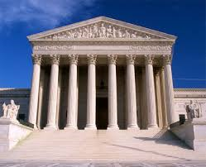
Key Players
Appeals go to the Federal Court of Appeals or U.S. District Court
USCIS
ICE
CBP
EOIR
BIA
Immigration Court
OIL
U.S. Embassies
U.S. Consulates
Notes:
Additionally, the Office of Refugee Resettlement within the Department of Health and Human Services oversees the placement of refugees and unaccompanied children. The mission and purpose of the ORR is to assist in the relocation process and provide needed services to these individuals

Slide 19
Definitions
Noncitizen
US Citizen
Immigrant
Nonimmigrant
Lawful Permanent Resident
Undocumented
Naturalization
Visa
Inadmissibility
Removal
Removal Proceedings (Formerly Called Exclusion and Deportation)
Notes:
US citizens cannot be removed unless a federal court takes away their citizenship because they obtained citizenship by fraud or other illegal means. Citizens don’t need DHS authorization to work and may file petitions for lawful permanent residence for their spouses, parents, sons and daughters (both married and unmarried), and brothers and sisters. Citizens are eligible for all federal, state, and local public benefits, whether they were born in the United States or otherwise obtained citizenship. Most US citizens will either have a birth certificate showing they were born in the United States or a certificate of naturalization.

Slide 20

The Visa Alphabet
A visas: Ambassadors and Diplomats
B visas: Visitors for Business or Pleasure
E visas: Traders and Investors
F visas: Students
G visas: International Orgs and NATO
H visas: Temporary Employees
I visas: Journalists and Media Workers
J visas: Exchange Visitors
K visas: Fiance(e)s
L visas: Intercompany Transferees
M visas: Non-academic Students
O visas: Extraordinary Ability “Superstars”
Q visas: International Cultural Exchange Visitor
R visas: Religious Workers
S visas: Informant/“Snitch” visas
T visas: Trafficking victims
U visas: Crime victims
VAWA: Domestic Violence victims.

Slide 21

Visa waiver Program
Citizens of 38 countries (as of 2014) do not need visa if
  Visit the U.S. for tourism & certain business activities for
  no more than 90 day
Trade-off
  Extensions of stay are available only in the most extreme circumstances
  Waives the right to a removal hearing before an Immigration Court
  If had a U.S. visa before or previously traveled to the United States under the VWP, must have complied with the conditions of previous admission
  Must not have previously been found ineligible for a U.S. visa
Apply through the Electronic System for Travel Authorization (ESTA) prior to boarding a U.S. bound air or sea carrier
Notes:
A Andorra, Australia, Austria
B Belgium, Brunei
C Chile, Czech Republic
D Denmark
E Estonia
F Finland, France
G Germany, Greece
H Hungary,
I Iceland, Ireland, Italy
J Japan
L Latvia, Liechtenstein, Lithuania, Luxembourg
M Malta, Monaco
N Netherlands, New Zealand, Norway
P Portugal
S San Marino ,Singapore, Slovakia, Slovenia ,South Korea, Spain, Sweden, Switzerland
T Taiwan
U United Kingdom

Slide 22
TWO-Step Process of Getting Green card
Step 1 – Qualifying Relationship or Circumstances | Step 2 – Applying for green card (Legal Permanent Residence)
Petition to show you have a qualifying relationship | Must meet the requirements to get a green card
Get priority date | Adjustment of Status (Inside U.S.)
 | Consular Processing (Outside U.S.)
Many undocumented people often have a qualifying relationship and are able to get an approval for this step but cannot get approval for step 2 | Must show admissible Must not have Committed certain immigration violations Committed certain crimes Certain contagious diseases
 | Problem of 3 or 10 year bar
Notes:
Getting permission to live in the United States legally is a two-step process:
Step One -- You must show you have a qualifying relationship, such as a family member (family sponsorship), employer or that you are under a special group such as: a victim of trafficking, crime or domestic violence; being a refugee; seeking political asylum; or diversity lottery.
Many people who are undocumented often have a qualifying relationship and are able to get an approval for this step.
Family Sponsorship – You must have a qualifying relative who is willing to sponsor you. The qualifying relative, who is an adult U.S. citizen, can sponsor their spouse, parent, child or sibling. A Lawful Permanent Resident can sponsor their spouse and unmarried children.
Employment-based immigration – Immigration law allows about 140,000 employment visas to be admitted to the United States to work. Most of these immigrants are highly skilled professionals. A worker usually needs an employer to petition on his or her behalf. Some workers – priority workers, investors, and certain special immigrants may petition on their own.
Step Two – You must meet the requirements to get a green card. Some of these requirements mean that you must not have:
Committed certain immigration violations
Committed certain crimes
Certain contagious diseases
These are just a few of the requirements. There are many more. There are a few exceptions to the requirements, but they may be difficult and risky prove. You should consult with an experienced immigration attorney or BIA accredited advocate when you have questions about your immigration status.
Many people have immigration violations, such as entering the United Sates without permission. People, who came to the United States without permission, usually cannot apply for a green card in the United States. They must go to their home country to apply and also request a waiver which are often difficult to obtain.
Depending on how long they have been in the United States unlawfully, they may not be allowed back into the United Sates for several years once they leave, even if they have a qualifying relationship.
Disabled or sick - Having a disability or illness does NOT make you eligible for lawful residency. In fact, it may be a problem when USCIS (the immigration agency) looks to see if you are likely to become a “public charge.” A “public charge” is someone who depends on the government for public cash assistance or other government benefits.

Slide 23
Primary Path to LPR status
Family-based Immigration
Employment-based Immigration
Refugee/Asylee
Special Legislation
Diversity Lottery
Other highly specialized visas
Religious workers, investors, individuals with extraordinary abilities, etc.

Slide 24
Special Options
Special Immigrant Juveniles
Conditional Residence Waiver
VAWA Self-petitioning & Cancellation
U & T Visas
Self-petitioning for parents of US citizens

Slide 25
Immigration Enforcement
Only enough resources to remove 400,000 people per year (438,000 removed in 2013)
Removal Priorities
  Threats to national security, border security, and public safety
  Misdemeanants and new immigration violators
  Those who have been issued a final order of removal2 on or after January 1, 2014
Prosecutorial Discretion and Deferred Action Status for Childhood Arrivals (DACA)

Slide 26
Types of Removal Proceedings
Exclusion/Deportation –
  Proceedings commenced before April 1, 1997 (Order to Show Cause)
Removal -
  ALL Proceedings commenced after April 1, 1997
Expedited Removal –
  “Arriving aliens” subject to expedited removal (port of entry or by sea) and Undocumented Immigrants w/i 100 Miles of a U.S. Land Border.
  No hearing before an Immigration Judge
  Still entitled to credible fear interview or “reasonable fear” if previously removed. No Appeal, 5 year ban on return.
Reinstatement of Removal – similar to expedited removal but those who have reentered illegally after having been removed under a prior order of deportation, exclusion, or removal.

Slide 27
Rights of Detained Noncitizens
Speak to an unappointed attorney
Hearing with Immigration Judge
Unappointed attorney at hearing and interview
Request release from detention
Interpreter at Merits Hearing

Slide 28

How Do you End up in proceedings
Detained at the Border by CBP
Due to Criminal Prosecution
  ICE Detainers, 287(g), Secure Communities
Through ICE Raids (home & workplace)
Through USCIS applications (Biometrics)
Absconder List/Fugitive Operations

Slide 29
Detention
If person (over 18) is detained check: https://locator.ice.gov/odls/homePage.do
Detainees are often moved
Bond: DHS/ICE can set bond
  Request a bond hearing/bond redetermination hearing in front of an immigration judge who can order person’s release on payment of the bond or lower the bond amount. Bonds are set at a minimum of $1500.
Immigration Bondsman
Mandatory Detention –
  Arriving aliens are ineligible for bond
  For LPR: 2 CIMTs, 1 CIMT w/1yr sentence within 5 years of admission, Agg Fel, Controlled substance offense, firearms offense.
  For EWI: 1 CIMT (subject to petty offense exception), Controlled substance offense, drug trafficking offense, 2 or + offenses with aggregate of 5 yrs sentence, Prostitution, Domestic violation or violation of protection order

Slide 30

Immigration Court
Executive Office of Immigration Review (EOIR)
60 Courts including Hawaii, Puerto Rico, & Mariana Islands
Notice to Appear – filing of NTA vests jurisdiction with the Immigration Court
  Review NTA for errors
  Mentally incompetent and minors under the age of 14, NTA served on near relative, guardian, or friend
  Limited Rules of Evidence

Slide 31
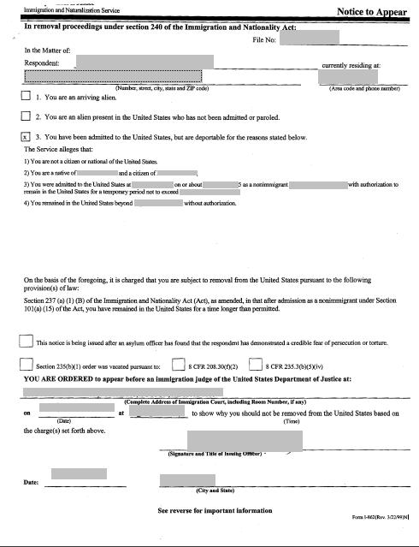
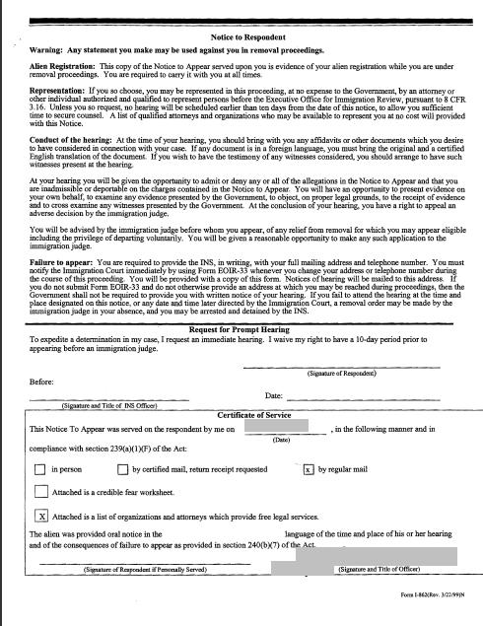

Slide 32
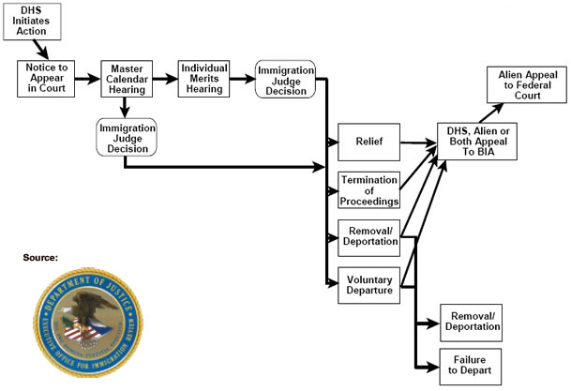
Immigration Court Process

Slide 33
Removability
INA § 237
  Clear and convincing evidence that respondent is removable – Govt’s burden
  Motion to Terminate – If a motion to terminate is granted, dismissal of the matter is generally without prejudice and the agency may file the same charges at a later time

Slide 34
Inadmissibility
Based in INA § 212
  Govt’s burden to prove alienage (non-citizenship),
  Burden shifts to the respondent
    Clearly and beyond doubt entitled to be admitted and is not inadmissible
  May include LPRs who are classified as applicants for admission
Notes:
May include LPRs who are classified as applicants for admission (those who have abandoned their status, engagement in illegal activity after departing the US, departing while in removal proceedings, or committed an offense listed in 212(a)(2) or entry without inspection

Slide 35
Crimes
Grounds of inadmissibility and removability
Effect good moral character
Can trigger mandatory detention
Aggravated felonies
  Super-penalties
  Bar to most forms of immigration relief
  20 year federal prison term for illegal reentry
  Possible deportation without a removal hearing

Slide 36
Conviction - INA § 101(a)(48)(A)
“A formal judgment of guilt of the alien entered by a court OR,
If adjudication of guilt has been withheld,
  (1) Where:
    a judge/jury has found the alien guilty or
    the alien has entered a plea of guilty or
    nolo contendere or
    has admitted sufficient facts to warrant a finding of guilt, AND
  (ii) the judge has ordered some form of punishment, penalty, or restraint on the alien’s liberty to be impose
Juvenile adjudications are NOT convictions
Pre-trial diversions and deferred prosecution are generally not conviction for immigration purposes
Notes:
Can include Alford pleas
Punishment can include: probation, house arrest, community service, anger management, drug/substance abuse programs, fines, restitution
Pre-plea diversions and deferred prosecution however will typically not result in a conviction for immigration purposes

Slide 37
Crimes Involving Moral Turpitude (CIMT)
Crimes that are “inherently base, vile, or depraved, and contrary to the accepted rules of morality and the duties owed between persons or to society in general
Crimes that are CIMT
  An intent to steal or defraud is an element;
  Bodily harm is caused or threatened, by an intentional or willful act
  Serious bodily harm is caused or threatened by a reckless act
  Sex offenses
Petty Offense Exception – one conviction with imprisonment term of less than 6 months and carries a maximum possible sentence of one year or less
“Youthful Offender” Exception: crimes committed under the age of 18 and has been more than 5 years since commission and release from confinement

Slide 38
Aggravated felonies
Drug crimes, any offenses relating to drug or firearms trafficking, including possession with intent to distribute
Rape
Sexual Abuse of a Minor or child pornography
Murder or attempted murder
Felony alien smuggling (unless it was your first and you were helping only your husband, wife, child or parent)
Fraud or income tax evasion, if the victim lost over $10,000
Money laundering (over $10,000)

Slide 39
Aggravated Felonies
Sentence of 1 year or more of jail time (it does not matter if your sentence was suspended and you never spent any time in jail):
  Theft (including receipt of stolen property)
  Burglary
  A crime of violence (including anything with a risk that force will be used against a person or property, even if no force was used)
  Document fraud (including possessing, using, or making false papers, unless it was your first time and you did it only to help your husband, wife, child, or parent)
  Obstruction of justice, perjury, bribing a witness (this does not include obstructing an officer)
  Includes attempt or conspiracy to commit any of these crimes

Slide 40
Questions?
Chay Sengkhounmany
CINA of Nashville, PC
2500 21st Avenue South, Suite 101
  Nashville, TN 37212
  P: 615-324-7757
  F: 615-324-7758
  chay@cinaimmigrationlawyers.com

