Slide 1
Procedural Fairness and
Judicial Decision Making
Kevin S. Burke
Tennessee General Sessions Judges Conference
Nashville, Tennessee
February 24, 2015
Notes:
1

Slide 2
Topics
What the public thinks about courts and judges
An in-depth tour of procedural fairness
The mental aspects of judging
Notes:
2

Slide 3
Judges don’t always see the world
the same way others do.

Slide 4
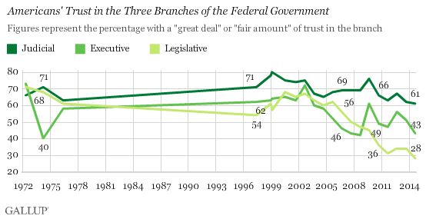
Current Climate:
Public Distrust

Slide 5
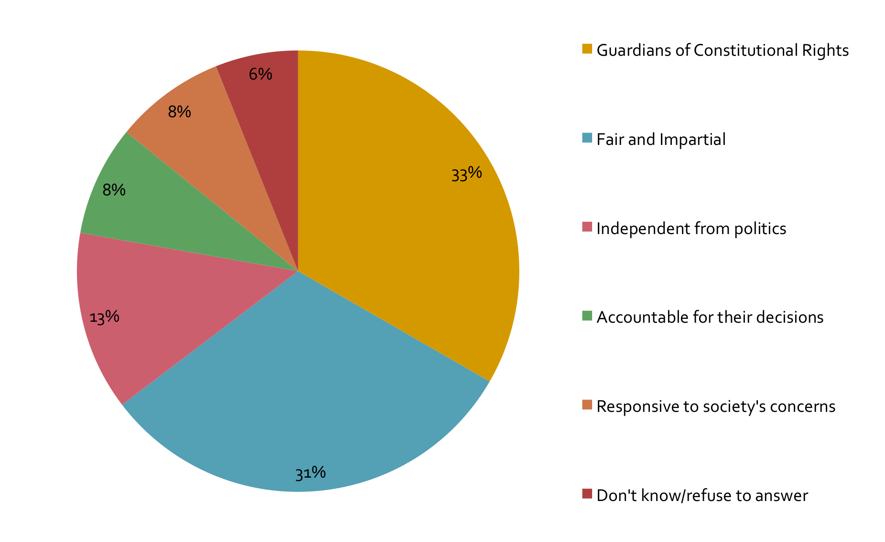
Most Important Quality for the Court System
Source: 2005 national survey for Justice at Stake.

Slide 6
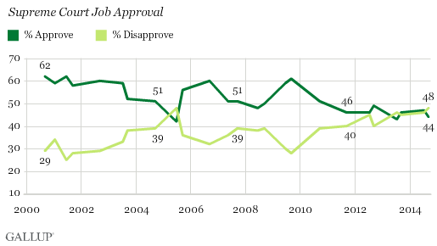
U.S. Supreme Court Approval
Notes:
The results are based on Gallup's annual Governance poll, conducted Sept. 4-7, 2014, and before Monday's announcement that the Supreme Court would not hear challenges to prior lower-court rulings that overturned bans on same-sex marriage in several states.
Gallup first asked Americans to assess the job the Supreme Court is doing using this question format in September 2000. At that time, 62% approved, which ranks as the highest rating to date. From 2000 through 2007, a majority approved of the Supreme Court, with one notable exception -- a 42% approval rating in June 2005, which ranks as the lowest to date. That record-low approval rating came shortly after a controversial decision in which the Supreme Court ruled that local governments could use the power of eminent domain to seize land from private homeowners for commercial development purposes.
In recent years, Americans have been less approving of the court, consistent with their reduced trust in government and their job approval ratings of federal government institutions. Still, during this time the Supreme Court's job approval rating has been about the same as or better than President Barack Obama's, and much better than Congress' approval rating. And Americans express significantly more trust in the judicial branch of the federal government than in the executive or legislative branch.

Slide 7
Weak Numbers on Key Principles of the Court System
Thinking about the (STATE) court system, please tell me whether, in your opinion, each of the following words or phrases describes the state’s courts very well, well, not very well, or not well at all.
Source: NCSC/Justice at Stake survey, June 2012 (MOE ± 3%).

Slide 8
In your opinion, to what extent do you think a judge’s ruling is influenced by his or her personal political views?
Great extent | 30%
Moderate extent | 45%
Source: Princeton Survey Research Associates International Poll for the Annenberg Public Policy Center, 2007 Survey. MOE ± 3.0%.
www.annenbergpublicpolicycenter.org (http://goo.gl/dyjEjn)

Slide 9
In general, to what extent do you think a desire to be promoted to the next higher court would affect a judge’s ability to be fair and impartial when deciding a case?
Great extent | 35%
Moderate extent | 40%
Source: Princeton Survey Research Associates International Poll for the Annenberg Public Policy Center, 2006 Survey. MOE ± 3.0%.
www.annenbergpublicpolicycenter.org (http://goo.gl/SK49bl)

Slide 10
Judges vs. the Public:
Rating the State Courts

Slide 11
Lawyers vs. the Public
Record six Colorado judges recommended not to be retained or resigned during evaluation process.
Commission recommended against Judge Ben McClelland: “Commentators described him as ‘arrogant, defensive, impatient, and lacking appropriate judicial demeanor.” The Commission credited him for hard work and efficiency.
Judge McClelland responded: “The appeals courts have upheld all of my trial court rulings. I’m strict in the application of law.”
    Source: Denver Post, Sept. 26, 2014.

Slide 12
There is a lack of trust in our public institutions that, although not focused specifically on courts, is troublesome.

Slide 13
Please tell me how you would rate the honesty and ethical standards of people in these different fields—very high, high, average, low, or very low? Gallup, Dec. 2013

Slide 14
Our legitimacy is not assumed by many who come before us.
Trust must be earned in each encounter.

Slide 15
Factors that could matter to perceptions of fairness
Outcome favorability – Did I win?
Outcome fairness – Did I get what I deserve?
Procedural fairness – Was my case handled through fair procedures?
1/30/2015
Notes:
15

Slide 16
Procedural Fairness
Aspects of Procedural Fairness
Respectful and
Dignified treatment
of disputants
Trustworthy
authority
Belief of Unbiased
Decision making
Tyler and Lind, 1992
Legitimacy
Providing
Explanations
Treating decision recipients respectfully
Higher
Compliance
Greenberg, 1993

Slide 17
Lawyers vs. the Public:
Predictors of Confidence
Source: 2005 California survey.
Notes:
17
There is an interesting twist to what such surveys and analyses reveal. Unlike the general public, lawyers and presumably judges give more weight to outcomes than to process. As shown above in an analysis of the 2005 California survey. Lawyers are more attentive to who wins or loses than to procedural fairness criteria. Procedural fairness thus offers court insiders a new perspective or lens to use, one that looks at the courts through the eyes of the public.
Second, when perceptions of procedural fairness are considered, that race and other demographic characteristics fail to be significant factors in whether confidence is low or high. People, at least in the United States, share common basis for deciding on what is fair. If African Americans are less confident in the courts, it is because they see less procedural fairness.
Third, this provides insight into what we can do to raise public confidence. The most productive avenues are changes in the courthouse. There are extensions to the public generally, but the lack of attention to the courts combined with media influences will make that a challenge in my country. The basic message is that when people are in the courthouse, do as much as possible to promote fairness in procedures, as defined by the public. [small claims example]
People who come to court are looking for evidence on how they are regarded. We know in large measure what is conducive to the perception that procedures are fair.
Later this month, the California courts will start on a three-year procedural fairness initiative. Its objective is to increase procedural fairness in all types of cases. This includes developing a Manual on Procedural Fairness.

Slide 18
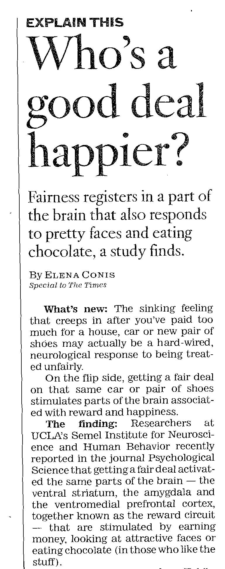
Maybe we’ve got something here . . .
Study reported in 2008 says perceived fairness triggers brain reactions similar to eating chocolate or seeing a pretty face
Notes:
18

Slide 19
Why do people accept court decisions?
1/30/2015
Notes:
19

Slide 20
Fairness Influences Decision Acceptance Over Time
Does a fair procedure lead people to view the law as legitimate and to obey it in the future?
Reintegrative shaming experiment (RISE)
  Adults – driving while drunk.
  Court/restorative justice conferences.
  900 adults in Australia.
Notes:
20

Slide 21
Reintegrative Shaming: Model
YEAR 0
YEARS 3-4
Was the procedure fair? Is the law legitimate?
Reoffending in years 3 and 4 (same crime).
Police records
2 years
1/30/2015
21
Notes:
21

Slide 22
Reintegrative Shaming:
Rearrest Rates
1/30/2015
Notes:
22

Slide 23
Four key components of procedural fairness
Voice
Neutrality
Respect
Trust (trustworthy authorities)

Slide 24
Voice
People want the opportunity to tell their side of the story and have their stories told to a judge who listens carefully.

Slide 25
Neutrality
Be transparent and open about how decisions are being made.
Give an explanation in terms understandable by a lay person.
Cite to relevant statutes, rules, or court policies.
Notes:
25

Slide 26
Neutrality
Neutrality is important, but if applied improperly, it can mask that you care.
Notes:
26

Slide 27
Respect
Taking people’s concerns seriously
  Shows respect for them as people and as citizens who have the right to address the court about their issues.
People come to court about issues that are important to them, irrespective of whether they have a strong legal case.
  Make clear that you have heard the needs and concerns that people are expressing.
  Explain why those concerns can or cannot be accommodated in a legal setting.
People take cues about respect for them as they encounter all government employees in the building.
1/30/2015
27
Notes:
27

Slide 28
Trust
Studies of legal authorities constantly show that the central attribute influencing public evaluations of judges is an assessment of the character of the decision maker (sincere, caring).
  Are you listening to and considering people’s views?
  Are you trying to do what is right for everyone involved?
  Are you acting in the interests of the parties, not out of personal prejudice?
1/30/2015
28
Notes:
28

Slide 29
Trustworthy Authorities
Give evidence that you have listened.
  Restate the party’s basic position.
Explain your decision, including an explanation about why rules preclude you from adopting the party’s position.
Express awareness of and empathy for their situation—this need not eliminate neutrality.
Notes:
29

Slide 30
Promoting a Sense of Fairness:
Judicial Humility Builds Trust
Learned Hand said:
  “The spirit of liberty is the spirit which is not too sure that it is right.”
This is an essential ingredient to good judging and procedural fairness.
  Which judge listens better?
    The one who already knows the answer.
    The one who is willing to admit he or she may not.
Why not be up-front about your limitations?

Slide 31
Judicial Humility:
Judges as Truth-Finders
  Are we better than others at figuring out who is telling the truth?
    No. In a controlled study of 110 judges with an average of 11.5 years on the bench, judges did not better than chance in telling who was being truthful and who wasn’t.
      See Paul Ekman & Maureen O’Sullivan, Who Can Catch a Liar?, 46 Am. Psychologist 913 (1991); Richard Schauffler & Kevin S. Burke, Who Are You Going to Believe?, 49 Court Rev. 124 (2013).

Slide 32
Stay Focused
PREPARE: Clear your mind.
MONITOR: Recognize when your concentration has strayed.
CORRECT: Refocus your mental attention on the speaker.
Source: HRDQ
Notes:
32

Slide 33
Capture the Message
BE OPEN MINDED: Let go of your assumptions, biases, and expectations.
THINK: Mentally interact with the speaker’s ideas or information.
CLARIFY: Ask questions to get more information and settle points that aren’t clear.
CONFIRM: Offer summaries to check your understanding.
Source: HRDQ
Notes:
33

Slide 34
Help the Speaker
SCREEN: Avoid distracting verbal comments.
CONTROL YOURSELF: Avoid distracting nonverbal actions.
RESPOND: Offer verbal encouragement.
ASSIST: Offer nonverbal support.
Notes:
34

Slide 35

Let’s go to the video…

Slide 36
People’s Court video

Slide 37
A Criminal Docket Call
http://vimeopro.com/ncsc/pfs/video/92466157

Slide 38
The Meaning of Procedural Fairness
California study: respondents with personal experience with courts, strength of connection to court approval.
1/30/2015
Notes:
38

Slide 39
The Importance of This Stuff:
Increased Compliance (Minn. Study)
More than 400 petitions seeking civil protection orders were part of the study; 89 of the cases went to trial and were then handled in a blind, random experimental design
For cases tried, the judge opened a sealed instruction after reaching a decision. Based on that instruction, the judge either:
  Told litigants only which way he or she was ruling and sent them to another room to await the written order OR
  Gave litigants a full explanation of what he or she had decided and why, then took time to answer any questions (and then sent them to another room to await the written order)
    Family Court Fairness Study (Hennepin Co. Minn. Dist. Ct.)
      Available at http://goo.gl/ls85bV

Slide 40
Minnesota Study: Satisfaction with Various Aspects (1-9 scale)
 | Distrib. Fairness | Proc. Fairness | Voice | Legitimacy | Satisfaction with Outcome
No explanation (control group) | 5.79 | 7.23 | 7.07 | 8.33 | 6.07
Explanation (experimental group) | 6.83 | 7.83 | 7.33 | 8.69 | 7.84
Statistically significant | Yes | No | No | No | Yes
Those who got the explanation were more satisfied with the outcome’s fairness (“The outcome of the case was fair.”) and with the case outcome (“I am satisfied with the judge’s decision.”) at a statistically significant level. There was also a greater perception of procedural fairness and voice, though not at a statistically significant level.

Slide 41
Minnesota Study:
Additional Analysis
“Perceptions of fairness account for approximately twice the variance in litigants’ satisfaction compared with absolute and relative case outcome [satisfaction].”
“Having an explanation significantly predicts satisfaction . . . . [T]he explanation makes the biggest difference for those who did not get what they asked for from the court. In short, someone with a ‘bad’ outcome is significantly more likely to feel satisfied with the court’s decision if the court provides an explanation.”

Slide 42
Vermont Study
Bennington County, Vermont, established an integrated domestic-violence docket
  Same judge handled misdemeanor DV cases, some felony DV cases, all related probation violations, and civil protection-order cases
  Expedited assessments of criminal defendants
  Attorneys provided to both defendants and victims
  Recommendations from assessment reviewed early (often within one week) with both parties.
  Typical case might have court hearing at that point, apology from defendant in court, guilty plea, probation with conditions to address key risks, court supervision.
    Report available at http://goo.gl/3eQWpY

Slide 43
Vermont Study:
Recidivism Numbers (3-year study)
 | Burlington Court | Statewide
Recidivism – New DV Conviction | 4.3% | 7.4%
Recidivism – New Crim. Conviction (Any Type) | 22.1% | 47.7%
“The data, we believe, support the efficacy of this combination of procedural fairness and swift and certain sanctions. The result is that at the same time [this court] was significantly reducing recidivism, we did so by actually significantly reducing the rate of incarceration. . . . As for myself, after 23 years on the . . . bench, the [new] program provided new hope and energy.”—Judge David Suntag

Slide 44
Making better decisions

Slide 45
Monkey Business Illusion Video
https://www.youtube.com/watch?v=IGQmdoK_ZfY

Slide 46

Dual System of Information Processing
Reflexive
  Automatic, rapid, unconscious
  Relies on patterns—or schemas—that develop based on your experiences with the world
Reflective
  Deliberate, slow, conscious
  Requires attention
  Because of the need for conscious attention, there’s limited capacity, so the “principle of least effort” applies.
    So we tend to process reflexively based on schemas where possible

Slide 47
Limited Capacity
“Most of the time we solve problems without coming close to the conscious, step-by-step analysis of the deliberative approach. In fact, attempting to approach even a small fraction of the problems we encounter in a full, deliberative manner would bring our activities to a screeching halt. Out of necessity, most problem-solving is intuitive.”
  Brest & Krieger, Problem Solving, Decision Making, and Professional Judgment: A Guide for Lawyers and Policymakers (2010)

Slide 48
Effects of Schema-Based,
Reflexive Decision Making
May be better than a deliberative approach in some situations (especially with training)
  Firefighters
But schemas may be
  Based on inaccurate information (e.g., assuming that there’s a cause-and-effect relationship between two events that take place in sequence)
  Be only partially correct (e.g., stereotypes)
  Be applied incorrectly (e.g., assuming a gesture used by one culture means the same thing to another group)

Slide 49
Two Types of Schemas That May Lead to Inaccurate Decisions
Implicit Biases
  Implicit biases are schemas based on implicit attitudes and stereotypes that operate below the radar.
Cognitive heuristics
  Heuristics are schemas that rely on only some of the information that’s available to make a decision quickly and with little effort.
  Examples:
    Anchoring
    Reliance on small samples
    Framing
    Hindsight
    Egocentric

Slide 50
Other Examples of Heuristics
Reliance on small samples
Framing
Egocentric

Slide 51
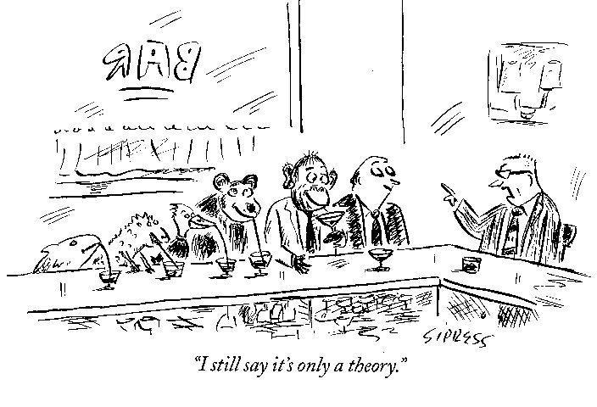
Are judges immune from common heuristic errors?
A Theory: Judges have been specifically trained to follow procedural rules designed to minimize the influence of irrelevant information. So maybe they aren’t subject to common heuristic errors.

Slide 52
Judges & Heuristic Errors:
Anchoring
Anchoring: when making numeric estimates, people commonly rely on the initial value available to them. It becomes a starting point to adjust away from but tends to greatly affect the result.
Case study: judges given a civil case with substantial damages. Half the judges are told that the defendant moved to dismiss for lack of federal diversity jurisdiction (< $75,000 damages).
Judges differed in estimated damages:
  Told of motion: $882,000 average.
  Not told of motion: $1.25 million average.
    Guthrie, Rachlinski & Wistrich

Slide 53
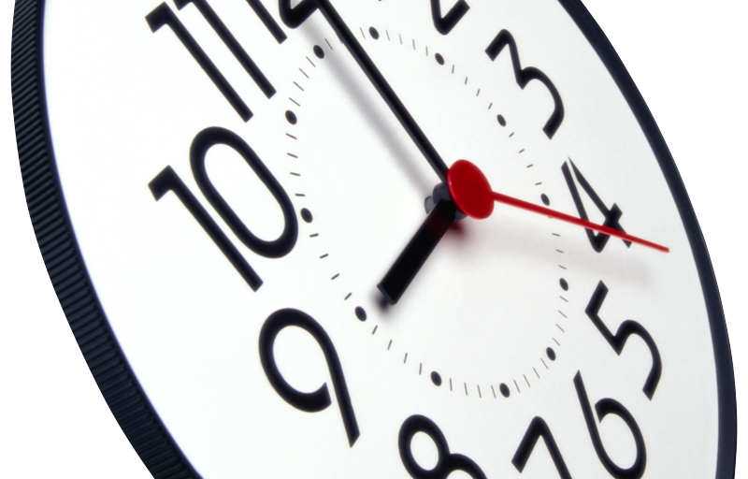

Slide 54
Factors Detracting from
Mindful Decision Making
Mood
  In general,
    Those in a positive mood engage in more reflexive, automatic processing.
    Those in a negative mood engage in more reflective, deliberative processing.
  Reliance on stereotypes may be more likely if you’re in a good mood—and just cruising along.
  Vigilance—and conscious thought—is important.

Slide 55
Factors Detracting from
Mindful Decision Making
Multitasking
  The brain “multitasks” by rapid task switching, not actually multitasking.
  Almost universally (97% of people), multitasking has a cost in performance.
    Are you really among the 3%?
  Note: Multitasking in the courtroom also has a procedural-fairness cost—litigants may perceive that the judge is not paying attention.

Slide 56
A DV Bail Hearing
Notes:
56

Slide 57
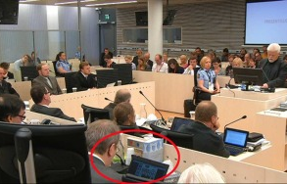
Multitasking on the Bench: Norway

Slide 58
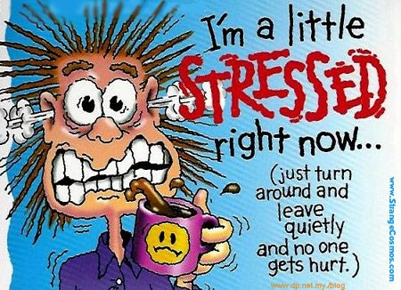

Slide 59
It took me a long time to learn to never get mad, just to get sensibly irritated.
Sam Snead

Slide 60
Judges and Emotion
Vanderbilt Law Prof. Terry Maroney
  “The Emotionally Intelligent Judge: A New (and Realistic) Model
    http://goo.gl/BEwsem
  Judges expend labor to deal with their emotions on the bench.
  She makes suggestions on how best to management process.

Slide 61
Judges Perform Emotional Labor
Other-directed
Self-directed
Unhappy witnesses, defendants, jurors, spectators, and
family members;
Feuding lawyers;
Cranky clerks; etc.
Handling your own emotions
Notes:
So what does the universe of work-related emotion experienced by non-robot judges look like? It looks much like it does in one’s private life: judging, like parenting, or marriage, or any other major life endeavor, can evoke and call on the entire spectrum of human emotions. But of course the fact that these emotions occur within the judging framework matters quite a lot. As sociologists have found, every profession has its own “feeling rules,” and complying with those rules is a form of “emotional labor.” Emotional labor comes in two basic flavors: other-directed, and self-directed. The first is that part of your job that has to do with handling other people’s emotions so that what needs to be done can get done. This is, I imagine, very familiar to you all, especially those of you sitting in trial courts, who might sometimes feel surrounded by [read above]. Yesterday I heard Judge Susan Burke, in her session on being a happy civil court judge, talk about this quite a bit: she talked about dealing with lawyers who were so out of control with their hatred of one another that they needed her to rule firmly and rein them in. A few of you also talked about letting pro se litigants give narrative testimony without interruption, to ease nerves and minimize confrontations. Judge Burke also talked about tactics for making sleeping jurors feel ashamed, like calling “stretchy breaks,” so they’ll self-regulate out of fear of humiliation. You probably spend a decent part of your days massaging, cajoling, vaguely threatening, and otherwise taking care of other people’s emotions, and that work is really important. It not only keeps the trains rolling, but it has a large impact on how people experience our court system.
So judges’ other directed emotional labor is pretty visible, a known quantity. It would be better if we discussed it more openly and offered more training on how to do it, but at least we don’t ignore it. This is not so much the case with self-directed emotional labor. This is the critical part of handling your OWN emotions as a judge. Sometimes this sort of labor follows the first – it is exhausting and stressful to handle all those other people who are crying, or yelling, or glowering, or afraid, and so on. You can also experience something psychologists call “emotional contagion.” Judge Burke also described this yesterday, when she said that lawyers can be “poisonous” with each other, and that can “get all over you.” And sometimes it’s not that someone is rubbing off on you: you’re generating your own emotions in reaction to what is going on. After all, you are just another human being living in the same world. And this is the part that we DO tend to ignore, and even to stigmatize. So today I am going to focus on this aspect of your emotional labor.

Slide 62
STOP Meditation
Stop what you are currently doing
Take a deep breath and focus on the sensation of breathing
Observe what you are thinking, feeling, and doing, and
Proceed with new awareness

Slide 63
Procedural Fairness in a Nutshell
Was the person listened to?
Were litigants treated with respect?
Do they understand:
  What the decision was?
  Why the decision was made?
    Neutral principles

Slide 64
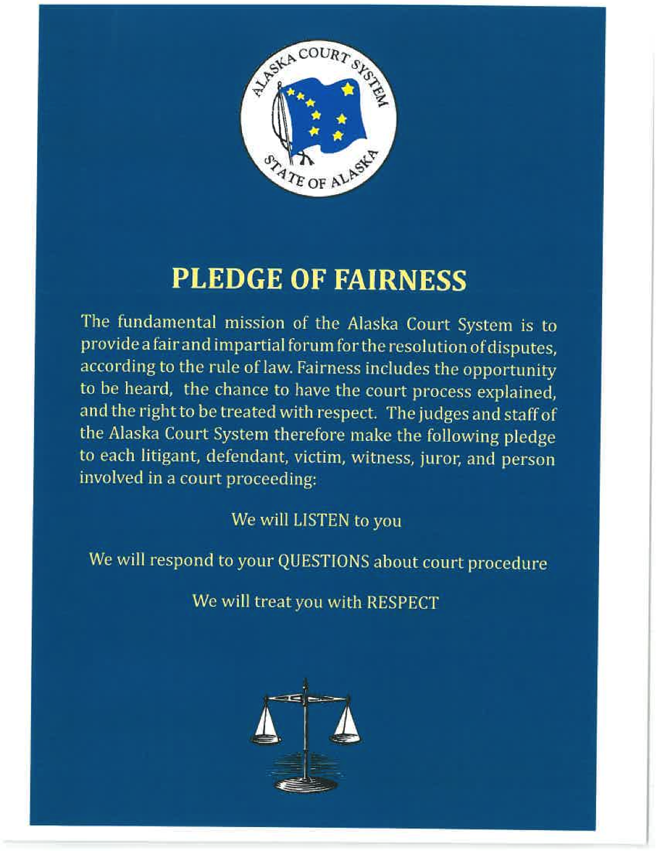

Slide 65
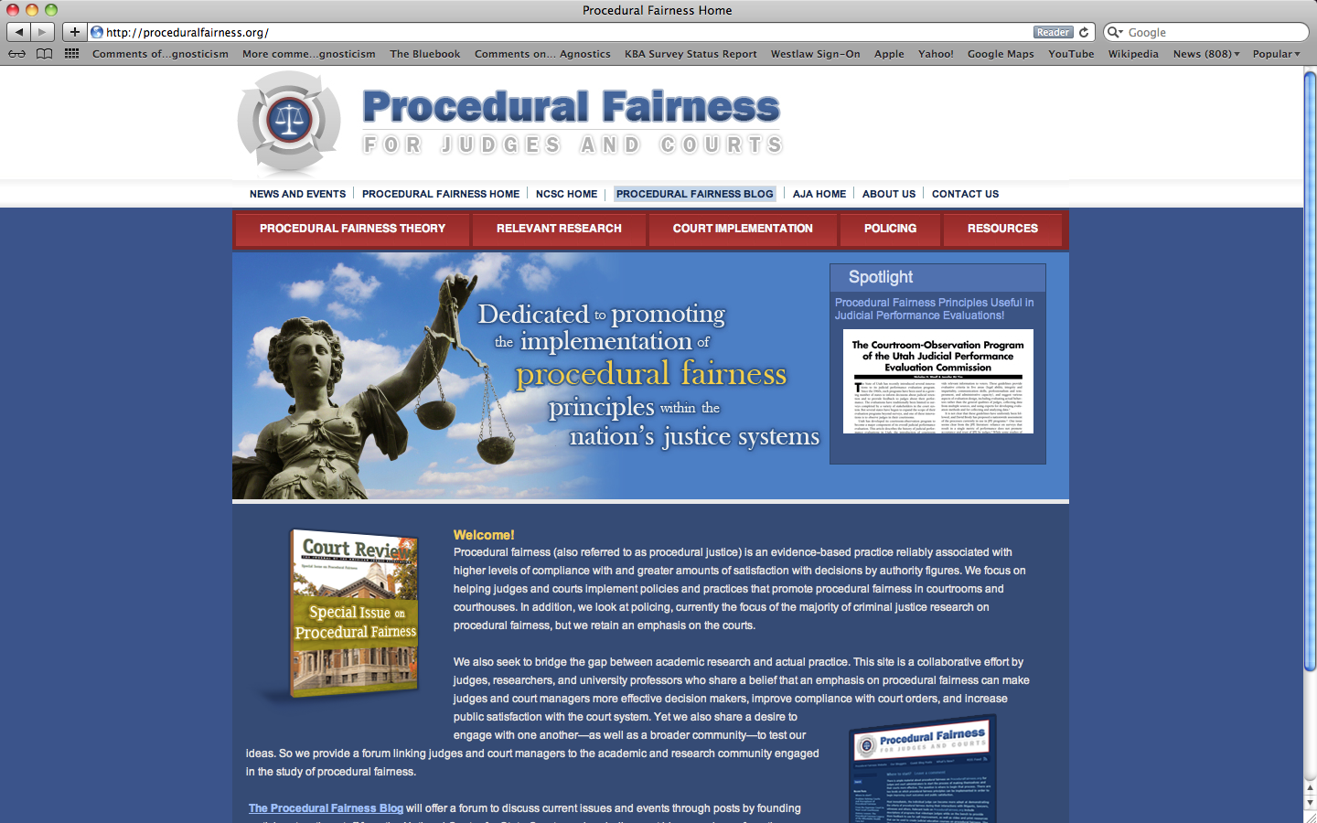
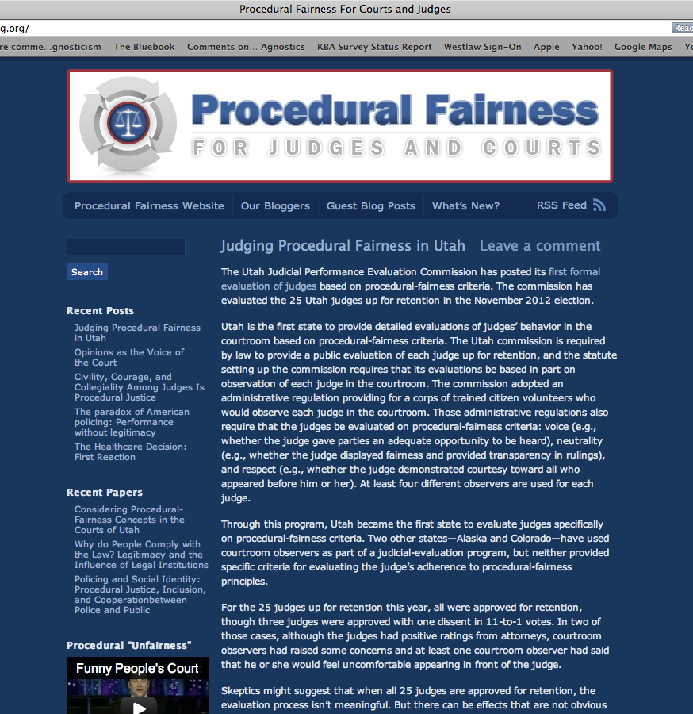
For More on Procedural Fairness . . .
Proceduralfairnessblog.org

Slide 66

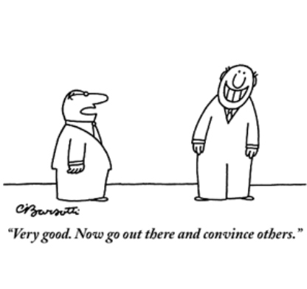
Ways to follow up:
  AJA bog
    blog.amjudges.org
  Procedural fairness website
    Proceduralfairness.org

