Slide 1
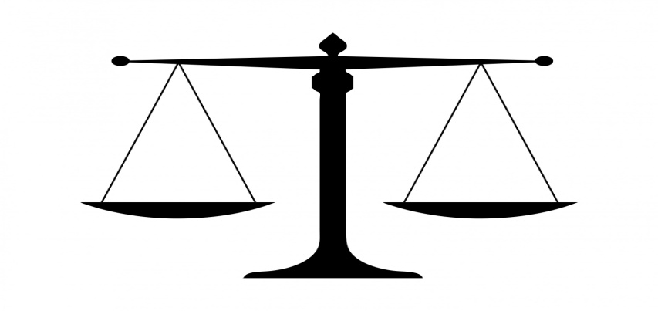
The Perception of Justice vs. the Execution of Justice
Henry H. Parker, Ph.D.

Slide 2
TN General Sessions Judges
You love the law.
You have a keen sense of integrity.
You are devoted to the pursuit of justice.

Slide 3
Blind Spot: Hidden Biases of Good People
Mahzarin Banaji, Anthony Greenwald, 2015

Slide 4
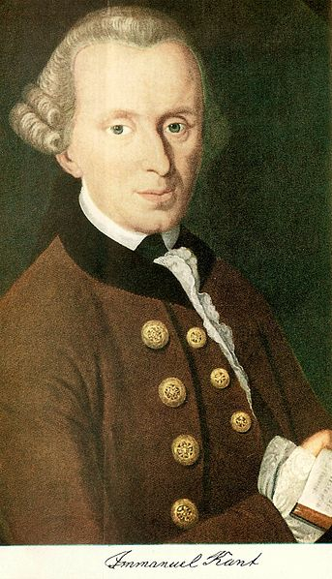
Outline of the Presentation
Part I: A Summary of the book: Blindspot
Part II: The Father of Racism: Kant
Part III: Three Refutations of Kant

Slide 5
The New Racism=Favoritism

Slide 6
The Blind Spot in the Mind
Hidden biases live here, and sub- consciously shape our decision making.

Slide 7
The Implicit Association Test (IAT)
A computerized test that measures one’s responses to pairings in fractions of a second.
It is the light that penetrates the darkness of our blind spot.

Slide 8
Examples of Implicit Association
Example 1: A surgeon and his son had an accident and were rushed, unconscious, to the hospital. The boy needed an operation on his brain.
As he lay in the surgery room, the surgeon came in, looked at him and said, “I can’t operate. He’s my son.”
Example 2: 3 year old Parker Academy Student

Slide 9
The Eurocentric Mind Pairs Race with Character Traits
White Black
Intelligent Dumb
Beautiful Ugly
Good Bad
Hard working Lazy
Moral Immoral
Success Failure
Peaceful Violent

Slide 10
What happens to the test-taker when the associations are reversed?
Black White
Intelligent Dumb
Beautiful Ugly
Good Bad
Hard working Lazy
Moral Immoral
Success Failure
Peaceful Violent

Slide 11
The Implicit Racial Bias Map

Slide 12
Through the Eyes of A Child
Anderson Cooper, CNN
Youtube Video

Slide 13
Check Out Where You Stand
https://implicit.harvard.edu/implicit/takeatest.html

Slide 14
No Biological Basis For Race
Youtube video

Slide 15
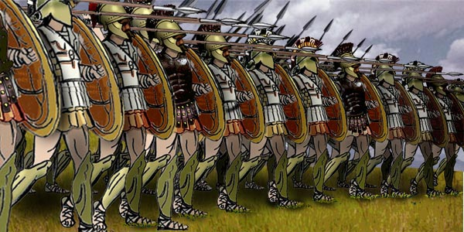
The Ancient Greeks
In the Greek dictionary, there is no word for “white” to describe a people.
The Greeks had no concept of “whiteness.”

Slide 16
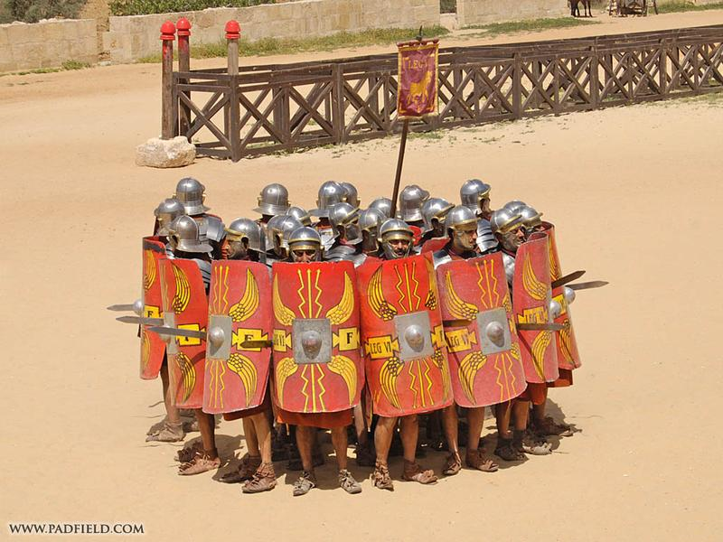
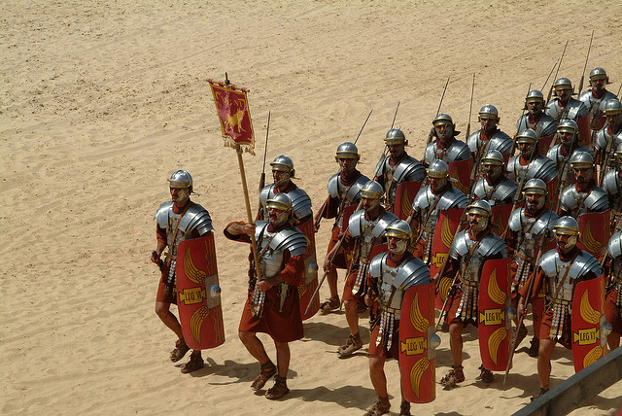
The Ancient Romans
In the Latin dictionary, there is no word for “white” to describe a people.
The Romans had no concept of race.

Slide 17
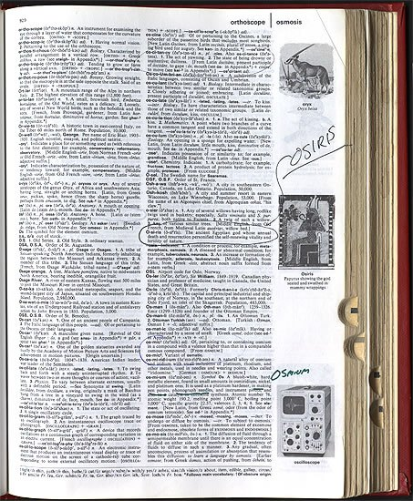
The English Dictionary
In the English dictionary, the first time the word, “white” is used to describe a human does not occur until the 1660’s.

Slide 18
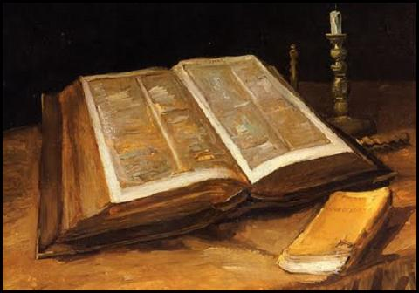
Galatians 3:28
“There is neither Jew nor gentile, slave nor free, nor is there male and female, for you are all one in Christ Jesus.”

Slide 19
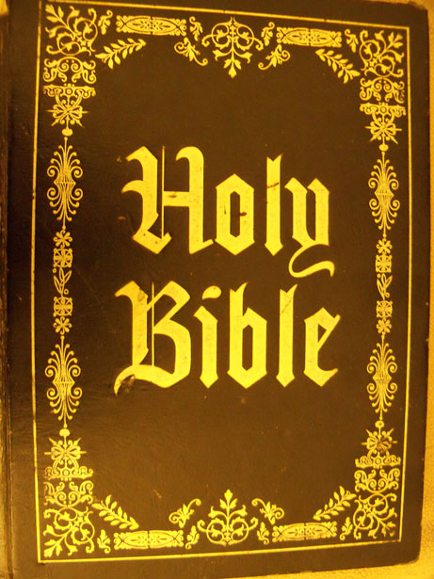
Leviticus 19:15
“ You shall do no injustice in court. You shall not be partial to the poor or defer to the great, but in righteousness shall you judge your neighbor.”

Slide 20
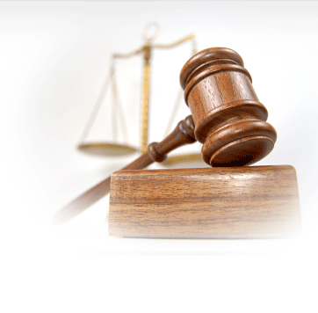
Your Challenge
Your execution of justice will be consistent with your perception of justice!

