Slide 1
Expungement in Tennessee
Volunteer Attorney Training: Expungement
March 31, 2016
11:15 a.m. – 12:00 p.m.

Slide 2
The Proliferation of the Criminal Record

Slide 3
http://www.peopleverified.com/?act=criminal&fc=2&fck=history&utm_source=adc&utm_medium=cpc&utm_campaign=criminal&creativeid=m1600277499&utm_term=criminal%20history&group=adc-free-criminal-history&kwdid=13171563708&search=criminal%20history&match=e&pos=%7Badposition%7D&mob=

Slide 4
Collateral Consequences at a Glance
One Source: http://www.abacollateralconsequences.org

Slide 5
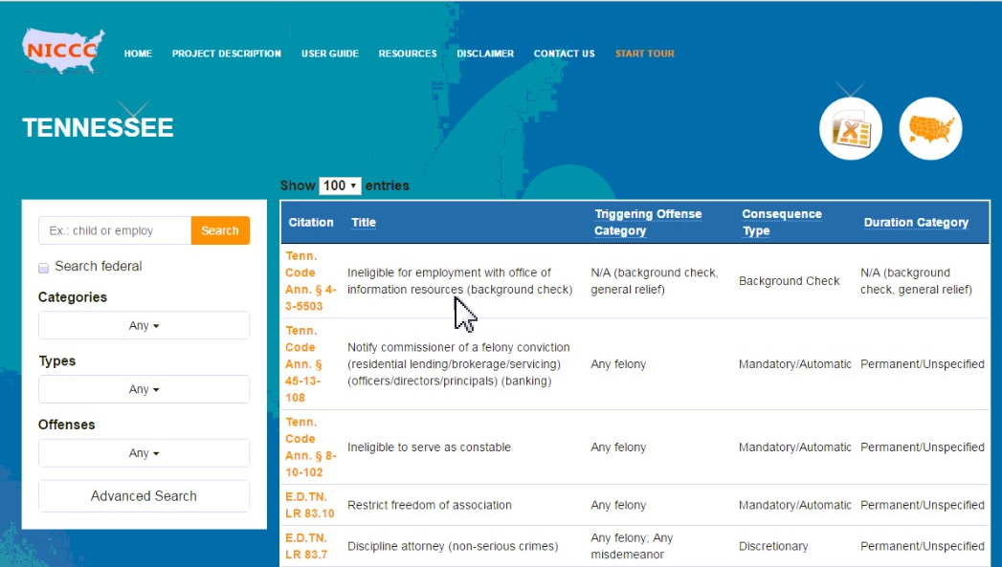
National Inventory of Collateral Consequences: American Bar Associations Collateral Consequences Project
http://www.abacollateralconsequences.org

Slide 6
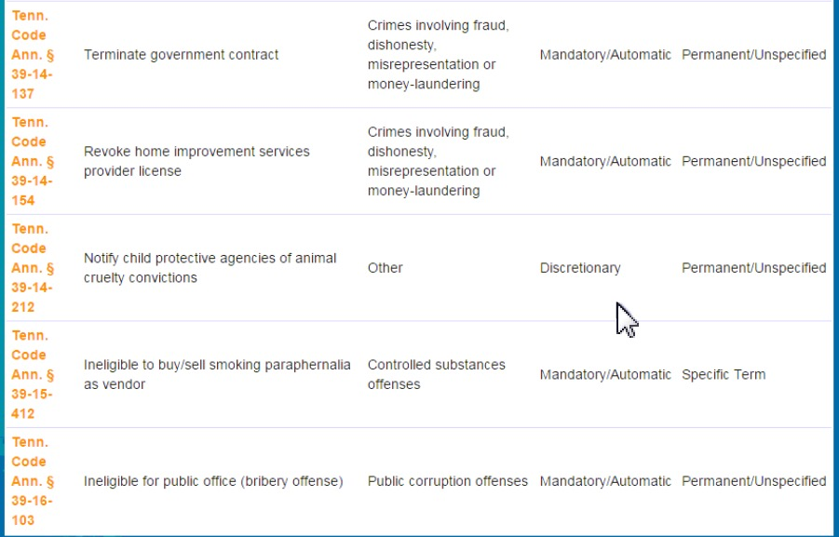
National Inventory of Collateral Consequences: American Bar Associations Collateral Consequences Project
http://www.abacollateralconsequences.org

Slide 7
Theories of Desistance

Slide 8
Tennessee Department of Corrections – Mission Statement
“The department's mission has always been to operate safe and secure prisons to enhance public safety in Tennessee through incarceration and rehabilitation of felony offenders.”
Tennessee Department of Correction, Department Overview, March, 28, 2016. Read more at: https://www.tn.gov/correction/topic/tdoc-department-overview

Slide 9
What are Expungements?
Expungement is the process by which all public record of criminal charge, conviction, and/or arrest are removed by order of the court. The expunged public records are no longer accessible by public.

Slide 10
Tennessee’s Expungement Statute
Tenn. Code Ann. § 40-32-101

Slide 11
What’s Expunged?
All public records
Does a public record include:
Files of the DA?
Fingerprints?

Slide 12
What is a “Public Record”?
For Adults (not Juveniles) a Public Record is defined under Tenn. Code Ann. Section 40-32-101(b)(1) and (2) as:
(b)(1) “Public records,” for the purpose of expunction only, does not include arrest histories, investigative reports, intelligence information of law enforcement agencies, or files of district attorneys general that are maintained as confidential records for law enforcement purposes and are not open for inspection by members of the public and shall also not include records of the department of children’s services or department of human services that are confidential under state or federal law and that are required to be maintained by state or federal law for audit or other purposes. Whenever an order of expunction issues under this section directed to the department of children’s services or department of human services, the department shall notify the defendant if there are records required to be maintained as directed above and the basis therefore. The department shall delete identifying information in these records whenever permitted by state or federal law. These records are to be expunged whenever their maintenance is no longer required by state or federal law.
(2) “Public records”, for the purpose of expunction only, does not include appellate court records or appellate court opinions.

Slide 13
GROUP ACTIVITY: Tenn. Code Ann. § 40-32-101
Diving into the Statute -Read:
(a)(1)(A)
(a)(1)(B)
(a)(1)(C) – deleted
(a)(1)(D)
(a)(1)(E)
(a)(1)(F)

Slide 14
The Tennessee Statute Tenn. Code Ann. § 40-32-101:
40-32-101 (b) – Public Records
40-32-101 (c) – Penalties
40-32-101 (d) – Process and Cost

Slide 15
What happens if you do release them? (Check: Tenn. Code Ann. §40-32-101(c) )
Nothing
Fine of $1000
A Class A Misdemeanor
A felony

Slide 16
The Cost of Expunging a Charge
Dismissal, No True Bill, Arrested and Released – (a)(1)(A)
– “without cost to the person”
Successfully Completed Diversion – (d)(2)(A)
- $350.00 fee
Expunging a Criminal Conviction – (g)(10)
Acquittal, nolle prosequi, or dismissal for failure to prosecute (d)(2)(C)

Slide 17
Expunging a Conviction (Slide 1)
Tenn. Code Ann. § 40-32-101(g)(1)(A)
-The List of Class E felonies that are eligible for expungment, if sentenced to imprisonment for term of three (3) years or less.
Tenn. Code Ann. § 40-32-101(g)(1)(B)
List of Misdemeanors NOT eligible for expungment

Slide 18
Which convictions?
Aggravated Criminal Littering
Vandalism
DUI
Selling Glue for an unlawful purpose
Violation of a protective order
Simple possession
Disorderly conduct at a funeral
Indecent Exposure
Manufacturing of a schedule VII drug
Allowing a person ages 18-21 to consume alcohol on your premises
Child Abuse
Failure to Appear
Stalking

Slide 19
Expunging a Conviction (Slide 2)
Tenn. Code Ann. § 40-32-101(g)(1)(C)
Pre November 1, 1989 Conviction Expungments
Tenn. Code Ann. § 40-32-101(g)(1)(D)
Expunging Drug Fraud, Sentenced 4 years or less, after 1989, if at least 10 years have elapsed since completion of the sentence

Slide 20
Expunging a Conviction (Slide 3)
Tenn. Code Ann. § 40-32-101(g)(1)(E)
Multiple Convictions – can be expunged
IF:
- if the conduct upon which each conviction is based occurred contemporaneously, occurred at the same location, represented a single continuous criminal episode with a single criminal intent, and all such convictions are eligible for expunction under this part.
- if all other requirements are met under (g)(2)

Slide 21
What Other Requirements? -The Requirements of Tenn. Code. Ann. § 40-32-101(g)(2)
- Never been convicted of any other criminal offense, including federal offenses and other states – not including traffic offenses.
- At the time of filing of the petition at least 5 years have elapsed since the completion of the sentence.
- Petitioner has completed all the requirements of the sentence imposed by the court including: (i) Payment of all fines, restitution, court costs and other
assessments;
(ii) Completion of any term of imprisonment or probation;
(iii) Meeting all conditions of supervised or unsupervised release;
and
(iv) If so required by the conditions of the sentence imposed,
remaining free from dependency on or abuse of alcohol or a
controlled substance or other prohibited substance for a period
of not less than one (1) year.

Slide 22
Juvenile Expungment
Juvenile Expungment
At least 1 year removed from the person’s most recent delinquency adjudication;
Has never been convicted of a criminal offense as an adult,
Has never been convicted of a criminal offense following a transfer from juvenile court pursuant to Tenn. Code Ann. Section 37-1-134
Has never been convicted of a sexual offense as defined in Tenn. Code Ann. Section 40-39-202, whether in juvenile court or following transfer from Juvenile court, or as an adult
Does not have an adjudication of delinquency for a violent juvenile sexual offense as defined in Tenn. Code Ann. Section 40-39-202.
Has maintained a consistent and exemplary pattern of responsible, productive and civic-minded conduct for 1 or more years immediately preceding the filing of the expunction petition; or
The juvenile has made such an adjustment of circumstances that the court, in its discretion, believes that expunction serves the best interest of the child and the community.

Slide 23
Certificates of Employability
Tenn. Code Ann. Section 40-29-107
IF GRANTED a Certificate of Employability: Requires that persons presenting a valid certificate of employability must be considered on a case-by-case basis instead of based solely on the person’s past record of criminal activity as to whether to grant or deny the issuance, restoration or renewal of an occupational license or an employment opportunity.
IF AN EMPLOYER HIRES someone with a valid Certificate of Employability, then they are partially protected against lawsuits alleging negligent hiring.

Slide 24
Client Examples

Slide 25
When Reviewing a Criminal Record – Key Facts to look For
Dismissal, Conviction, or Diversion
Timing
Sentence
Court Costs and Fees
Year

Slide 26
Common Misconceptions
Every crime is eligible
rape, minor sexual abuse, murder, most offenses related to minors
Dismissals are not on your record
That there is absolutely no history after expungement
Non-public records: records relating to the person’s arrest, indictment or information, trial, appeals, police investigations.

Slide 27
What else do I need to know?
Common misconceptions of expungements.
What clients should expect.
How long does it take?
Costs associated with it?
What do you need?

Slide 28
What Clients Should Expect
All expunged offenses/ dismissals will be removed from their criminal history.
That some offenses may not be expungeable
Some offenses may have outstanding costs
30 days to process.
Driver’s license/ voting issue.

